Slide 1
Topic 4: Working to help young people deal with their problems

Slide 2
Part 1: Mental health

Slide 3
Feelings
We all deal with different feelings and emotions every day.
Sometimes these can be positive and easy to cope with, but other times they can be stressful and much harder to manage.
The things that cause you worry or stress are often shared by many other young people and by talking to someone it can help to ease the problem.

Slide 4
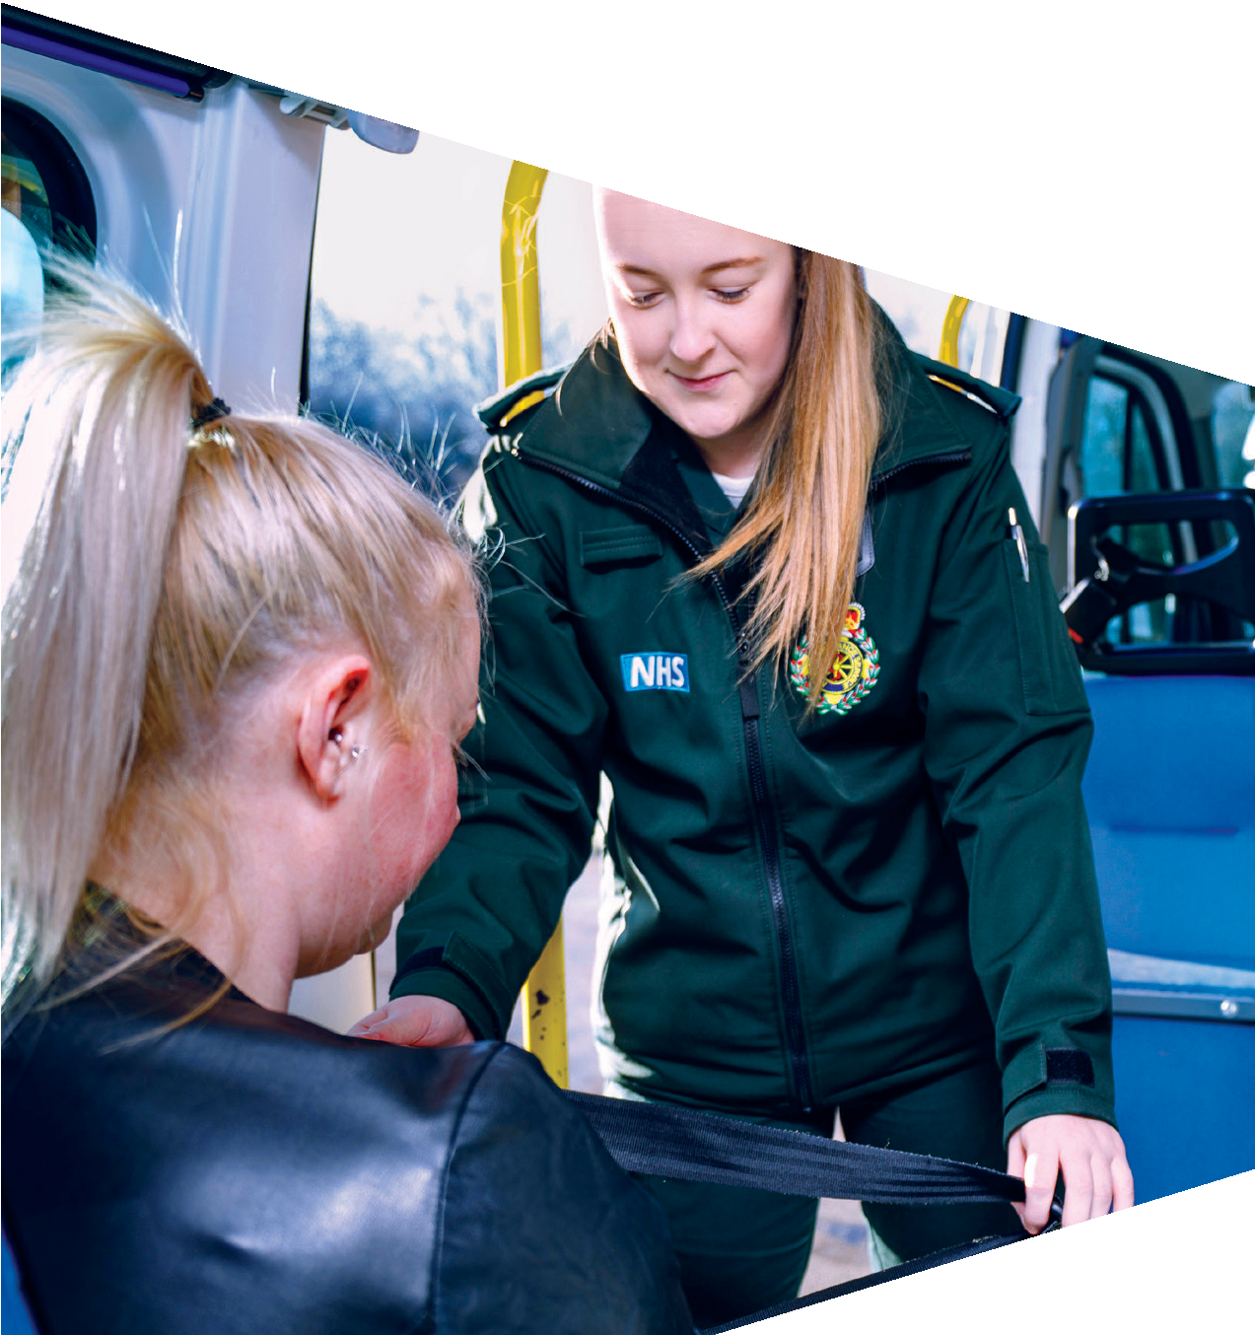
The Covid-19 pandemic is an experience we have all been through and has influenced everyone’s mental health in one way or another.

Slide 5
Examples of stress
Knowing what I want to do in the future
Making and keeping
friends
Relationships
Body image
Arguments
Exams
Bullying

Slide 6
Maintaining mental health
Here are five things that can help to maintain good mental health:
Relax and reduce stress
Find ways to learn and be creative
Spend time in nature
Connect with others
Get enough sleep and exercise
Organise these five factors into order of importance.

Slide 7
Part 2: Drugs

Slide 8
What leads young people to take drugs?

Slide 9
Peer pressure
Experiment
Some reasons for taking drugs
Escapism
Curiosity
Relaxation
Fun
Boredom

Slide 10
Scenario 1
Imagine a friend of yours has been invited to party by someone they really like. The person they really like is called Josh, he’s really confident and two years above you and your friend in school. All of Josh’s friends will be there – they’re all pretty popular and cool, and they’re also really nice!
At the party, your friend has a couple of drinks and starts talking to Josh’s friends. Some of them are going to uni or starting apprenticeships in a few months, some are taking a gap year and some are going to see how their music works out.
As your friend’s talking to them, one friend starts to hand out small tablets to Josh and the others. Josh offers one to your friend as all the others take theirs with a reassuring smile and nod.
Your friend is unsure what the tablets are and says ‘no’, but the others all tell them the night will get much better if they take it. Your friend looks at Josh - they want to show him how grown-up and exciting they are, and desperately wants to fit in with his friends. Your friend took the tablet and placed it in their mouth as they had seen the others do.

Slide 11
Scenario 2
Your friend started smoking weed around six months ago. Their mum recently married their stepdad and now their four step-brothers and sisters have come to stay too. The house is really crowded and your friend needs to sneak out sometimes to meet you.
About a month ago, your friend got introduced to a guy you don’t know called Warren. Your friend is always banging on about how Warren’s such a good guy and sells the best weed they’ve ever smoked. Your friend’s now smoking so much, missing school and is totally disengaged, it’s like they’re just handing all their money over to Warren.
Warren offered your friend the chance to earn some cash by running a small errand, taking a bag of drugs to a friend and bringing back cash in return. The job was easy enough, but then Warren started asking your friend to do more and more of them.
Your friend was excited at first, but the jobs are getting bigger and harder now and are taking him to some pretty scary places. Whenever your friend refuses to help, Warren hits them. Your friend is trapped but doesn’t reach out, only smokes. Your friend never thought they’d end up feeling so isolated.

Slide 12
Part 3: Campaign to help young people

Slide 13
Getting help
Many young people can experience problems.
Sometimes you might think you are the only person dealing with your problem, but it’s not true. It’s good to talk things through with someone you can trust – a friend, teacher, parent or carer. But, there are also lots of helplines and organisations that can give you advice and support.

Slide 14
Helping young people
Your challenge is to create a campaign that can help young people to deal with mental health or drugs problems.
Whilst exploring these issues further, you will also discover careers in the NHS that you could work in to help people deal with these kinds of problems.

Slide 15
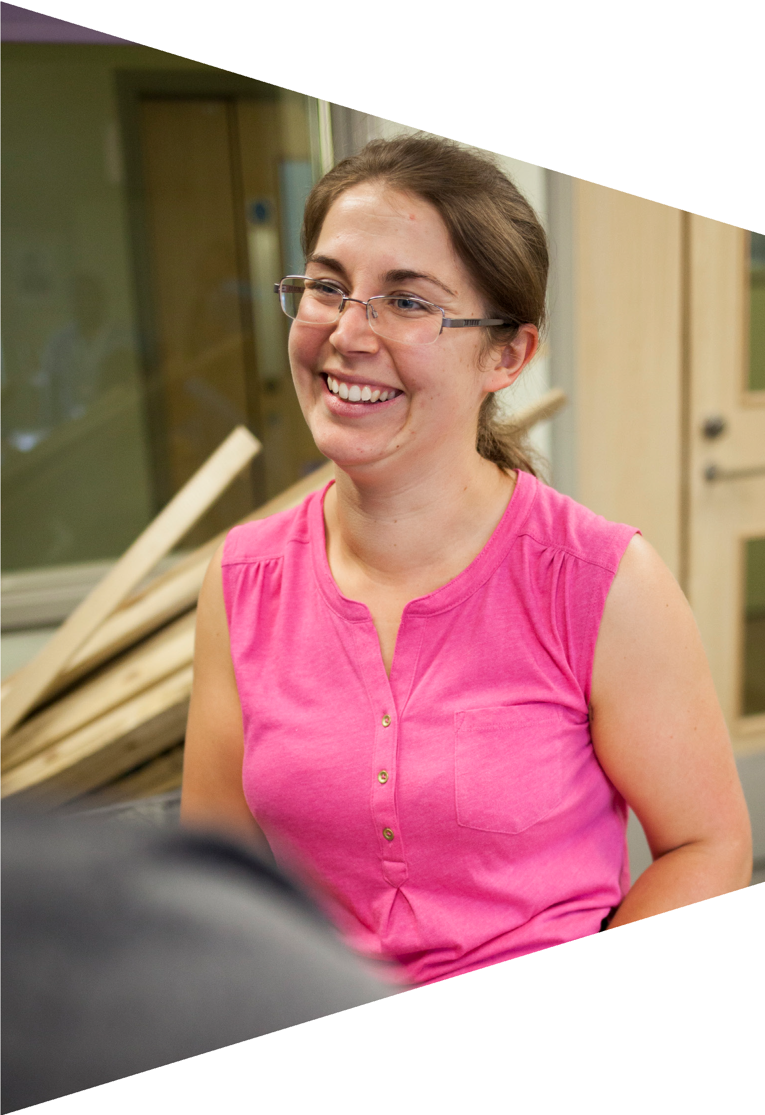
Helping young people
You need to create a campaign that:
Provides tips and advice to help young people deal with issues around mental health or drugs.
Raises awareness of the places they can go for advice.
Identifies the people who can help them.

Slide 16
Your challenge
You should be creative when thinking about your campaign:
How can you catch the attention of young people?
What channel should you use to reach young people?
It may be a radio show, website, leaflet, poster, social media campaign, TV show or advert etc.
The factsheets are your starting point for research, but you can also explore the useful websites highlighted in the documents.

Slide 17
Careers
Did you discover any new careers helping people with poor mental health or drugs problems that sounded interesting?
What do you think it would be like working with people experiencing these issues?
What would be the good and challenging parts of these jobs?
For further information about careers in the NHS visit: stepintothenhs.nhs.uk
For further information about the NHS visit: nhs.uk

