Slide 1
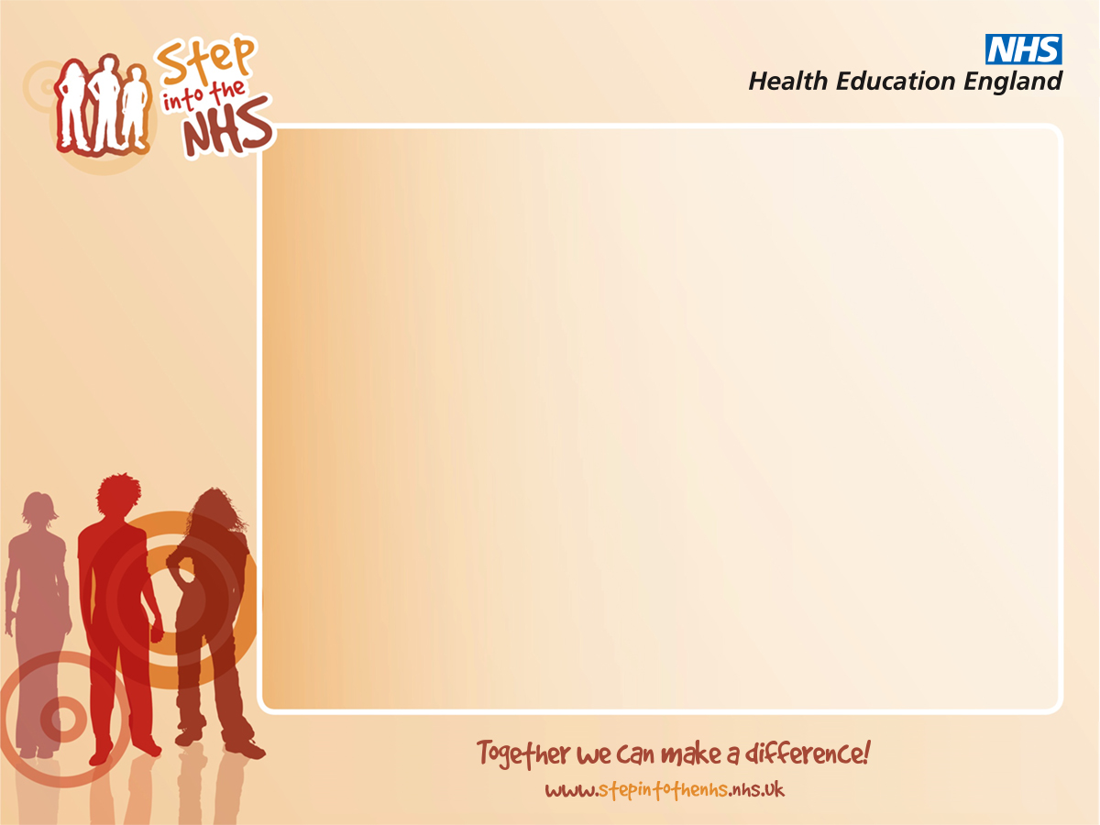
There are over 350 different careers available in the NHS!
Here are just some of the NHS team to tell you about their jobs.

Slide 2

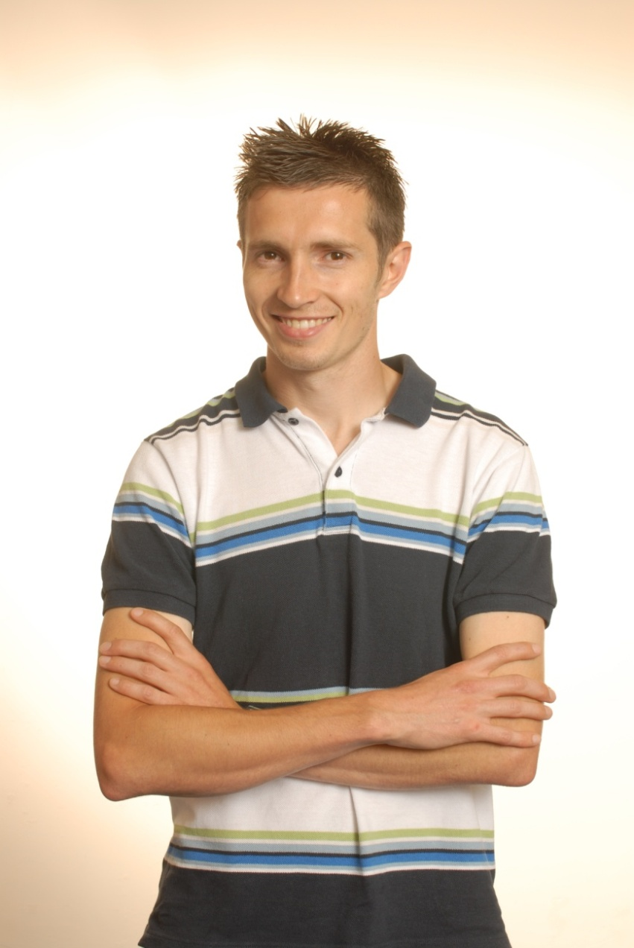
The exercise physiologist
Name: Scott Elliott
Role: Exercise physiologist and smoking
cessation officer
Responsibilities: A vital part of a life-saving healthcare team, working with patients with heart problems, carrying out diagnostic investigations and offering expert advice to doctors.
Personality: Calm, understanding and confident enough to put people at ease.
Advice: If you’re interested in sport and fitness, this is the perfect job. You get to use some sophisticated medical equipment too.
Entry requirements: Five GCSEs at grade A-C.
At least two A levels (including a science subject) or equivalent.
Degree in physiological science.

Slide 3

The personal assistant
Name: Nikki Crooks
Role: Administration assistant / clerical officer
Responsibilities: Organising workload for the team secretaries, dealing with the chief executive’s correspondence, organising meetings, preparing and keeping medical notes up to date.
Personality: Organised, responsible and reliable, with excellent communication skills.
Advice: No day is ever the same – I love the fast pace and responsibility of this position.
Entry requirements: There are no minimum entry requirements, but a good general education as well as computer and word processing skills are advantageous.

Slide 4
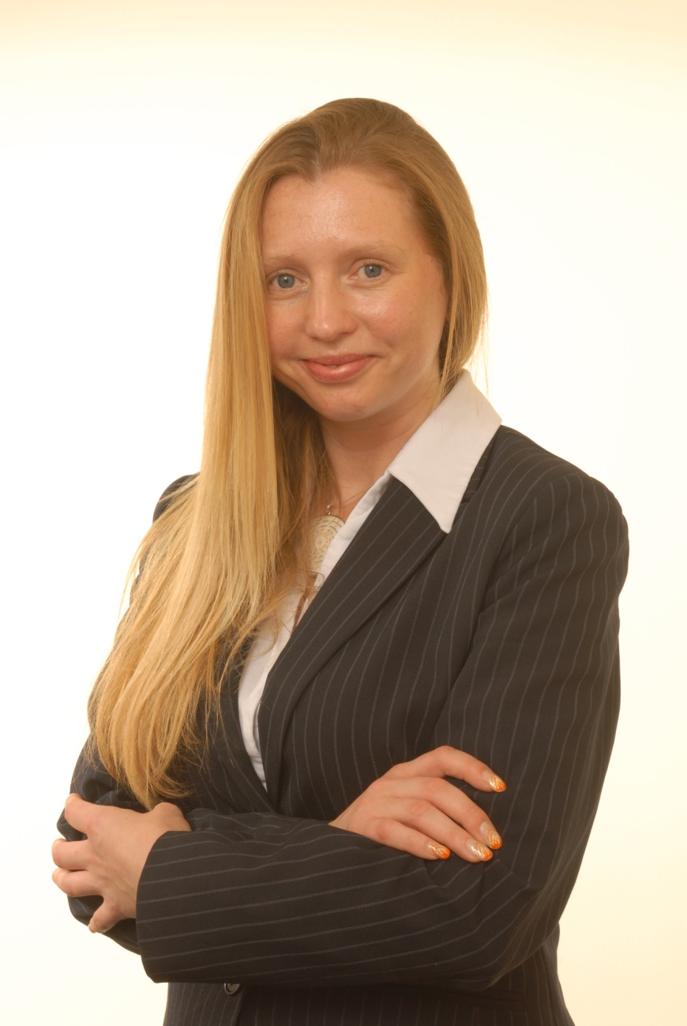
The accountant
Name: Becky Fletcher
Role: Accountant
Responsibilities: Finance reporting, including compiling spreadsheets, graphs and written data; analysing financial records, monitoring spending trends, budget planning and fund allocation.
Personality: Strong planning and analytical skills.
Advice: If you have a logical mind and like analysing facts and figures then this is a great job for you.
Entry requirements: Five GCSEs at grade A-C.
At least two A levels or equivalent.
Degree in accountancy or relevant subject. You can then apply for an NHS training position.

Slide 5
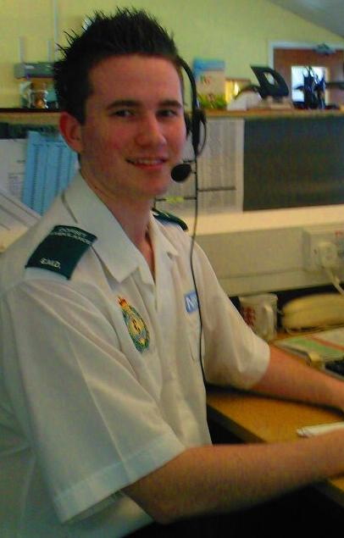
The emergency medical dispatcher
Name: Tom Davies
Role: Emergency medical dispatcher
Responsibilities: Processing emergency calls and deciding on the best emergency response to send to the scene, capturing critical information and transferring this from your computer directly to the screens in the emergency vehicles.
Personality: Calm under pressure and a good communicator.
Advice: You have to be really on the ball, listening carefully and picking up clues about the situation. Even when the adrenalin’s pumping you have to stay calm and reassuring for the caller.
Entry requirements: There are no national minimum entry requirements, but good GCSE grades and strong computer skills are usually required. You may wish to consider a typing/computer qualification when you leave school.

Slide 6
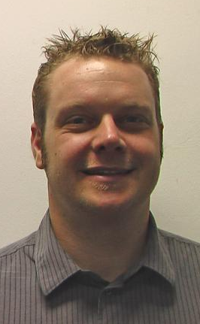
The IT support officer
Name: Izzy Pritchard
Role: Information technology infrastructure support
Responsibilities: Supporting and maintaining the computer systems which are critical to patient care and dealing with individual queries from staff members to identify faults and fix problems.
Personality: A good communicator, enjoy solving problems and like helping others.
Advice: To work here you need to have really good IT skills. You also need to be patient and tolerant and be able to deal with stress. Every day is interesting and varied.
Entry requirements: There are no national minimum entry requirements, but a good all-round education and proven knowledge and experience with ICT and Microsoft applications is essential. A levels (or equivalent) and a degree in computer science may be an advantage.

Slide 7
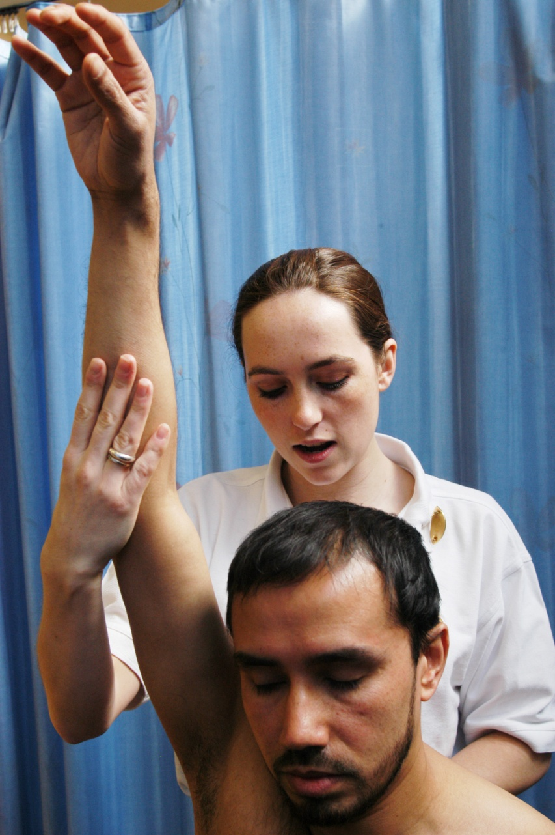
The physiotherapist
Name: Celia Cohen
Role: Senior physiotherapist
Responsibilities: Treating people with physical problems caused by illness, accident or ageing. Identifying the problems and helping to maximise patient mobility using manual therapy and therapeutic exercises.
Personality: Tolerant, patient, compassionate towards others, very level headed and practical.
Advice: It can be stressful dealing with a constant stream of patients but that’s also what makes the work really rewarding.
Entry requirements: Five GCSEs, including science.
Three A levels (including biology) or
equivalent.
Approved three or four year degree in
physiotherapy.

Slide 8
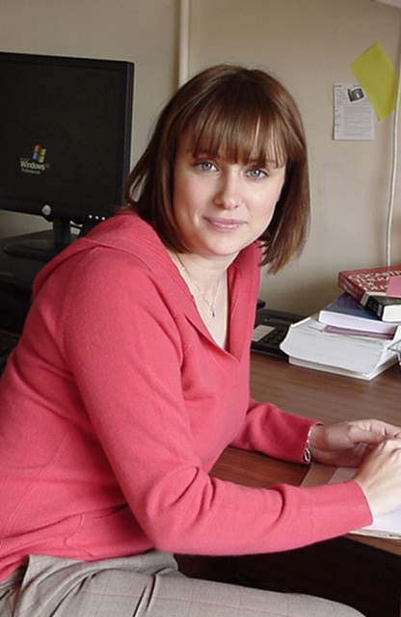
The clinical psychologist
Name: Anna Disney
Role: Assistant clinical psychologist
Responsibilities: Assessing patients and offering counselling, therapy and advice to a wide-range of people with mental health problems.
Personality: Interested in the feelings of others and fascinated by human behaviour. Empathise with people and understand their feelings.
Advice: I love working so closely with people and the challenge of such a steep learning curve, at the same time as feeling fully supported by my brilliant team.
Entry requirements: Five GCSEs.
Three A level subjects or equivalent.
Approved degree in psychology and postgraduate qualification in clinical psychology.

Slide 9
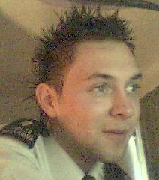
The healthcare assistant
Name: Grant Blackwell
Role: Healthcare assistant
Responsibilities: Providing hands-on care to patients with all kinds of problems: people recovering from surgery, people with cancer or other illnesses, elderly patients and young people. Updating bedside records and preparing care plans for patient recovery,
Personality: Mature and practical and able to make people feel comfortable. Work well under pressure and able to carry out many tasks at once without getting stressed.
Advice: Sometimes the emergency buzzers go off, which means someone is dangerously ill. It’s important to stay calm amongst the stress.
Entry requirements: There are no national minimum requirements. It is possible to enter work directly as a healthcare assistant or through an apprenticeship.

Slide 10
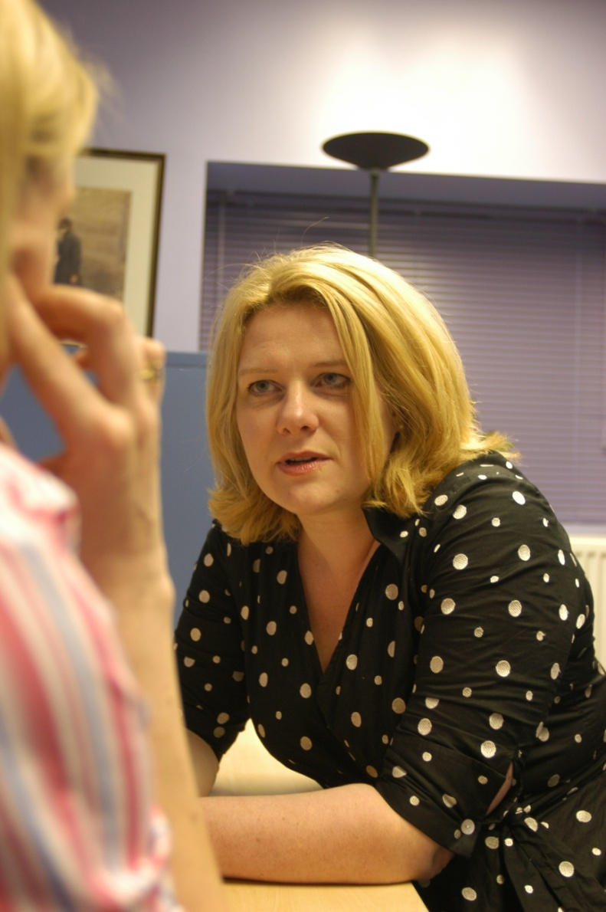
The human resources professional
Name: Louise Brandon
Role: Assistant personnel officer
Responsibilities: Staff management including recruitment and employee welfare; pay issues, training and development, health and safety, plus advising hospital managers.
Personality: Enjoy working with other people, organised and able to do many tasks at once, staying calm under pressure.
Advice: If you’re looking for a career with lots of opportunities to progress up the ladder, this job is excellent.
Entry requirements: There are no minimum entry requirements, but you'll need to demonstrate a good basic education.
You can either enter at an administrative level and work your way up or you can complete A levels (or equivalent) and then study for a degree - perhaps in human resource management.

Slide 11
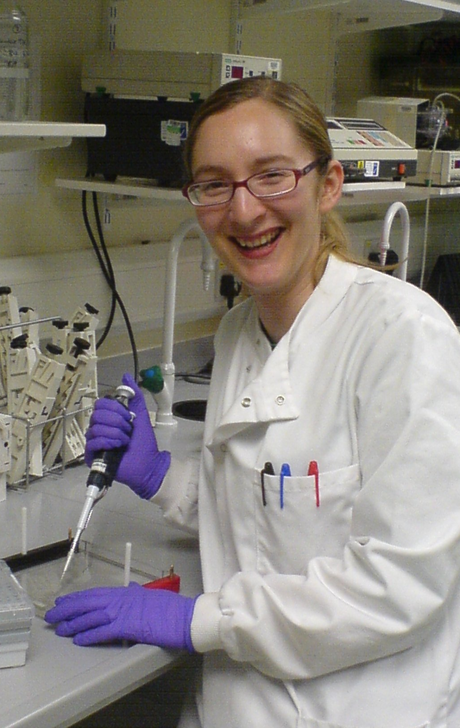
The clinical scientist
Name: Kate Garrard
Role: Pre-registered clinical scientist
Responsibilities: Taking samples of genetic materials and analysing it for diseases or abnormalities in the lab.
Personality: Able to concentrate for long periods of time, pay attention to detail and have good problem-solving skills.
Advice: If you’re interested in science, medicine and computing, and love using the latest technology, you couldn’t find a better job. Some of the mutations I find are quite unique - they have never been seen by anyone else in the world before.
Entry requirements: Five GCSEs at grade A-C (including maths, English and two science subjects). At least two A levels or equivalent. A biomedical science degree followed by the three year NHS Scientist Training Programme.

Slide 12
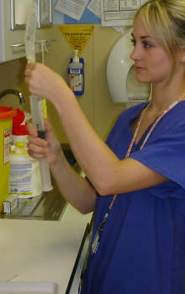
The intensive care nurse
Name: Anna Kerry
Role: Registered nurse in intensive care
Responsibilities: Providing one-to-one patient care for seriously ill people, monitoring and registering all the support equipment needed to keep patients alive.
Personality: Well balanced, mature and practical.
Able to work well under pressure.
Advice: It can be emotionally draining, you have to keep pretty balanced. The job can move from the sad times when everything you do is just not enough to help, to the fantastic sense of achievement of saying goodbye to a patient well on their way to recovery.
Entry requirements: Five GCSEs at grade A-C (including English and a science subject), plus at least two A levels or equivalent. A degree in nursing.

Slide 13
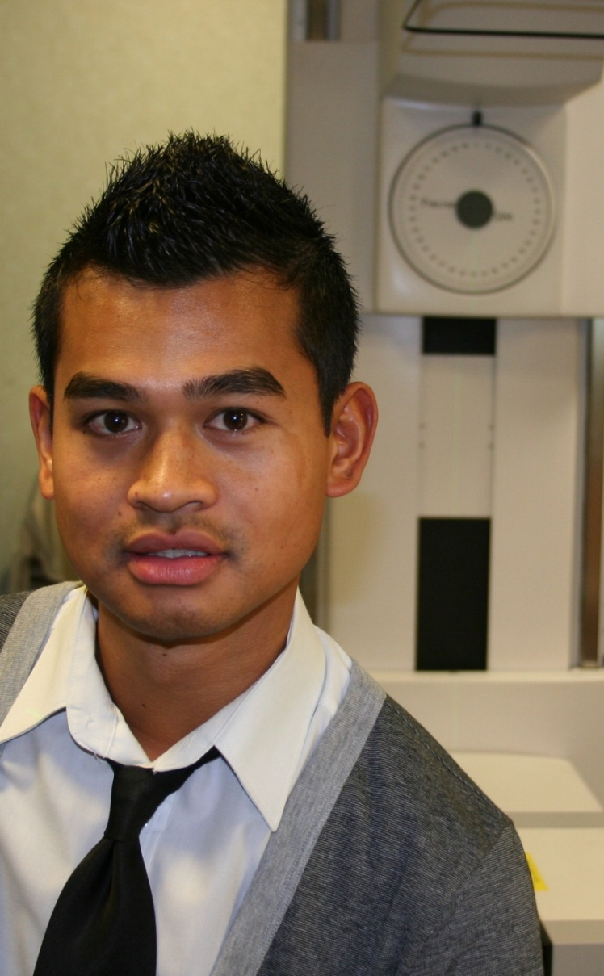
The radiographer
Name: Ricardo Khine
Role: Lecturer/practitioner in therapeutic radiography
Responsibilities: Planning and accurate delivery of the correct radiotherapy according to patient needs. This involves scans and x-rays for diagnosis and planning and operating highly specialised machines to treat the problem.
Personality: Able to put people at ease and enjoy working in a team.
Advice: This job enables you to explore an interest in digital imaging and technology within a medical environment.
Entry requirements: Five GCSEs at grade A-C (including a good grade in science).
At least two A levels (including a science subject).
Approved three-year degree in therapeutic
radiography at university.

Slide 14
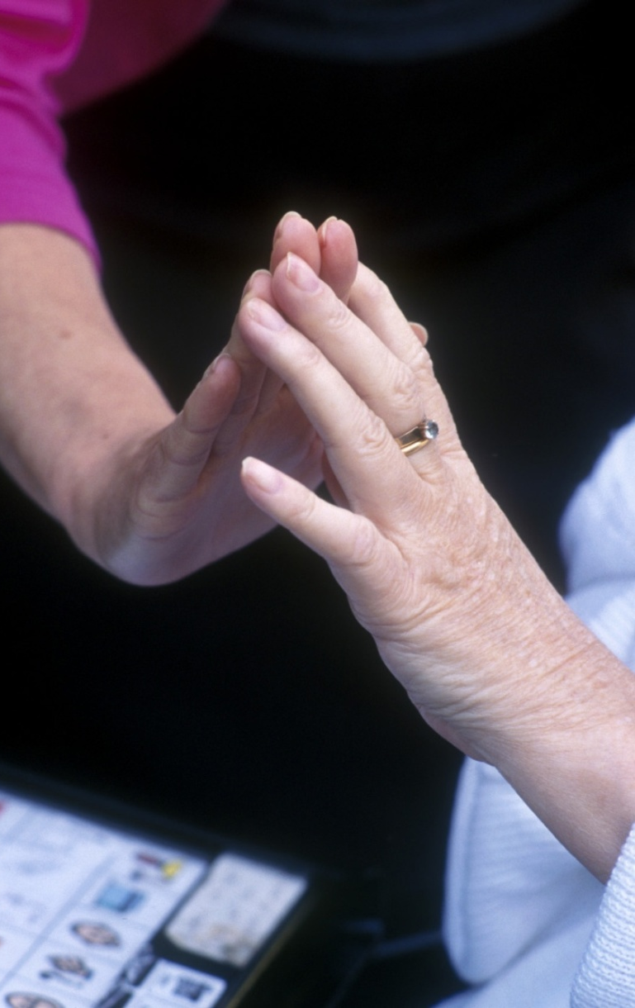
The occupational therapist
Name: Rachel Maton
Role: Occupational therapist in a children’s hospital
Responsibilities: Helping people who’ve been sick or injured to do everyday occupational activities. For children, this includes having a bath, eating breakfast, getting to school and playing.
Personality: Patient, determined with lots of common sense. Good at motivating others and like working closely with individuals.
Advice: Seventy per cent of my time is spent dealing with the effects of accidents, especially fractures to fingers and wrists. Trampolines and monkey bars have a lot to answer for!
Entry requirements: Five GCSEs at grade A-C (including a good grade in science).
At least two A levels (ideally including a science subject) or equivalent.
Approved three-year degree in occupational therapy at university.

Slide 15
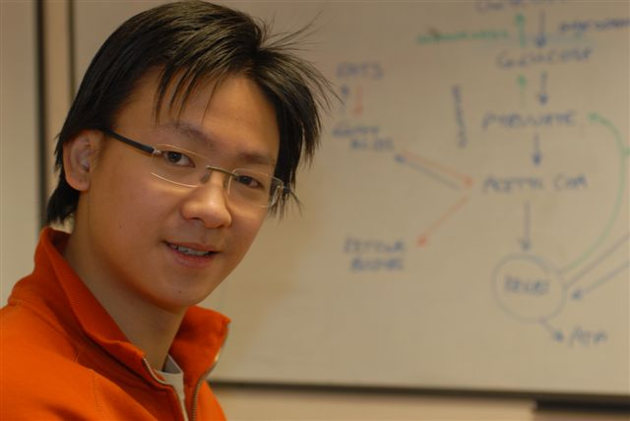
The GP
Name: Michael Wan
Role: Trainee general practice doctor
Responsibilities: As a trainee we look at a different medical topic each week through tutorials, discussion and research, plus lectures, demonstrations and visits to a GP.
Personality: Responsible, reliable with excellent communication skills. Make decisions quickly and like helping others.
Advice: Training to be a doctor usually takes five to
six years but the sense of job satisfaction is huge – you can really make a difference to
someone else’s life.
Entry requirements: Five GCSEs at grade A-C.
Three good A level grades (including science) or equivalent.
Approved medical degree (usually five years) followed by foundation and GP training.

Slide 16
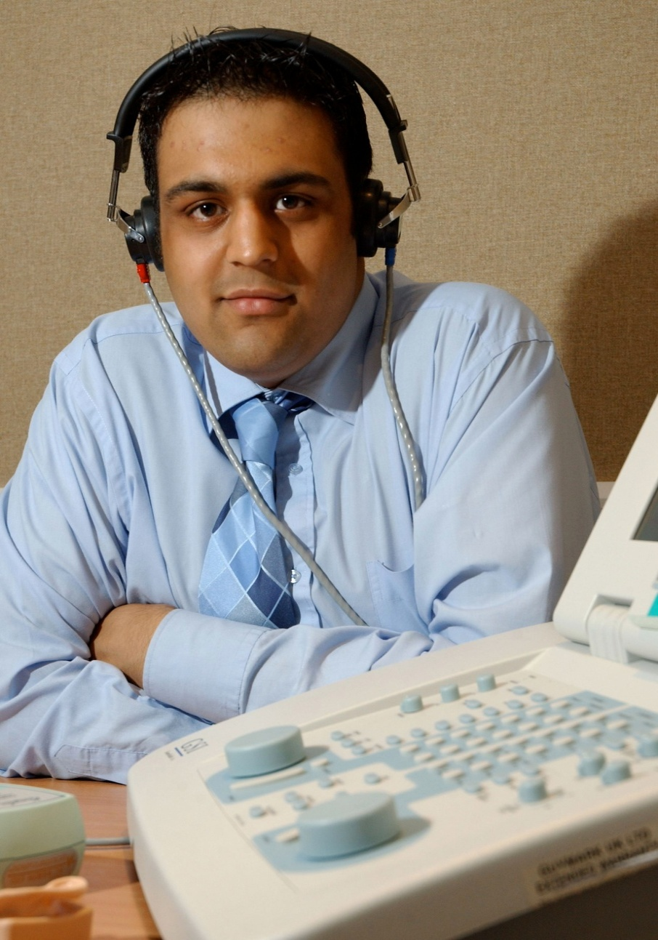
Healthcare scientist - audiology
Name: Devang Joshi
Role: Healthcare scientist specialising in audiology.
Responsibilities: Helping people with hearing and balancing disorders. Examining patients, assessing problems, prescribing the right kind of hearing aid or maybe arranging for further investigation.
Personality: Patient, understanding and enjoy helping others. Logical, with a passion for science.
Advice: It is challenging and always varied, with lots of opportunities to specialise; in babies, adults, special needs, or even research.
Entry requirements: Five GCSEs at grade A-C (including a good grades in English, maths and science).
At least two A levels (including a science subject) or equivalent.
A relevant science degree followed by a three-year post under the NHS Scientist Training Programme.

Slide 17
Do any of them sound like you?
Visit www.stepintothenhs.nhs.uk to find out more about these careers.

