Slide 1
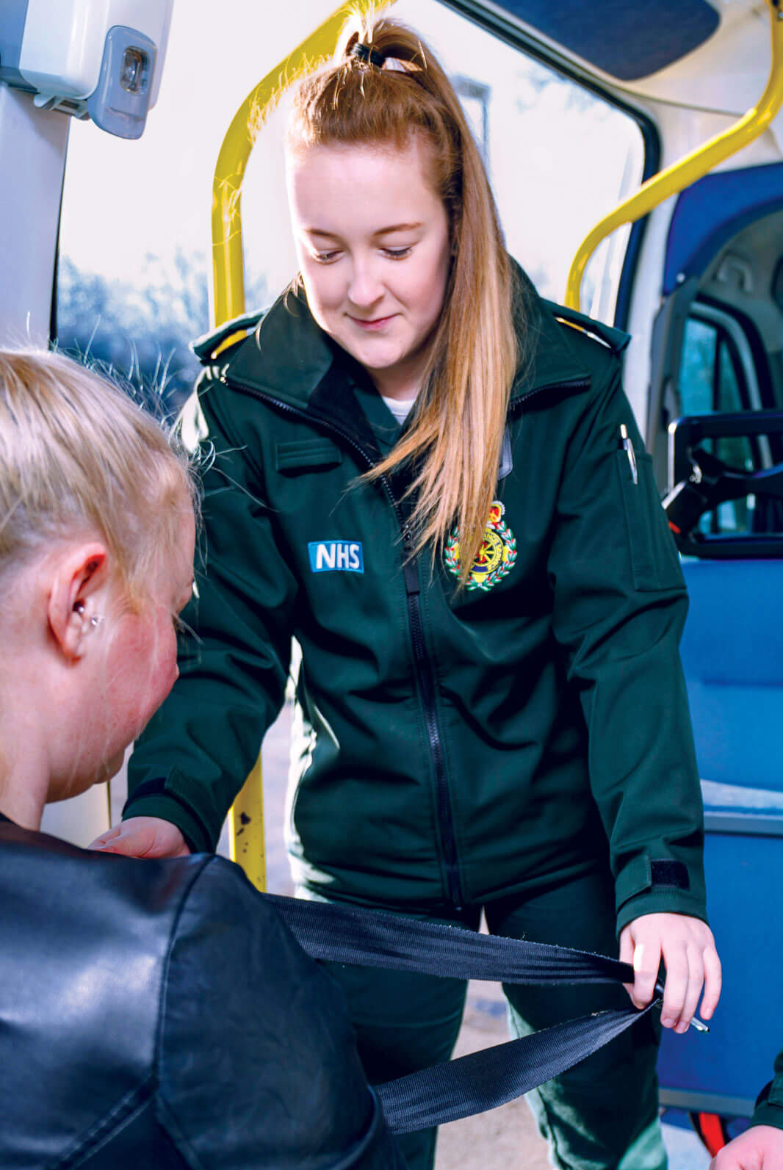
Annual schools’ competition
2021/22

Slide 2
Examples of
previous entries
  Previous winners have produced
  posters, poems, videos and
  even a song!
  What will you come up with?

Slide 3
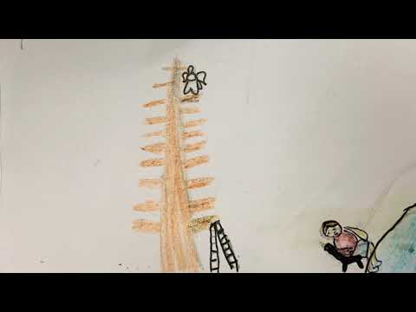
A patient journey animation
Entry type
An animation of a patient journey, highlighting many different career roles within the NHS.
Watch the animation

Slide 4
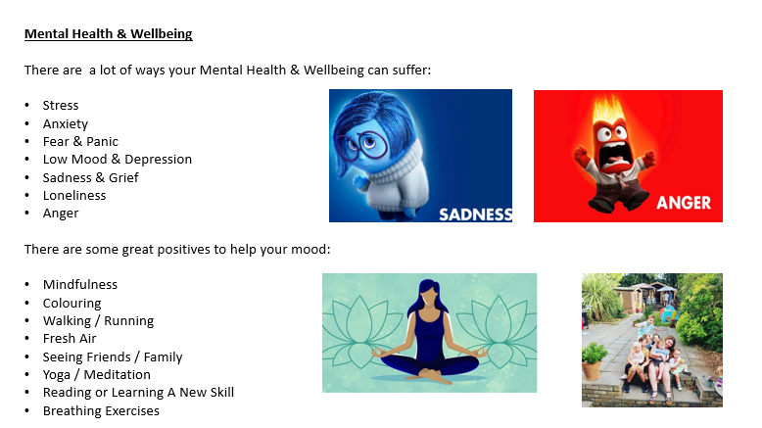
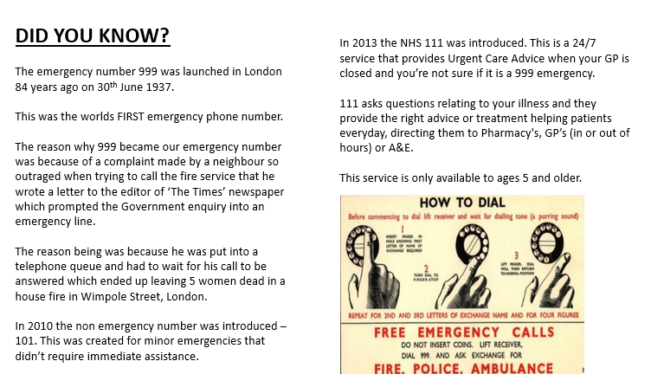
A PowerPoint presentation about the NHS
Entry type
A PowerPoint presentation about the NHS including the history of the NHS, its role, and personal stories related to the NHS

Slide 5
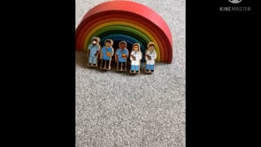
A stop-motion video about the NHS
Entry type
A stop-motion video about the NHS, challenging gender stereotypes and showing the range of careers available within the NHS.

Slide 6
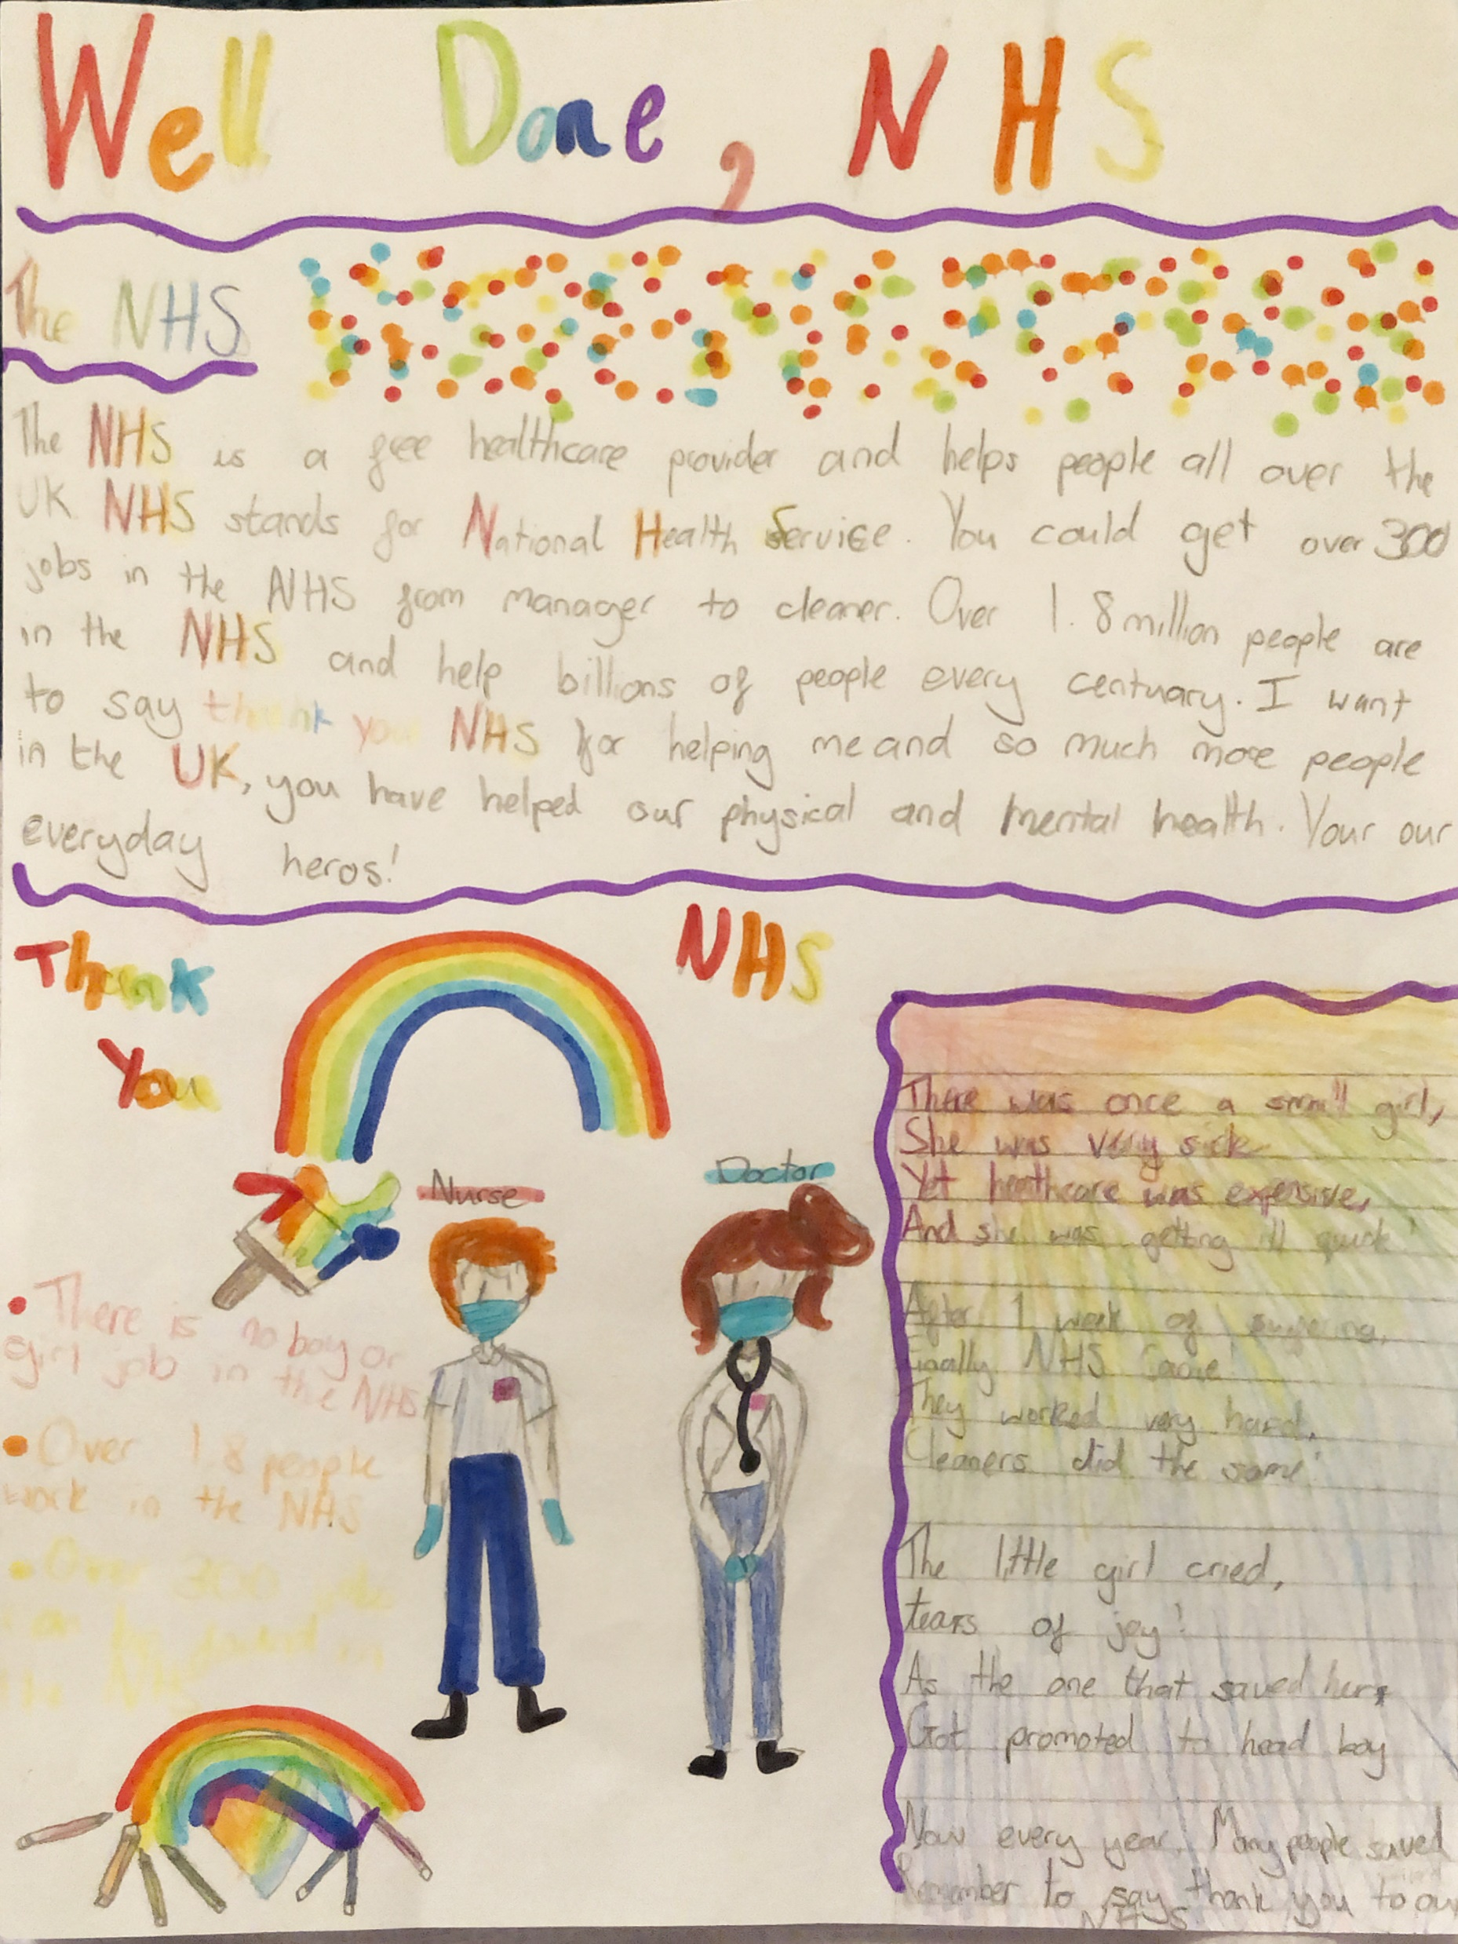
A poster and poem to say thank you to the NHS
Entry type
A poster and poem about the NHS, which explains the role of the NHS and challenges gender stereotypes.

Slide 7
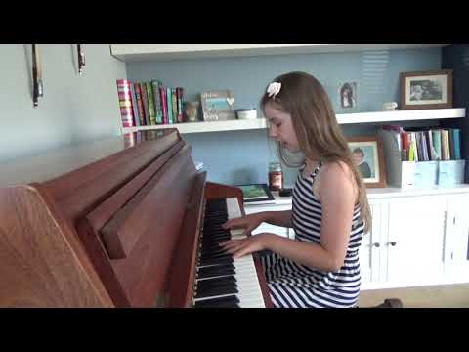
Song for the NHS
Entry type
A song written to say thank you to the NHS and played on the piano.

Slide 8
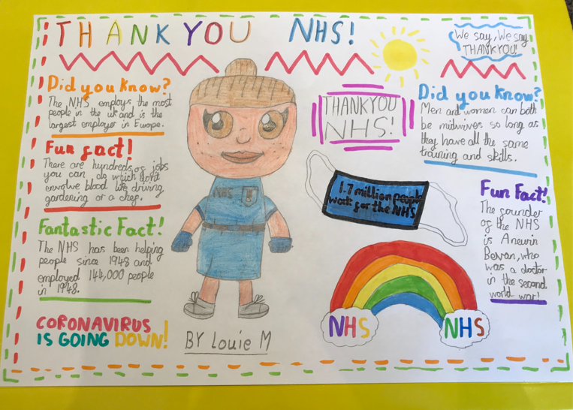
A poster
Entry type
A poster to say thank you to the NHS, including some fun and fantastic facts and challenging gender stereotypes.

Slide 9
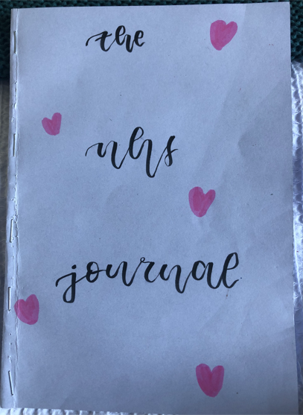
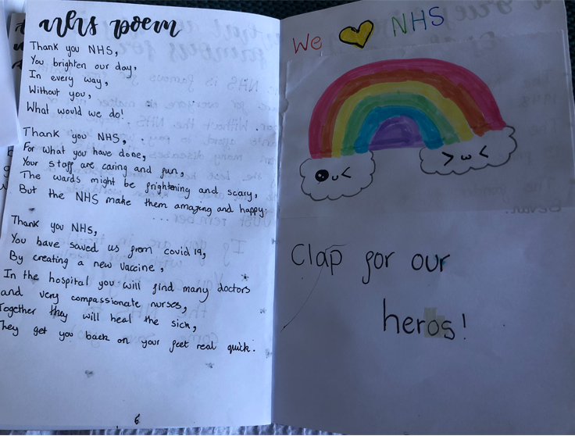
A NHS Journal
Entry type
A poster to say thank you to the NHS, including some fun and fantastic facts and challenging gender stereotypes.

Slide 10
Together we can make a difference!

