Slide 1
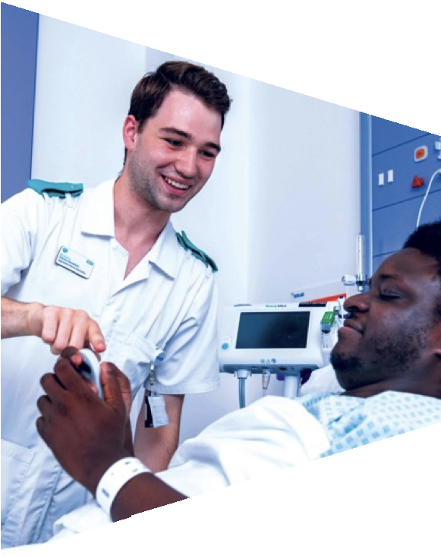
Topic 1: My interests, skills and future choices

Slide 2
Activity 1: Me

Slide 3
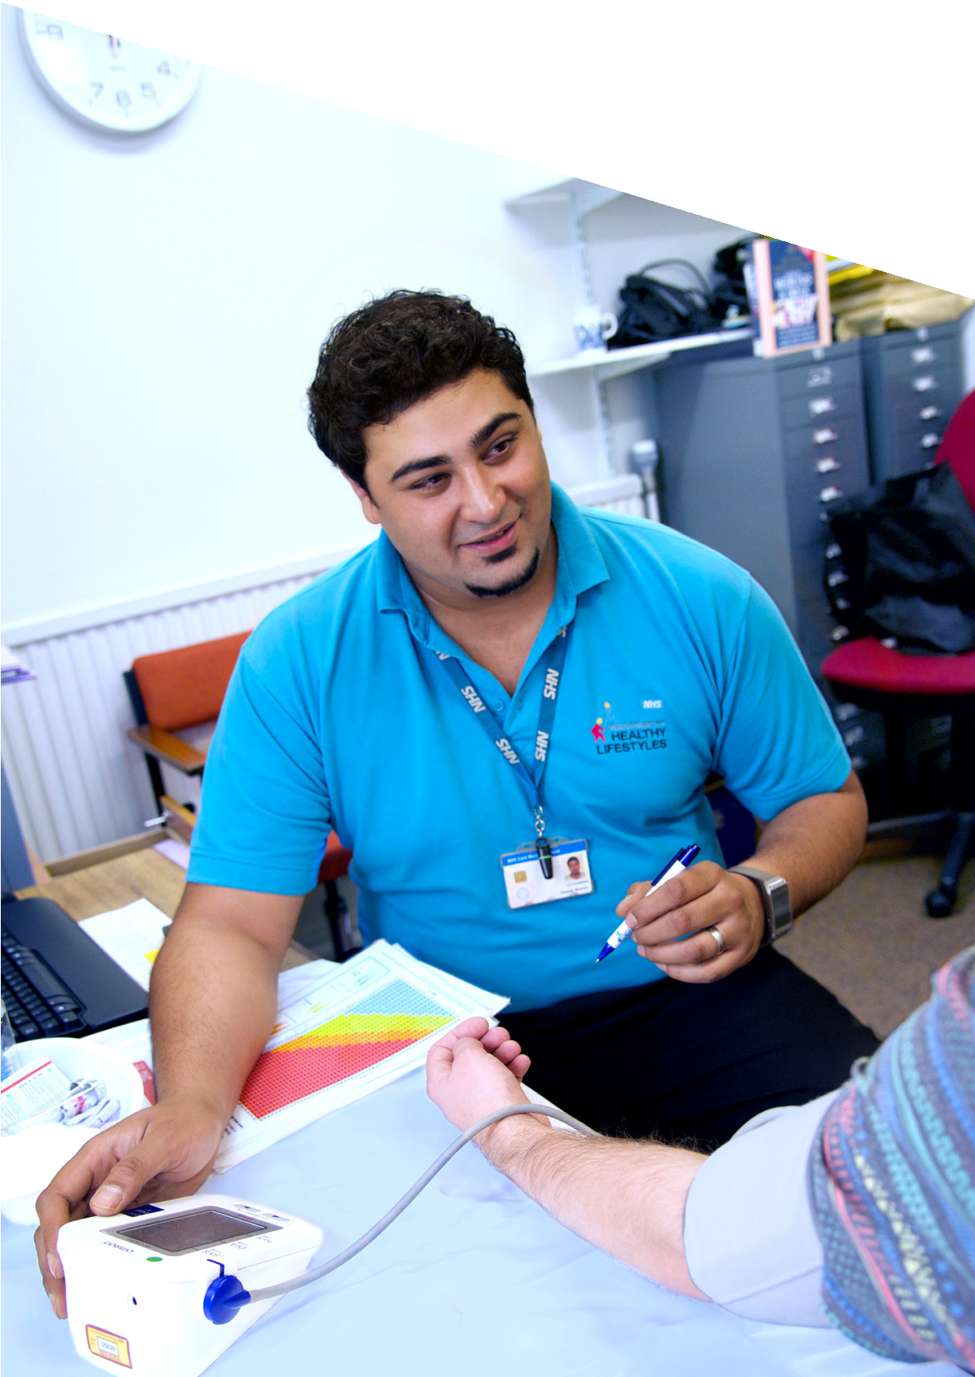
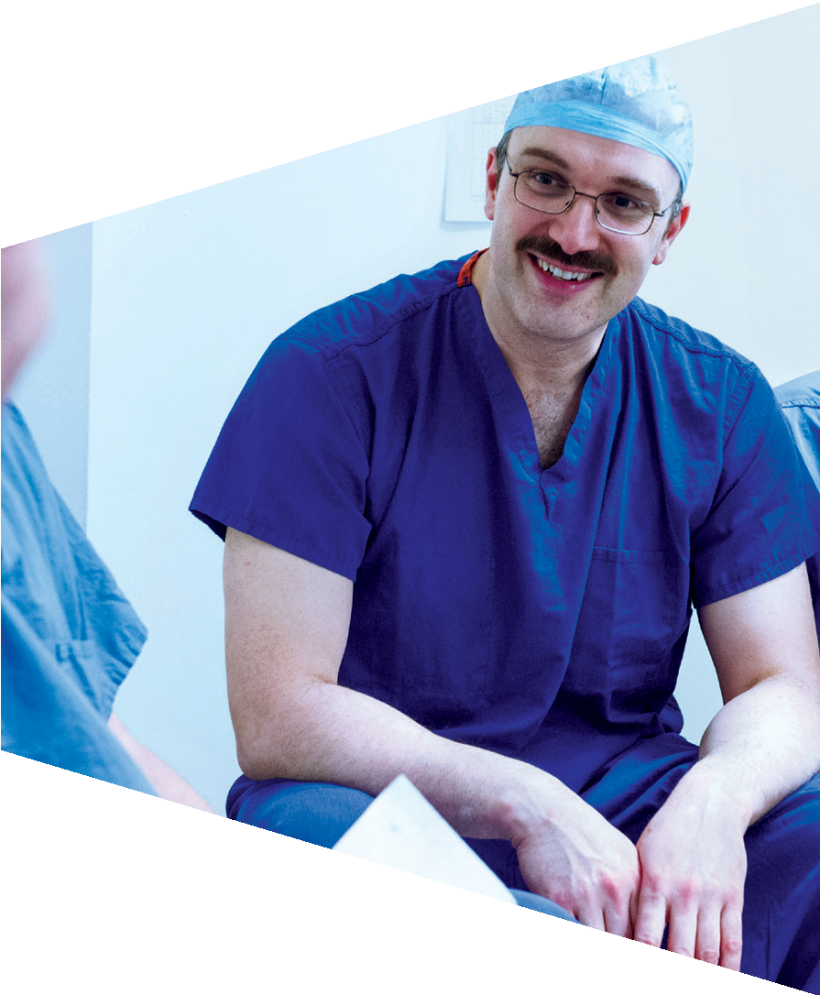
Interests and choices
People have lots of weird and wonderful interests.
Two minute challenge:
With a partner, list as many different types of interests as you can.

Slide 4
Example interests
Reading
Sports
Film
Gaming
Blogging
Cooking
Dancing

Slide 5
Interests and choices
Our interests can influence the choices we make.
During our lives, we have to make lots of choices.
Two minute challenge:
With a partner, list as many different choices that young people have to make as you can.

Slide 6
Do I or don’t I say sorry?
Should I limit my time on social media?
Should I do as a
parent says, or not?
Example Choices
What should I wear today?
What subjects shall I study?
Should I turn my phone off while working?
Should I go out or stay in and revise?

Slide 7
Interests and choices
You are going to complete a short quiz to think about your interests and future choices.
It’s good to think about these things as it can help you to make the right choices about what you want to do in the future.
Work on your own.
Remember there is no right or wrong answer – just follow your intuition.

Slide 8
We are all different
There are no right or wrong answers for the quiz, because everyone is different.
However, it is good to discuss your choices. Compare your quiz answers with another student.
Complete:
Tick all the answers that are the same. In what ways are you the same?
Tick all the answers that are different. In what ways are you different?
Discuss why you chose your answers.

Slide 9
Activity 2: Understanding skills

Slide 10
What are skills?
Skills help us to carry out tasks effectively.
Some people are more naturally skilled at some things, but a skill is something we can learn.

Slide 11
Skills
Think of as many skills as you can.

Slide 12
Understanding skills
In groups of 2-3, choose a skill from the list.
Describe what a person who has that skill is like.
Provide one or more examples of how that skill can be used.
Example
Communication skills.
This person might be good at talking to people.
Communication skills are really important when a doctor is dealing with a patient. They need to communicate clearly and adapt their style to suit the needs of the patient.

Slide 13
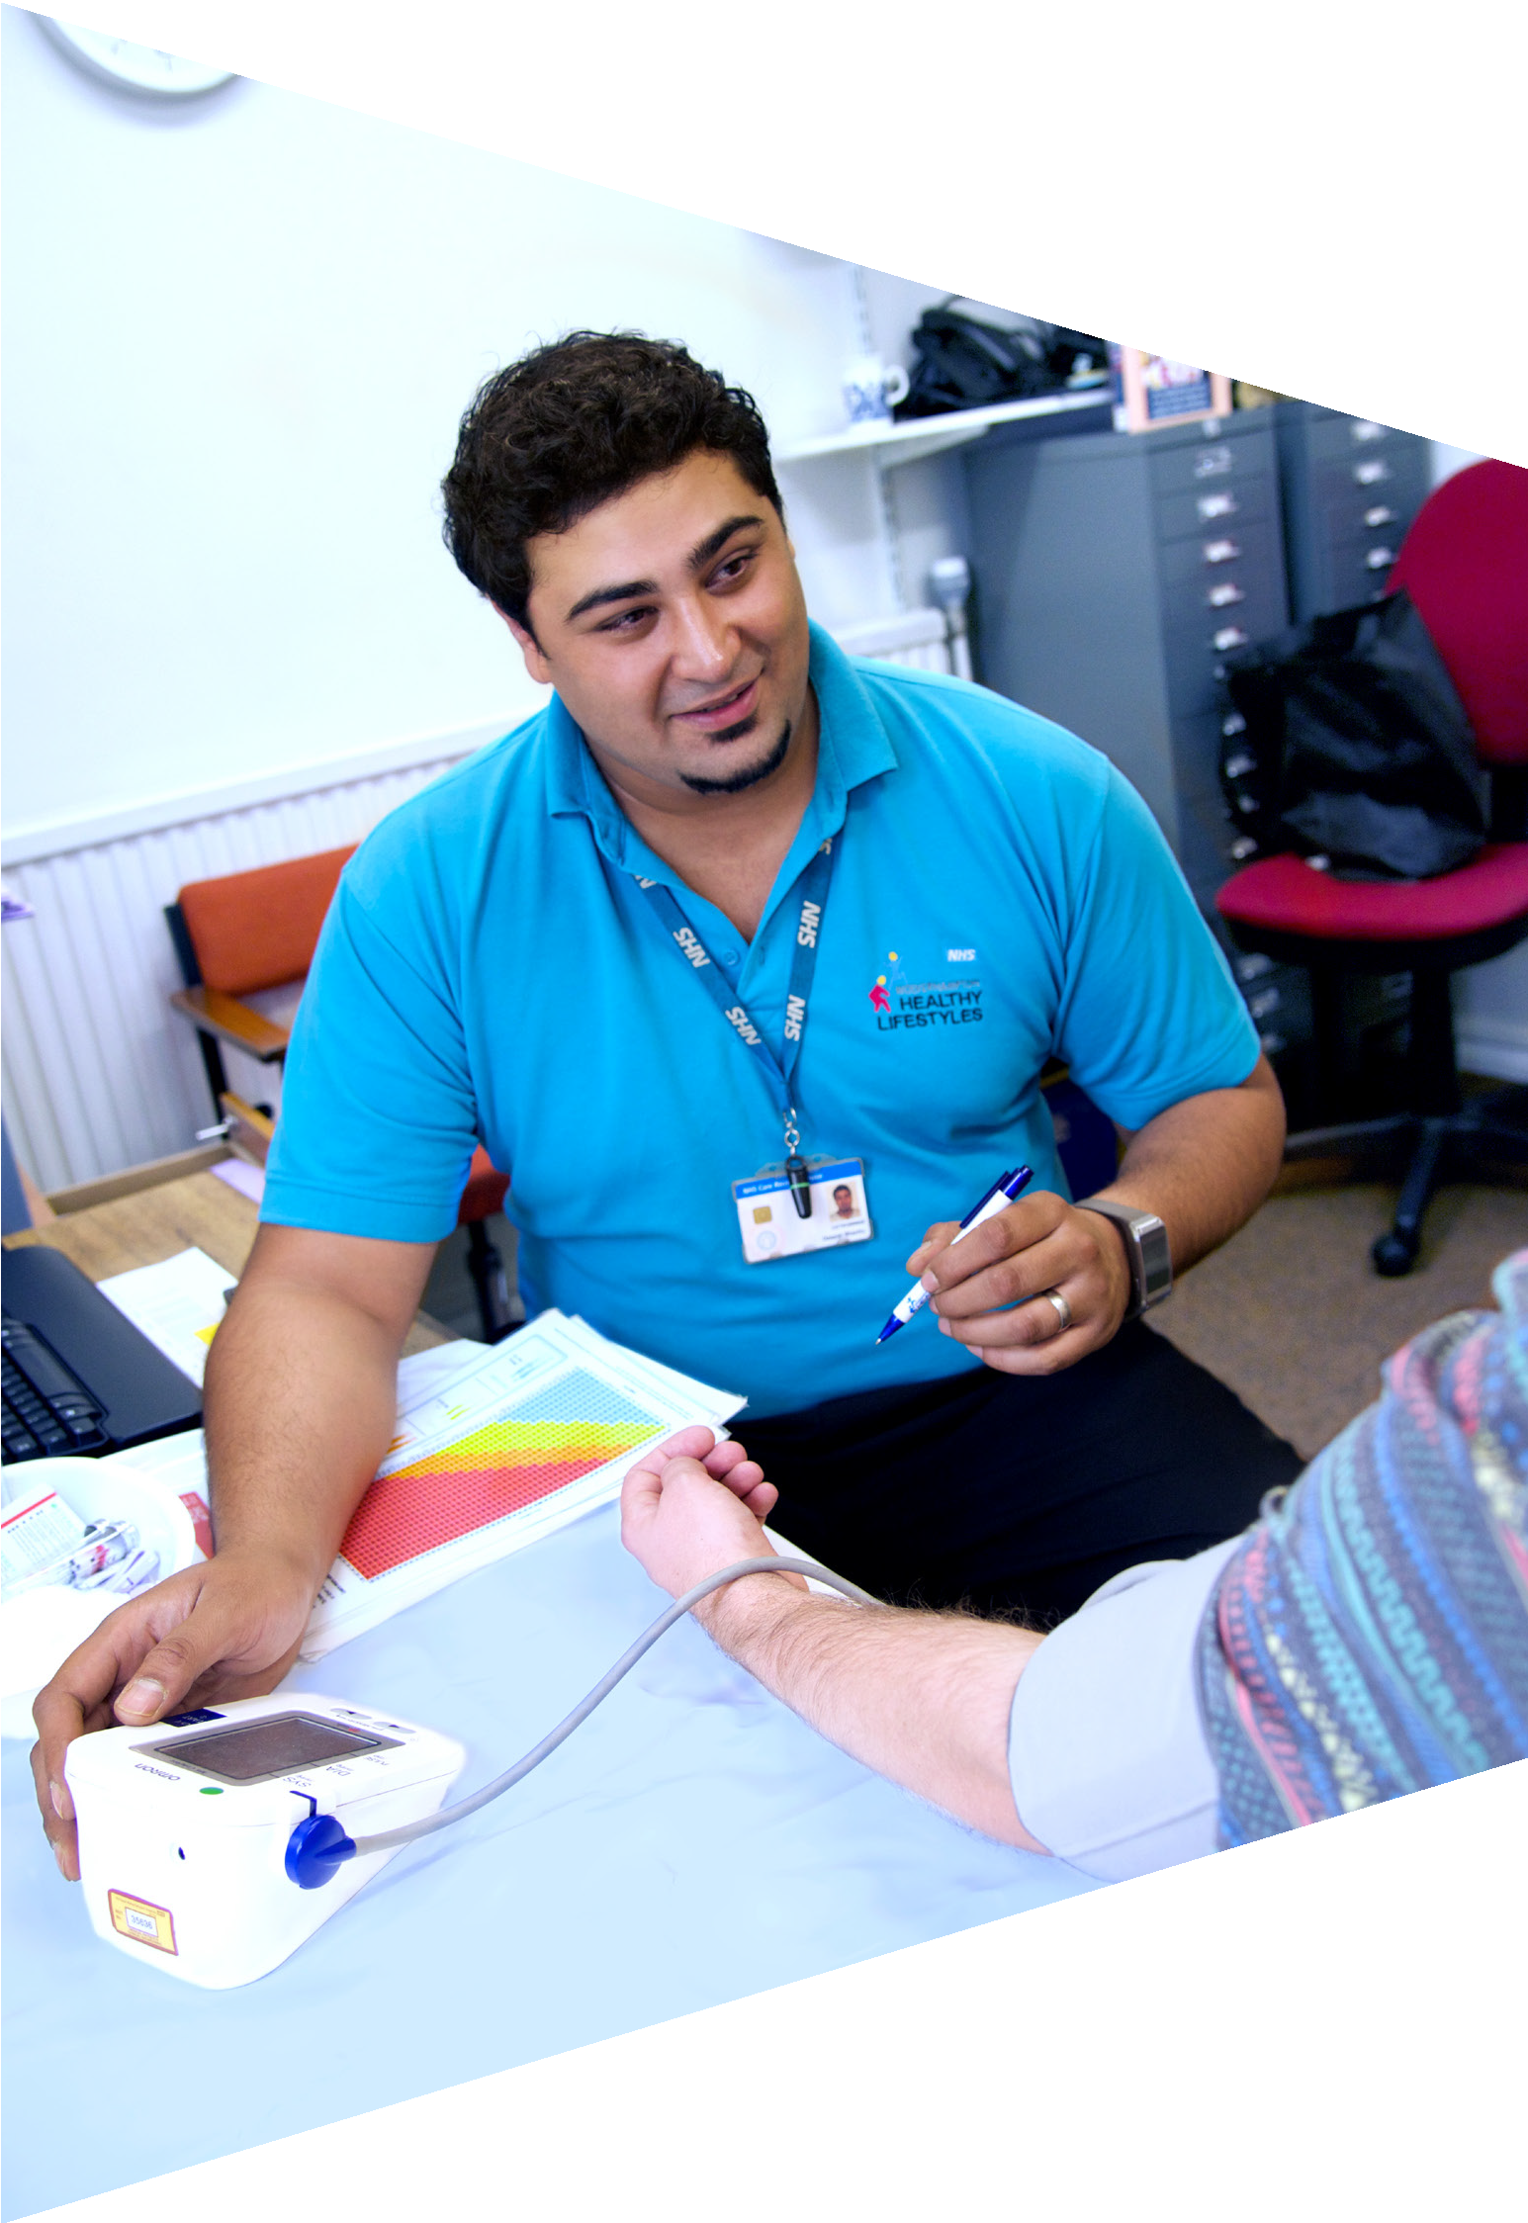
Your skills
It is important to identify your own skills so you know your strengths and weaknesses.
Then you can think of ways to address your areas of weakness and improve your strengths.
You can also match your skills to appropriate jobs.

Slide 14
Problem solving
Skills map
This is an example of a skills map. It sets out
the skills that employers might look for.
Emailing Confidence
Analysis
Data handling
Creativity
Coding Discussion
Research Digital literacy Negotiation
Organised
Creative Innovation
Good listener Microsoft Office
Layer 1
Layer 2
Communication
Team worker
Editing Cooperating
Ability to prioritise
Giving / accepting criticism Time management
Using the cloud Leading
Experimentation

Slide 15
Your task
You are going to create your own skills map.
Use the template on the worksheet.
In layer 1 add in your key skills, such as communication. These are your strongest or most important skills.
In layer 2 add in other skills or abilities that are linked to your key skills, e.g. If communication is a key skill, then you might also have presentation, listening, writing skills.

Slide 16
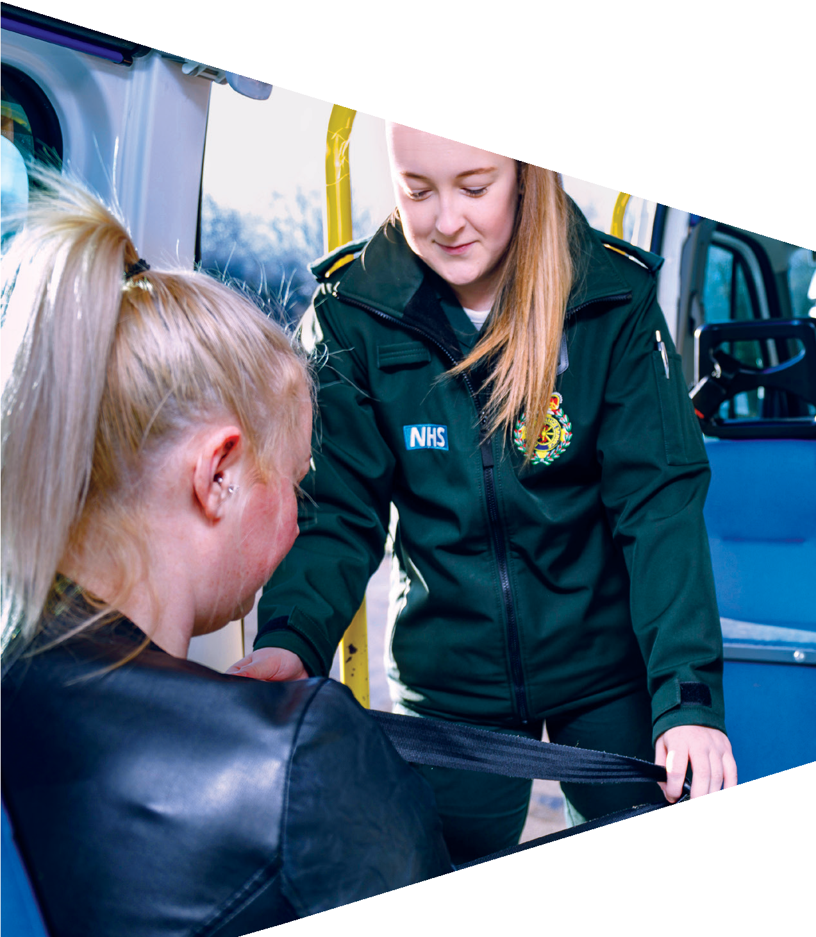
Activity 3: Skills and careers match

Slide 17
Your task
Go to stepintothenhs.nhs.uk/careers/take-the-test
Complete the quiz to match your skills to possible careers in the NHS.
Compare the top five NHS career results, identified through the quiz, with another student.

