Slide 1


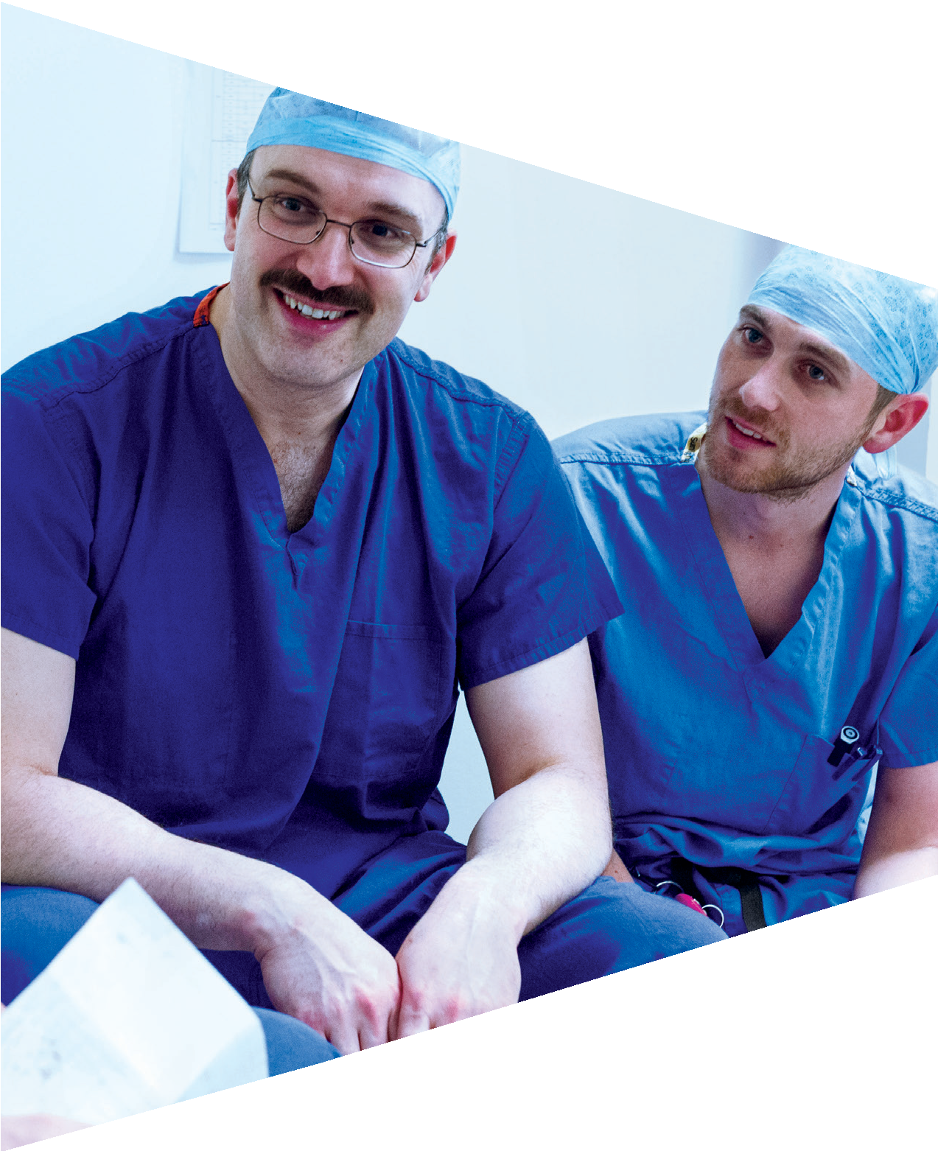


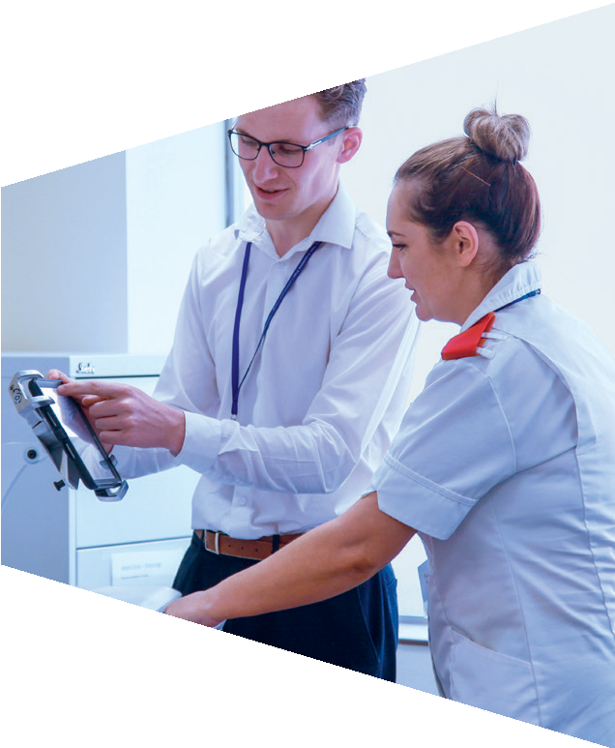





Topic 5: Preparing for the world of work

Slide 2



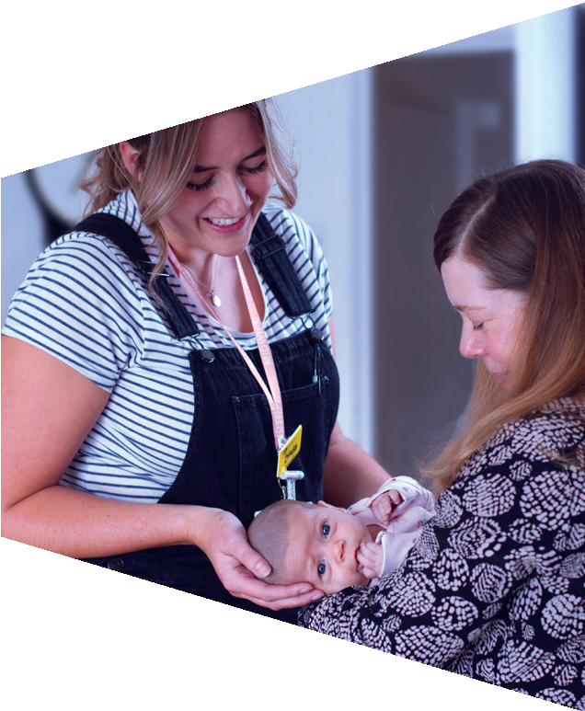

Activity 1: My skills

Slide 3
Personal, learning and thinking skills
How would you describe these kinds of people? What do you think they would be good at?
Independent enquirers | Creative thinkers | Reflective learners
Team workers | Self-managers | Effective participators

Slide 4
I can plan and carry out research
I can analyse and evaluate information
I can make reasoned decisions and present arguments
I can explore and solve problems
Independent enquirers

Slide 5
I can challenge and question my own and others’ ideas
I can come up with ideas
I can try out new ideas and adapt them as things change
Creative thinkers
I can explore new ideas and possibilities

Slide 6
I can deal with constructive criticism
I can set goals to work towards
I can review my progress
Reflective learners
I can assess myself and others

Slide 7
I can adapt to different
roles, including leadership
I can work with others towards a shared goal
I can provide constructive feedback to others
Team workers
I can manage discussion

Slide 8
I can work towards goals independently
I can prioritise actions
I can deal with pressure and adapt to change
I can manage my time
Self-managers

Slide 9
I can negotiate and try to influence others
I can discuss issues
I can suggest practical steps to move things forward
Effective participators
I can present a case for action

Slide 10
Personal, learning and thinking skills
Personal, learning and thinking skills are the skills and qualities that will help you to succeed in work.
They are things that employers will look for in their employees.
When applying for jobs, it is good to demonstrate that you have these skills and this can be shown through your experience.

Slide 11
Problem solving
Skills and qualities map
Research
Data handling
Analysis
Independent enquirers

Slide 12
Problem solving
Skills and qualities map
Research
Data handling
Creativity
Analysis
Independent enquirers
Innovation
Creative thinkers
Experimentation

Slide 13
Problem solving
Skills and qualities map
Research
Data handling
Creativity
Analysis
Independent enquirers
Innovation
Experimentation
Giving / accepting criticism
Evaluation
Creative thinkers
Reflective learners

Slide 14
Problem solving
Skills and qualities map
Research
Data handling
Creativity
Analysis
Independent enquirers
Innovation
Experimentation
Giving / accepting criticism
Evaluation Leading
Creative thinkers
Reflective learners Team workers
Cooperating
Motivation
Communication

Slide 15
Problem solving
Skills and qualities map
Research
Data handling
Creativity
Analysis
Independent enquirers
Innovation
Risk taking Organised
Time management
Initiative
Experimentation
Giving / accepting criticism
Evaluation Leading
Creative thinkers Self-managers Reflective learners Team workers
Cooperating
Motivation
Communication

Slide 16
Problem solving
Skills and qualities map
Research
Data handling
Creativity
Confidence Analysis Negotiation
Independent enquirers Effective participators Creative thinkers
Self-managers Reflective learners Team workers
Discussion
Innovation
Risk taking Organised
Time management
Initiative
Experimentation
Giving / accepting criticism
Evaluation Leading
Cooperating
Motivation
Communication

Slide 17
Positive things about me
Write a list of positive things about you.
You can include:
Positive behaviour such as punctuality (e.g. turning up on time for class), reliability (e.g. completing homework), etc.
Things you are good at
Personal achievements
Ask the person next to you to tell you something positive to start your list.

Slide 18
Your task: My skills
Completed a science project
Use the skills map template. Against each personal, learning and thinking skill, try to think of a time that you have used those skills. For example:
Worked on the school council
Independent enquirers Effective participators
Creative thinkers Self-managers Reflective learners Team workers
Designed my own website
Organised
a fundraising event
Produced a personal
development plan
Team leader for the enterprise challenge

Slide 19


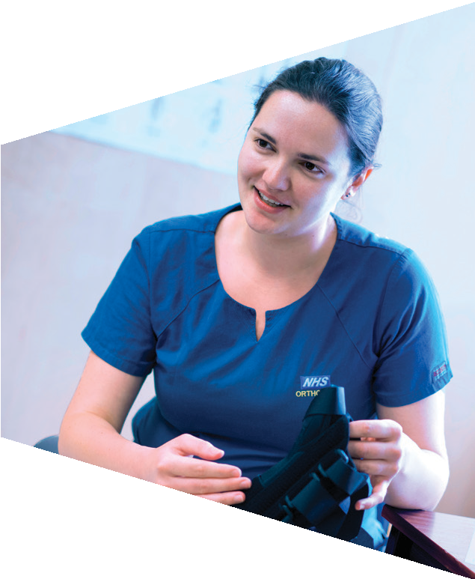
Activity 2: CV writing

Slide 20
What is a CV?
CV stands for curriculum vitae.
It provides an overview of your education, qualifications, experience and interests.
When recruiting new employees, employers will first look at the CVs supplied by the candidates for the job.
They will often have lots of CVs to read, so it’s important that yours stands out!

Slide 21
Top tips
Keep it real
Tell the truth about what you have achieved. Don’t risk someone finding out that small untruth. Also, don’t write any words you don’t know the meaning of – you could be asked about them!
Sell yourself
We’re not very good at blowing our own trumpets, but you should in your CV. Find ways of being positive about who you are and what you have achieved.
Remember – qualifications and qualities
Employers are not only interested in your school qualifications. Your qualities are even more important!

Slide 22
Top tips
Sweat the small stuff
Take care over the smallest details in your CV. Inaccurate and incomplete CVs are immediately rejected by employers.
Match the job
Check out what the employer wants in the job description and think about how you tell them that you are the person they are looking for! Always customise your CV to match the job.
Never let anyone write you CV
It’s important that only you write your CV unless it’s something you do together with a trusted adult.

Slide 23
Top tips
7. Write a covering letter
A covering letter is a really important part of your job application. It is a letter which accompanies your CV and is intended for the hiring manager to read.
It’s purpose is to introduce you, briefly summarise your background and highlight anything which is important for the hiring manager to know which isn’t on your CV. For example, why you think you’re the right candidate for the job!
Remember, your covering letter shouldn’t take up more than half a page!

Slide 24
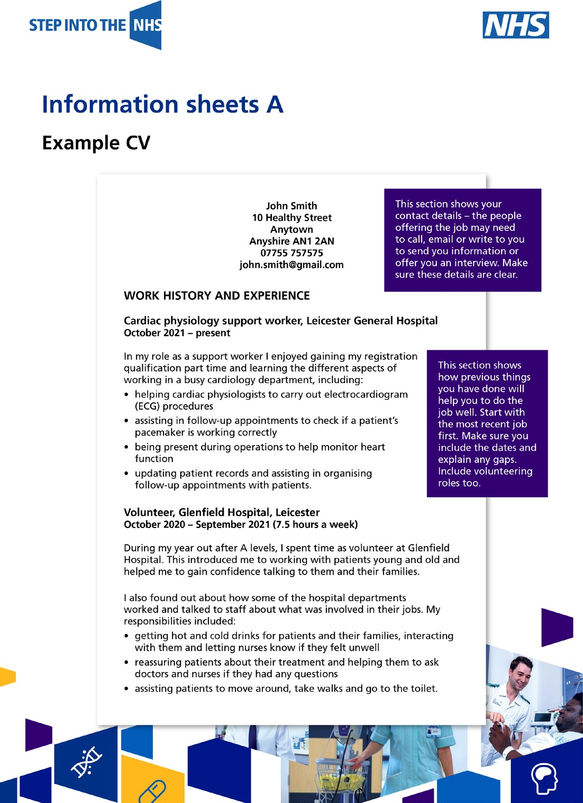
CV writing
Part 1: Contact infornation
The employer may need to call, email or write to you, so make sure these are clear.

Slide 25
CV writing
Part 2: Work history and experience
This is where you explain the responsibilities you’ve had and what you have learned from them, to demonstrate the experience you’ve gained.
You need to show how your previous experience will help you to do the job you are applying for. Start with the most recent experience.
You can include volunteering roles too.
Make sure you include the dates and explain any gaps.

Slide 26
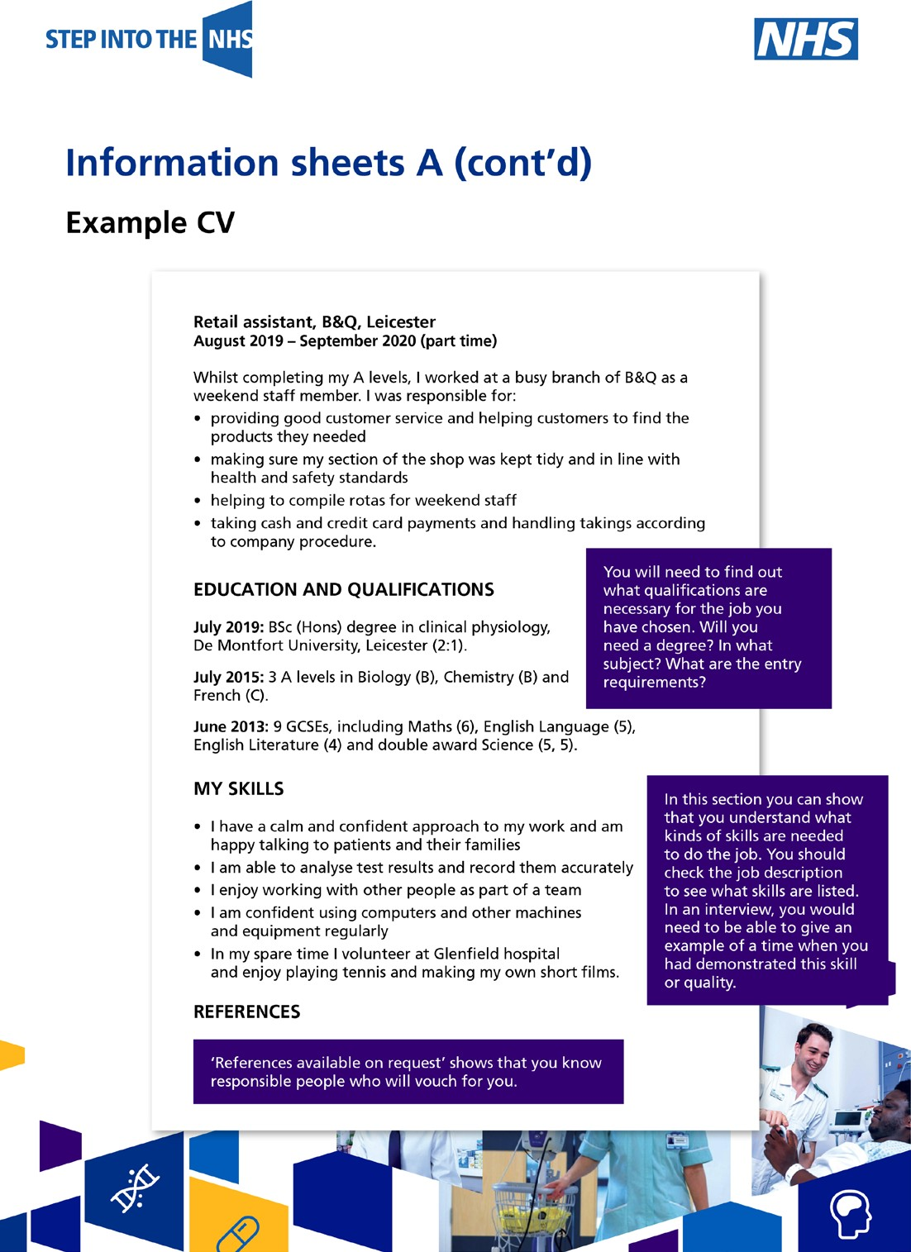
CV writing
Part 3: Education
Here you can list your formal qualifications.
What qualifications are necessary for the job? Have you got the qualifications to apply?
If so, make sure these are clearly listed on your CV with the most recent first.

Slide 27
CV writing
Part 4: Hobbies and interests
This is the place to discuss anything else that makes you a well-rounded candidate.
What skills are needed to do the job?
Make sure you clearly list your skills and personal qualities to show you’ve got what it takes to do the job.

Slide 28
CV writing
Part 5: References
‘References available on request’ shows that you know responsible people who will vouch for you.
Leave this line at the end of your CV.
Once you’ve sent your CV to employers, they can ask you to pass them the contact details of your referees.

Slide 29
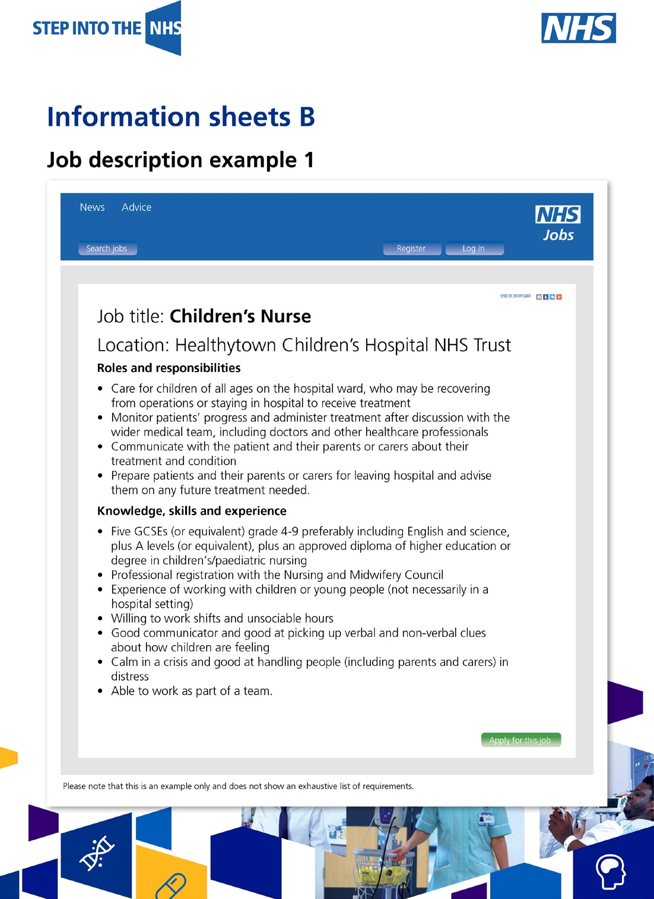
Your task: CV writing
Read the job descriptions.
Choose one to write your CV for.
Think about the qualifications, skills and qualities you need to demonstrate in your CV.
You may want to research these job roles further on the Step into the NHS website: stepintothenhs.nhs.uk

