Slide 1
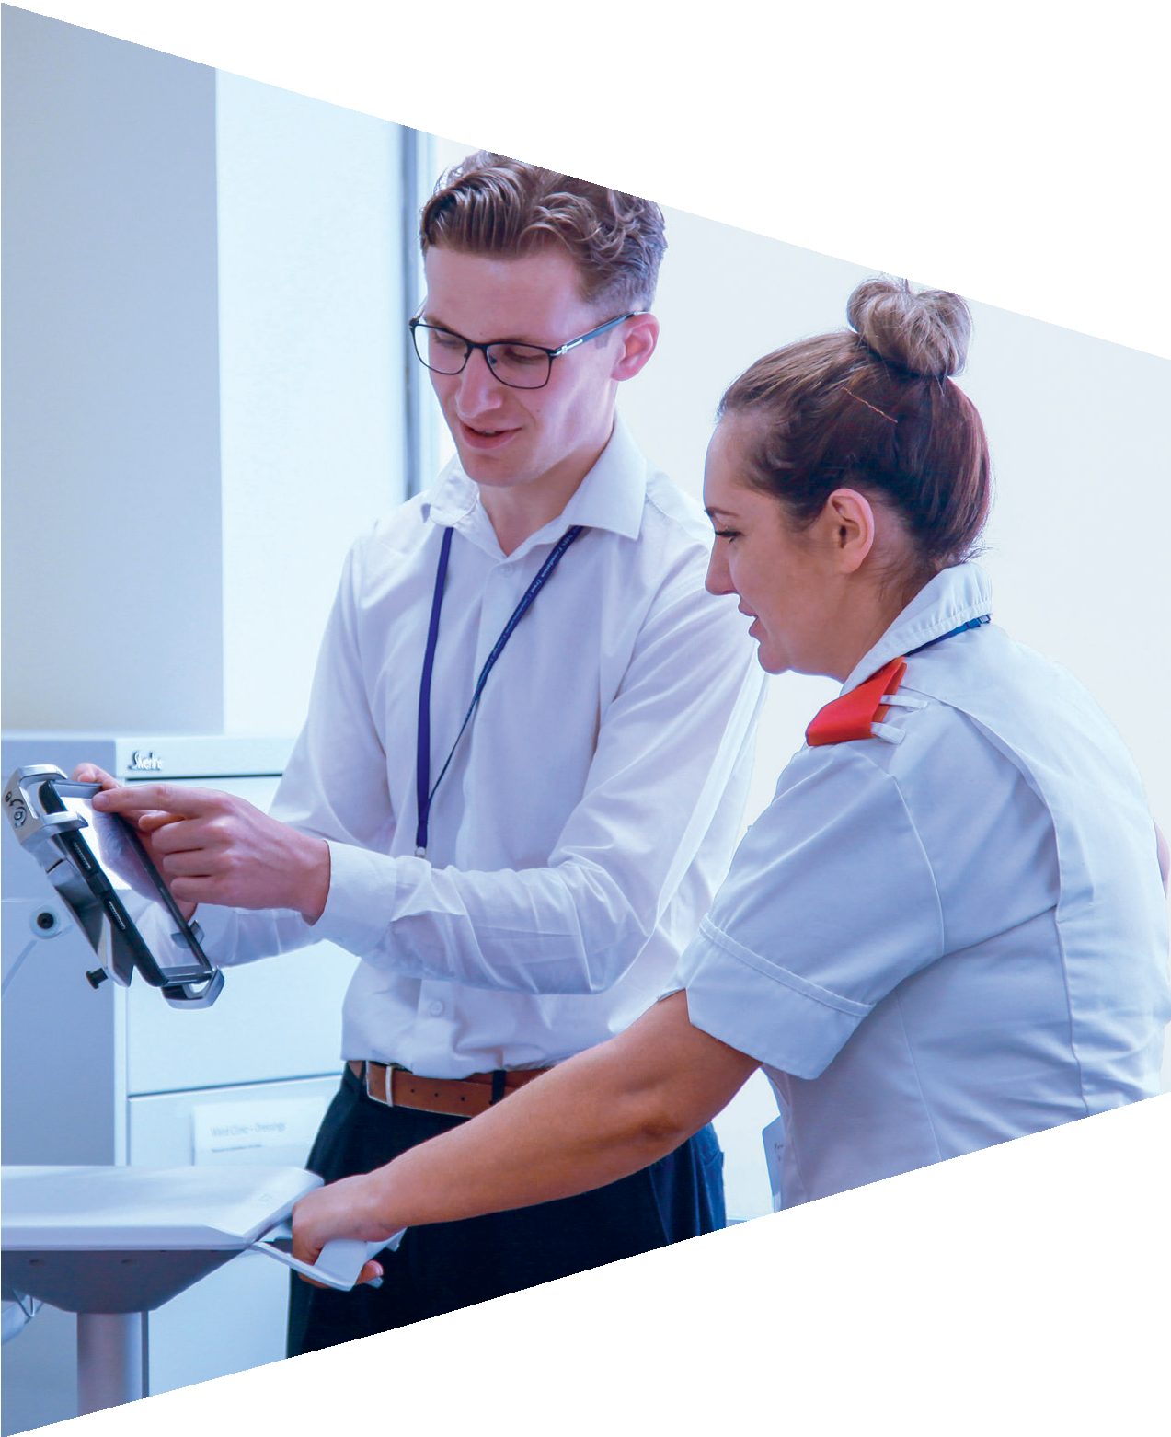

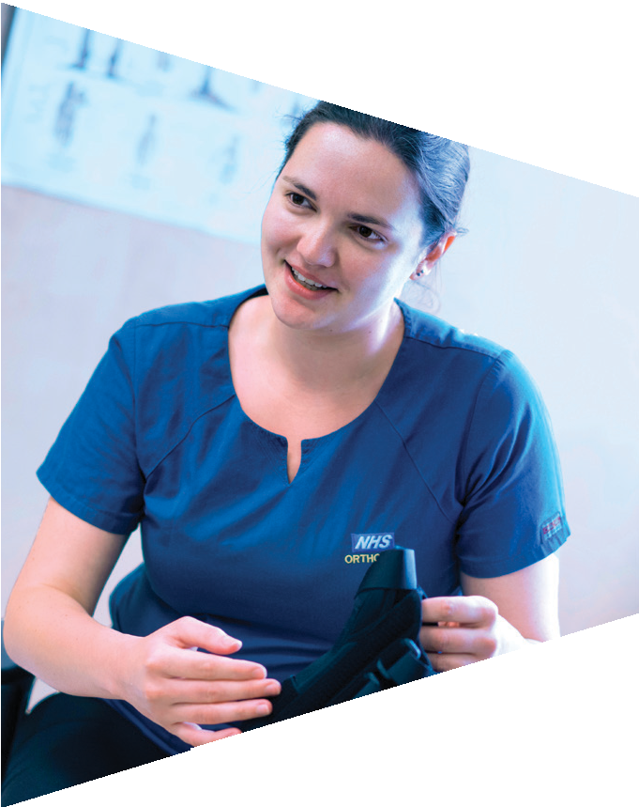
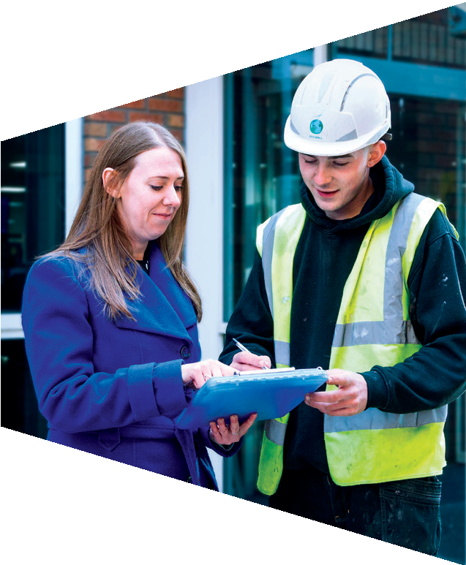





Topic 3: Verbal and non-verbal communication

Slide 2

Verbal and non-verbal communication
Verbal communication is the things we say.
Non-verbal communication is the things we don’t say, but communicate through our body language.
Both verbal and non-verbal communication are important and can say different things.
It is important we are aware of our own and others’ verbal and non-verbal communication.

Slide 3


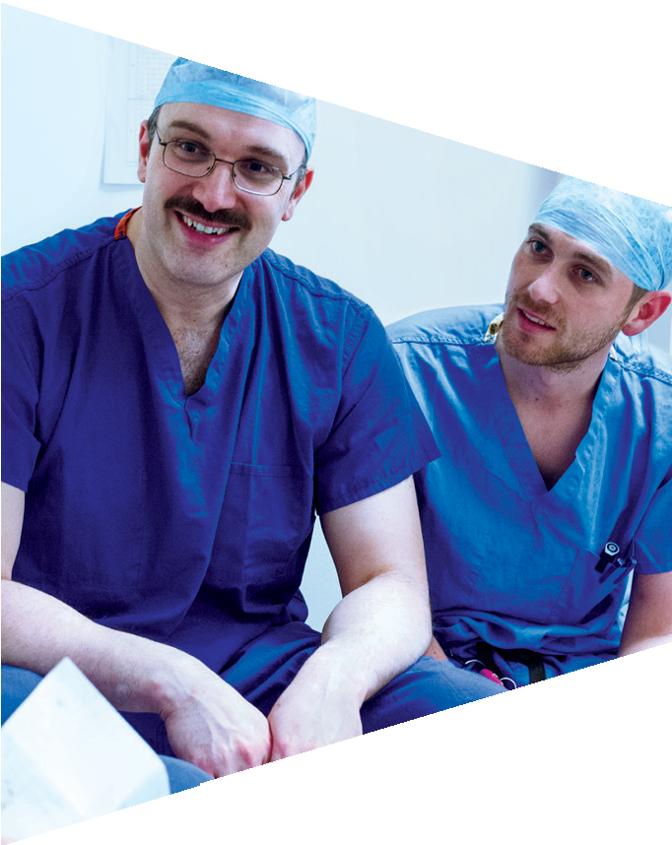
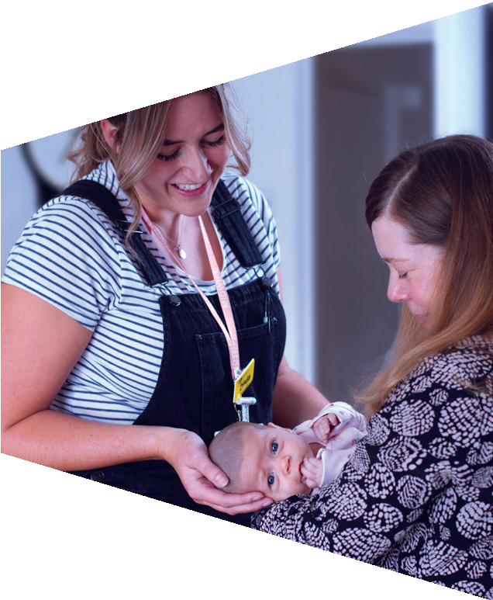

Activity 1: Interpreting body language

Slide 4


What messages are they conveying?

Slide 5
Body and face tense
Narrowed eyes
What messages are they conveying?
Frowning
Hands clenched
“I’m stressed and angry”

Slide 6

What messages are they conveying?

Slide 7
Looking down at the girl
Frowning, no smile
Head and eyes down
What messages are they conveying?
Mouth slightly down turned
Head turned away
Hand pointing
“I’m annoyed, angry”
“I’m in trouble”

Slide 8

Are they doing and saying the same thing?
“I’m finding this really interesting!”

Slide 9

Are they doing and saying the same thing?
“I’m fine”

Slide 10

Are they doing and saying the same thing?
“We’re feeling really confident.”

Slide 11
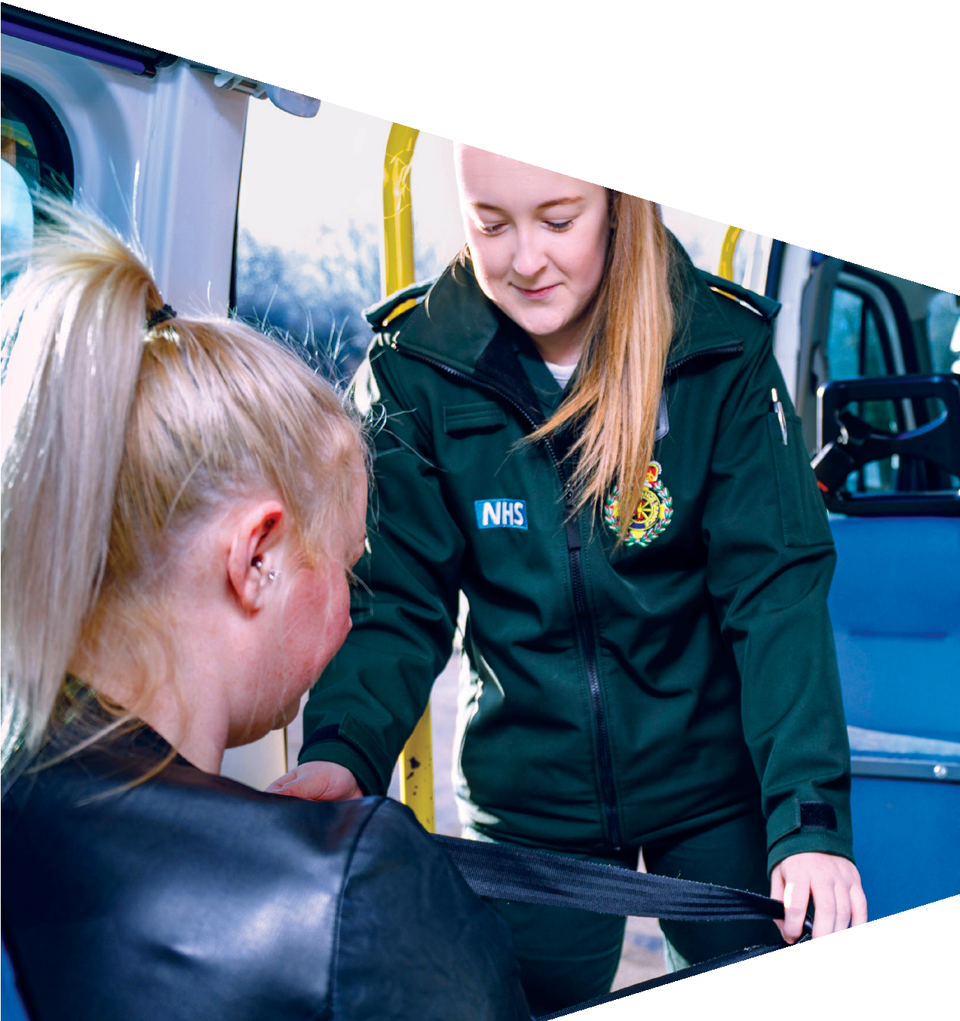

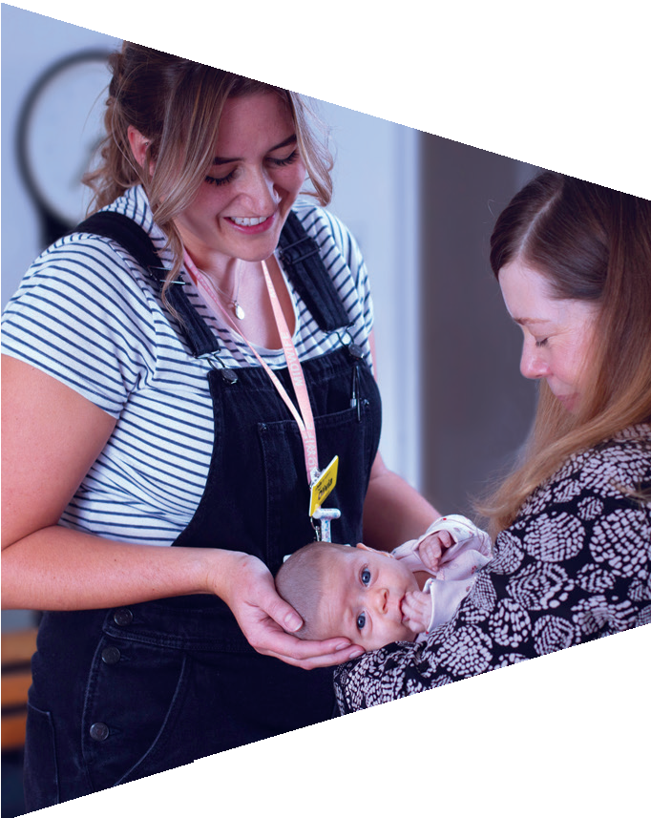



Why is it important to be aware of your verbal and non-verbal communication when going for a job interview?

Slide 12
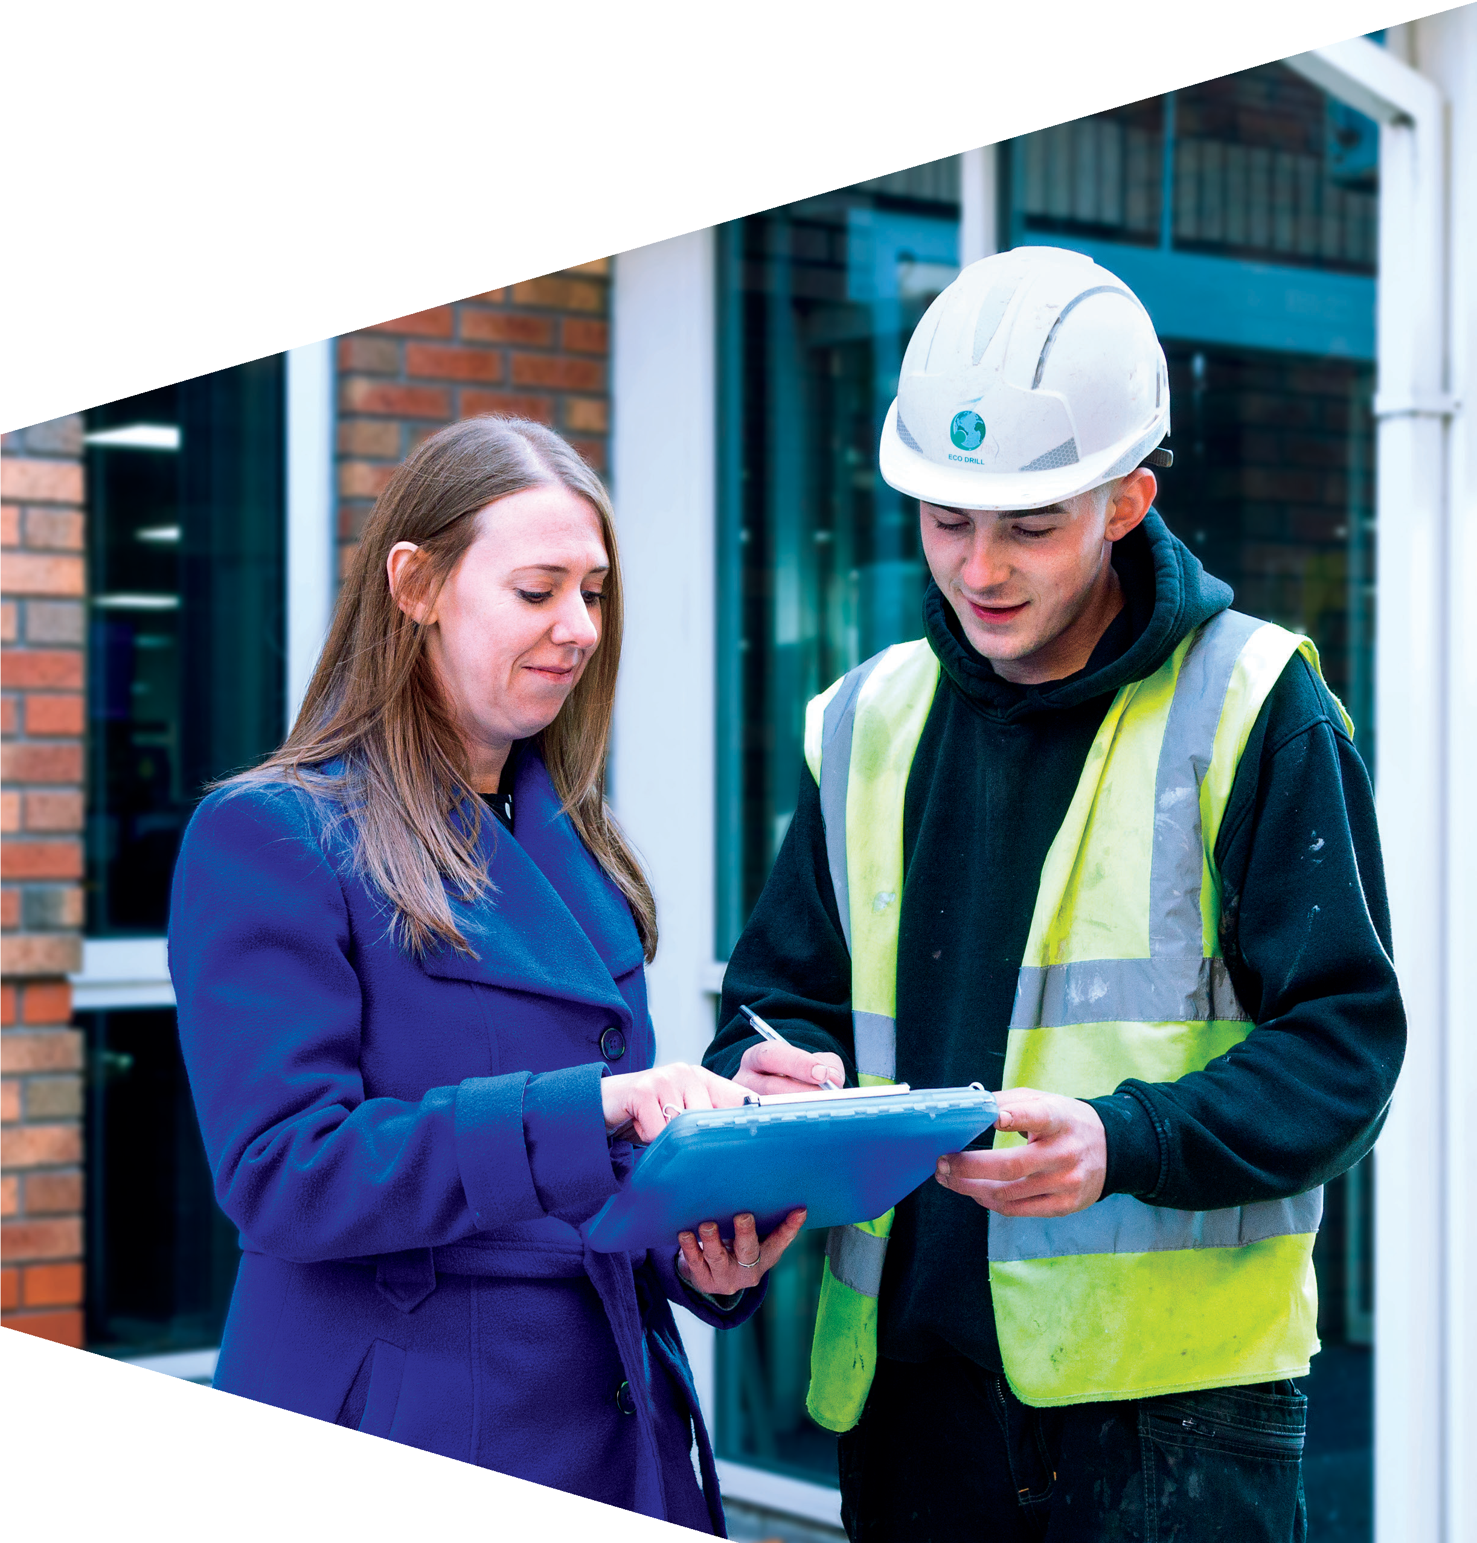
Job interview
Your CV and covering letter can secure you a job interview, but your non-verbal
communication can let you down on the day if you are not aware of the messages your body language is portraying.
For example, if you are saying you are confident, then your body language needs to say the same thing.

Slide 13

Job interview
What does the body language of these candidates tell you?

Slide 14

Job interview
What would the following body language communicate to an interviewer:
Crossed arms
Frowning face
Looking at the floor
Dressed in scruffy clothes
Tapping foot
Do you think this body language would help someone to secure a job?

Slide 15
Job interview
Remember, first impressions count and an interviewer’s decision will be largely influenced by ‘what you don’t say’.
So make sure you polish your non-verbal presentation as much as your verbal.

Slide 16
Job interview
Here are some ‘unwritten rules’ to follow when going to an interview:
Greet the interviewer professionally. E.g. ‘Good morning [first name], how are you?’ or ‘Nice to meet you’. Smile!
Avoid terms of endearment or slang! Can you think of any you use with your friends that wouldn’t be appropriate at an interview?
Show that you are paying attention. Maintain eye contact where you can and nod to show your understanding.
Put your mobile phone away and on silent or switched off.

Slide 17

Virtual job interviews
Today, many job interviews are held virtually.
How differently do you think you would have to prepare for a virtual interview? What would you have to prepare in your environment?

Slide 18
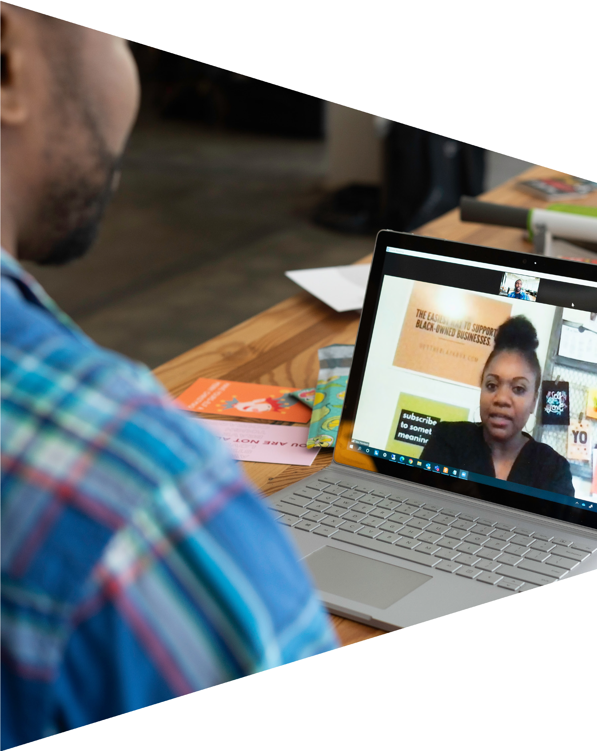
Virtual job interviews
How about the following?
Making sure:
Your head and shoulders are in frame and the camera is eye-level
You are facing the camera and not turning away
You have a background that is as plain as possible
There is no background noise
You will not be interrupted, e.g. by phones, people or pets!

Slide 19
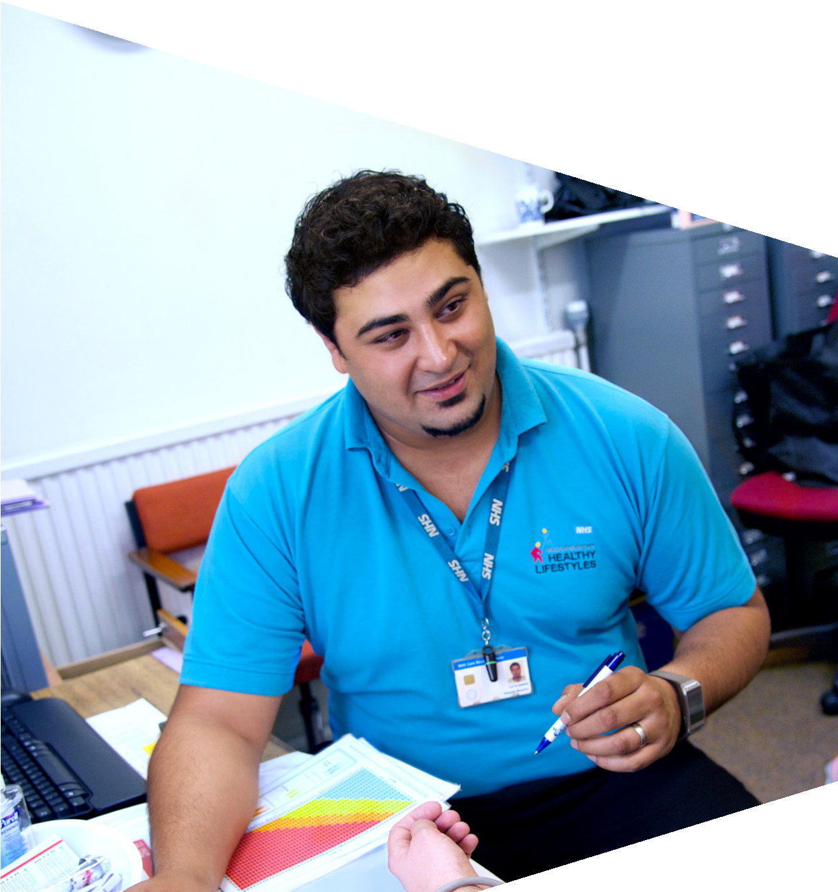
Why is it important that people who work in the health service are aware of their verbal and non-verbal communication?

Slide 20
Healthcare professionals
How would you feel if you went to the doctor and they presented the following body language?
Stared out the window the whole time they talked to you
Frowned at you when you were talking
Sat crossed arms and slouched in their chair
Dressed in a dirty, smelly shirt

Slide 21
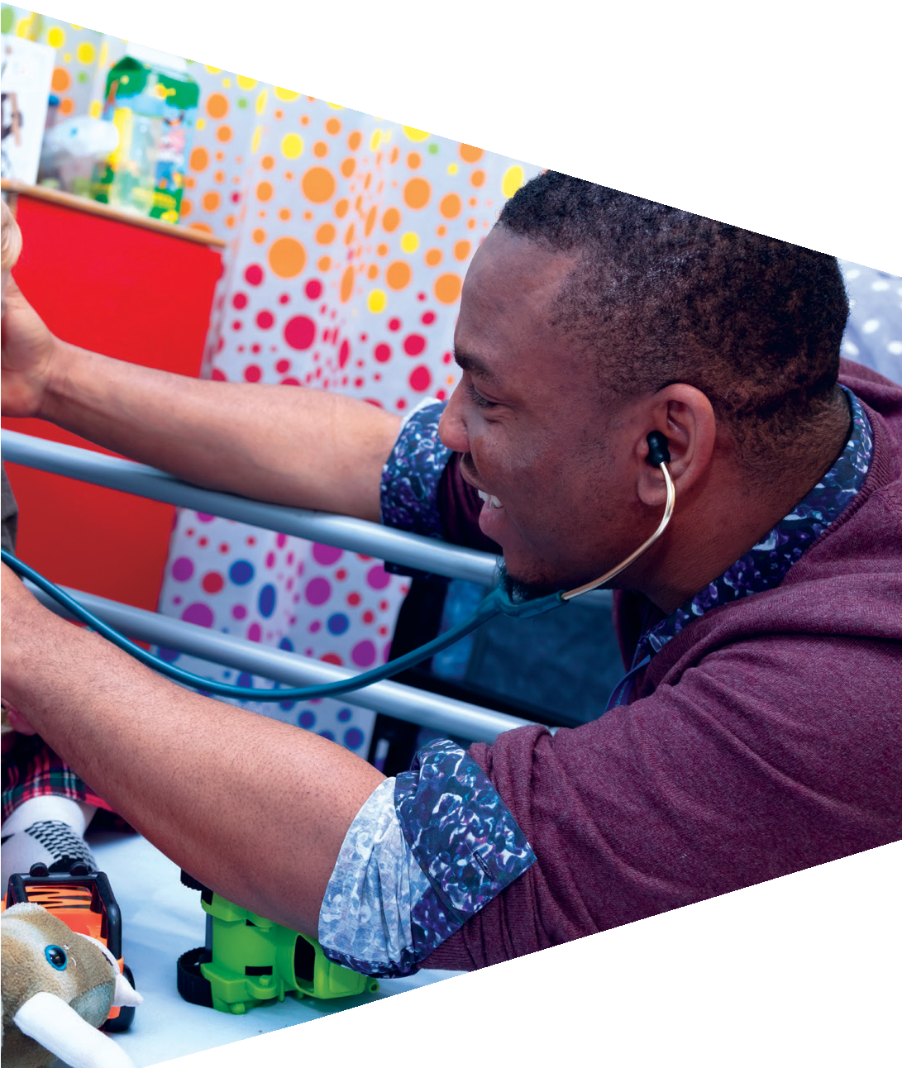

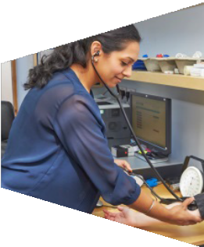
Healthcare professionals
It is really important that healthcare professionals convey body language that will make patients feel comfortable, safe and reassured.
Body language that could help to achieve this is:
  Open body language, e.g. arms open and facing forwards
  Smiling
  Professional appearance
  Eye contact
  Nodding to acknowledge listening

Slide 22
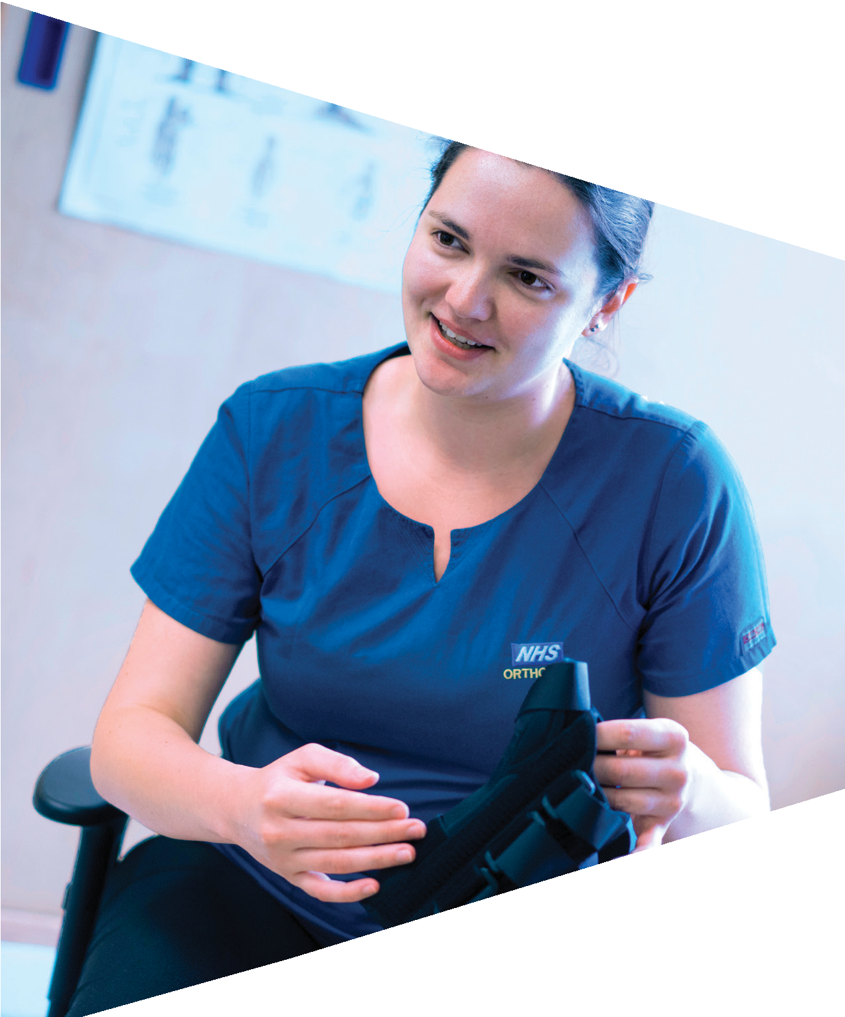
Activity 2: What am I communicating?

Slide 23
Body language facts
Did you know?
To show disgust we wrinkle up our noses and raise our top lip. This same expression is used in cultures worldwide
The smile is universal too. A genuine smile uses muscles around the eyes that we can’t fake
If you are interested in someone that is talking to you, your feet will usually be pointing towards them – even if you’re not actually talking to them
Animals know that if you narrow your eyes you are not pleased with them

Slide 24
Body language facts
Lots of body language gestures are about how others follow a leader. Watch what happens when you cross one leg, put your hand on your chin or move forward in your chair. Others will start to copy you! This technique is often used in interviews – and it can help the candidate to feel more relaxed
You can often spot when someone is not telling the truth by looking out for any (or all) of these signs:
  Little eye contact
  Sweating
  Too many hand movements
  Biting the fingernails
  Chewing of the inside of the mouth
  Swallowing (because the inside of the mouth is dry)

Slide 25
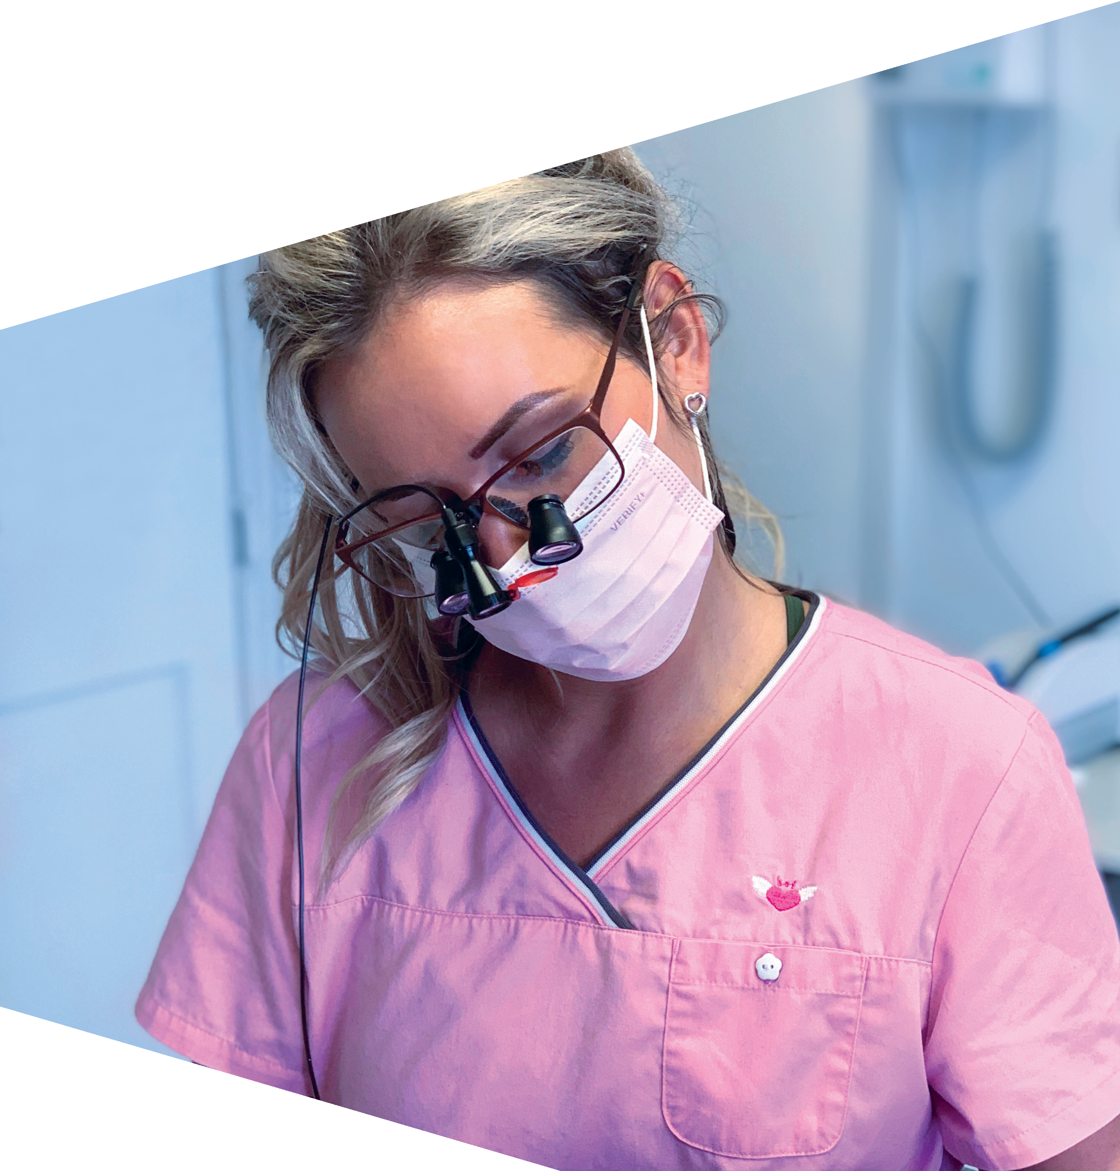
Challenge: What am I communicating?
Work in pairs.
Take it in turns to choose one of the prompt cards and then act out the emotion / feeling on the card to your partner. You can only use body language – no talking!
Your partner has to guess what emotion / feeling you are conveying.

Slide 26
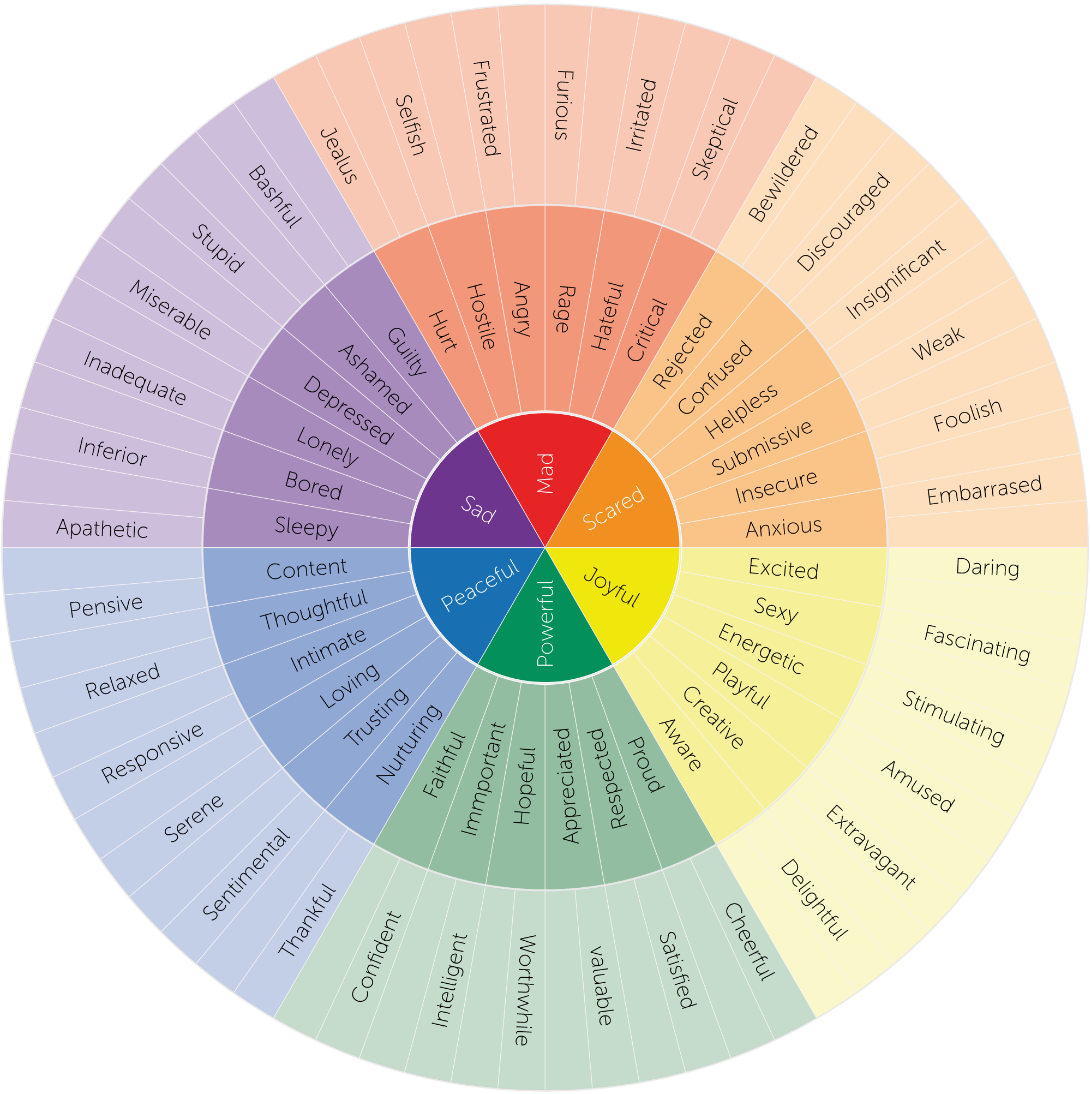
Challenge: What am I communicating?
This is an emotion wheel.
Using this wheel can help you identify feelings and how they relate to our core emotions.
Think about how you might be feeling before an important interview. What are the mixed feelings associated (outer circle)?
How can you harness these feelings to have a successful interview?

Slide 27

Activity 3: Observing body language

Slide 28
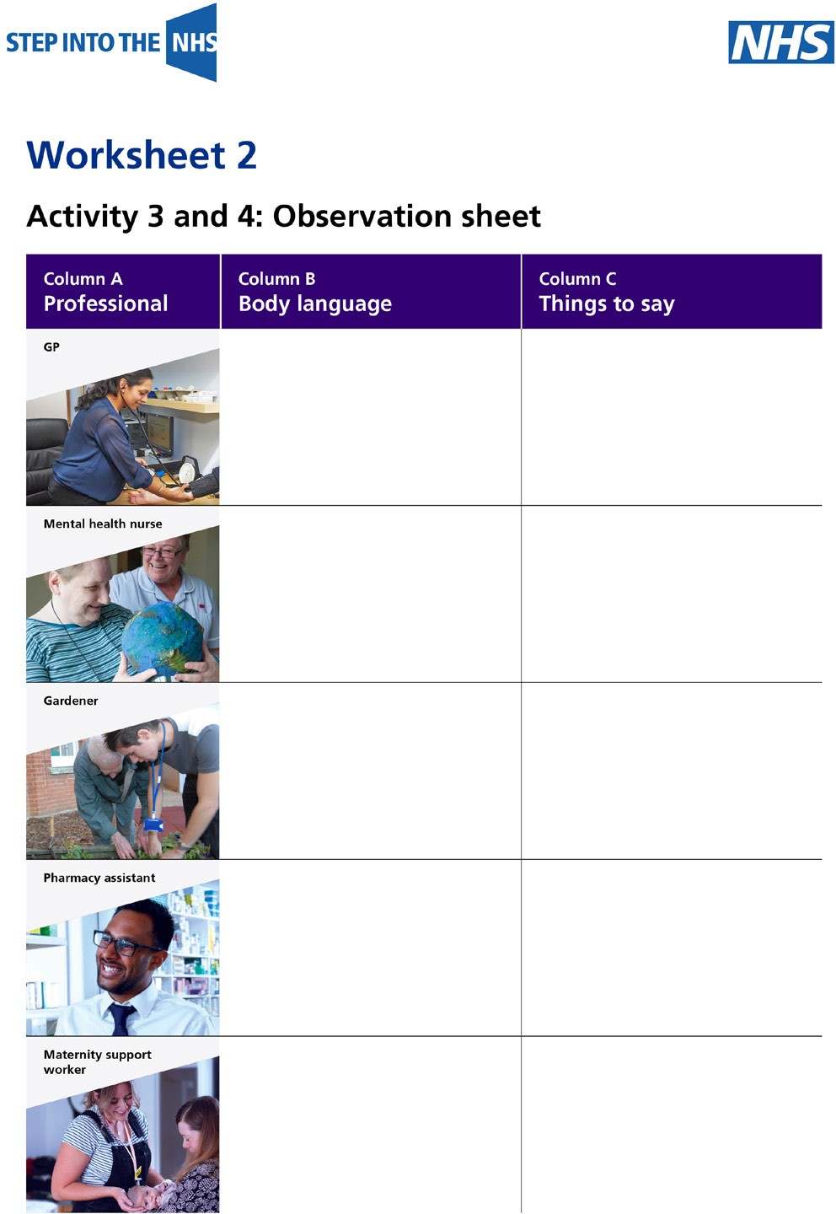
Observing body language
Look at the images on the next slides.
In column B of the worksheet, record the body language of the health professionals.

Slide 29
GP

Slide 30
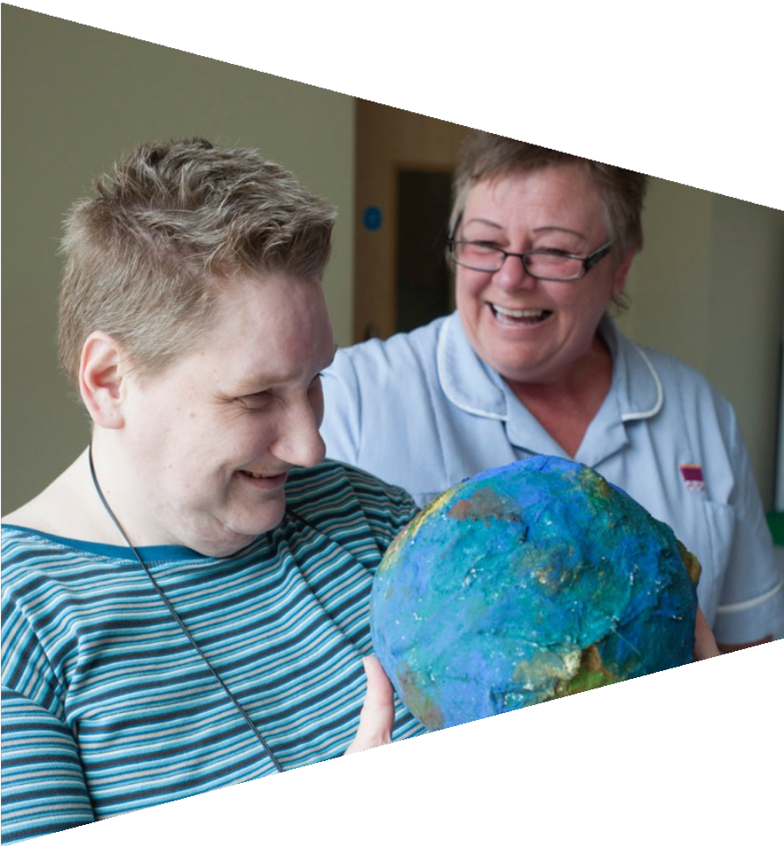
Mental health nurse

Slide 31
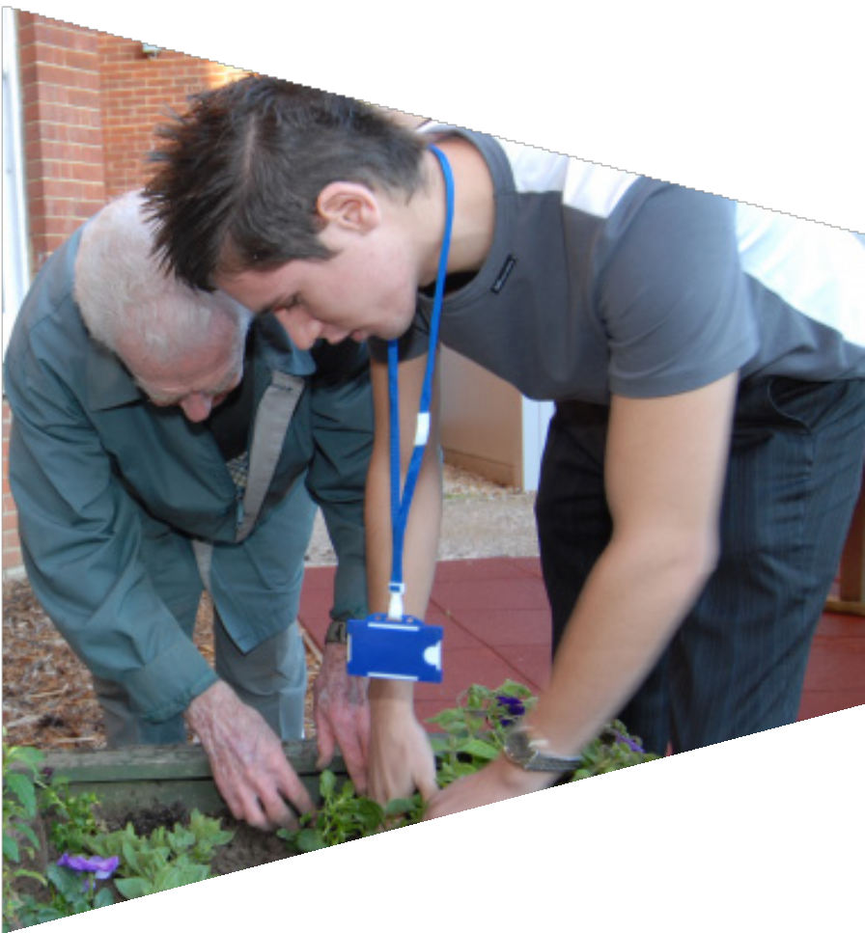
Gardener

Slide 32

Pharmacy assistant

Slide 33
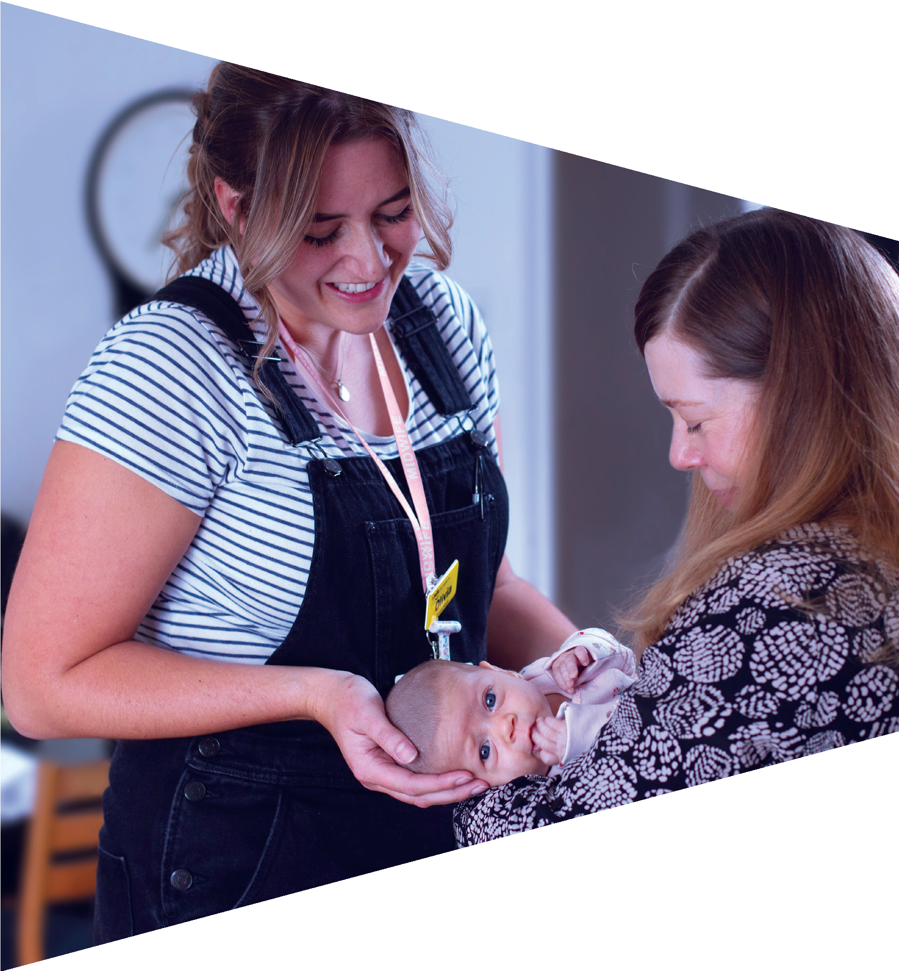
Maternity support worker

Slide 34
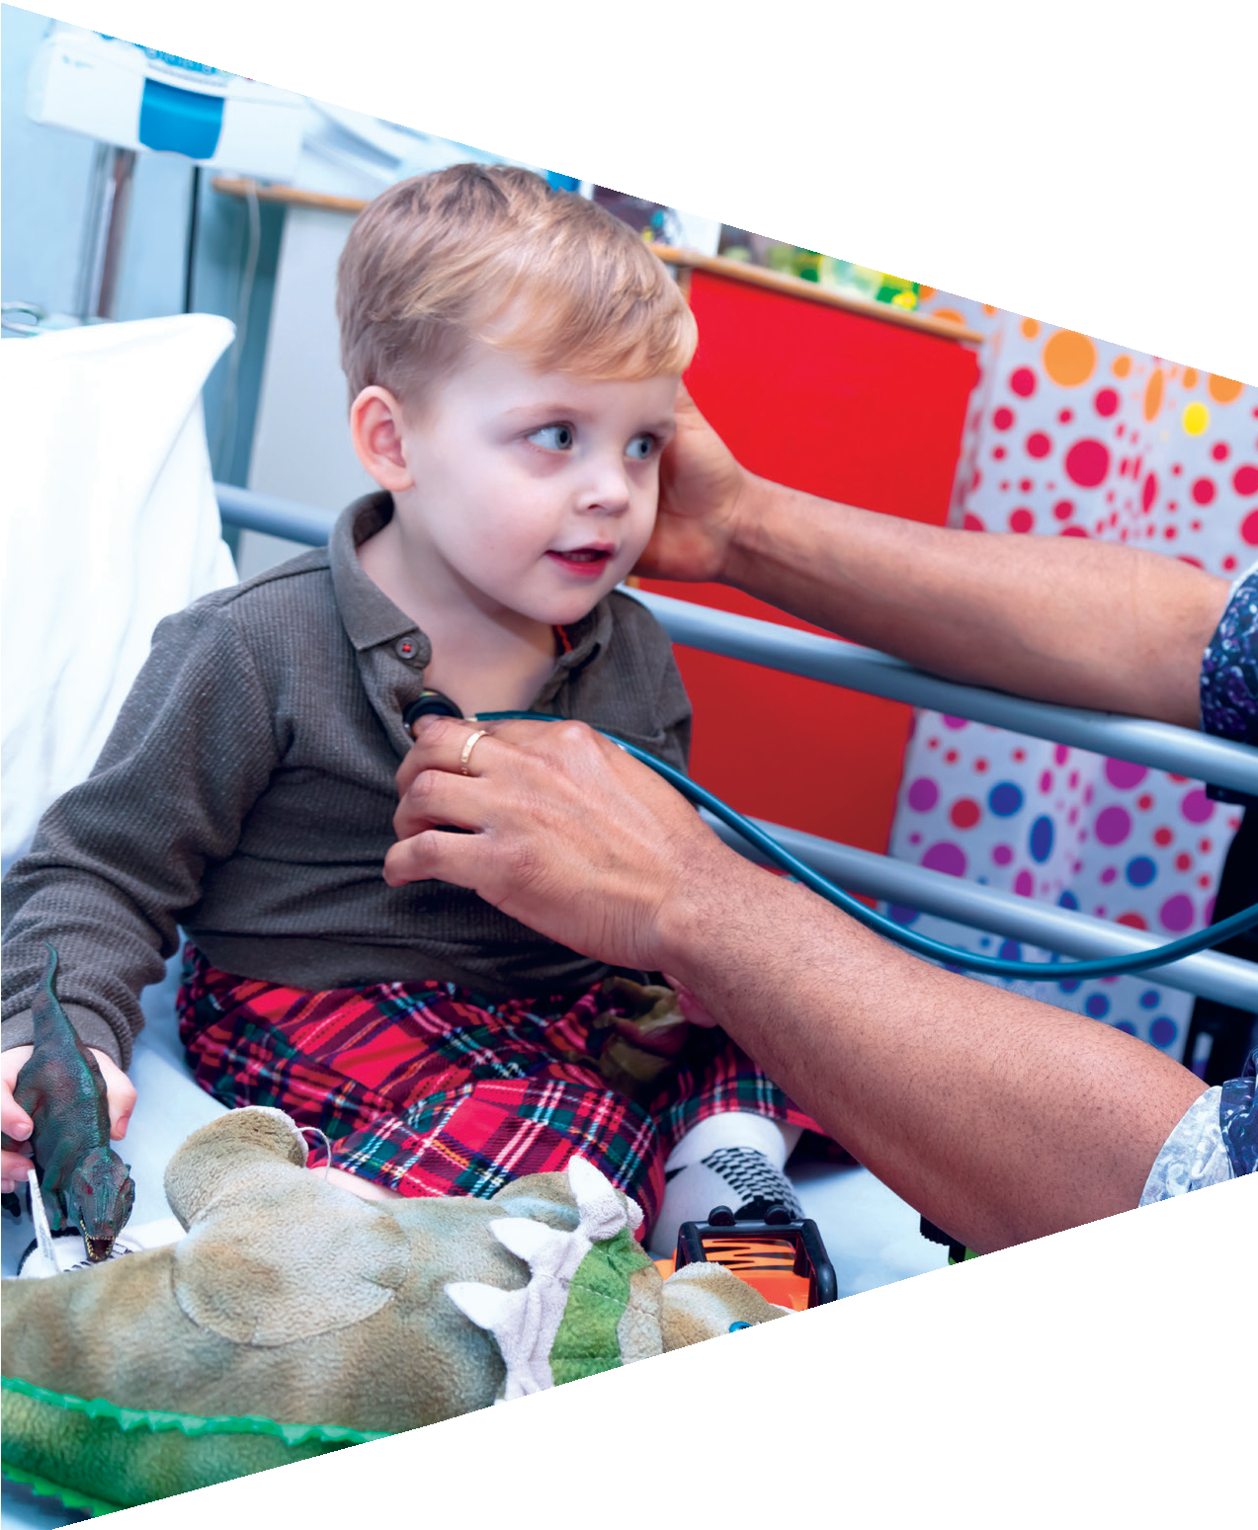
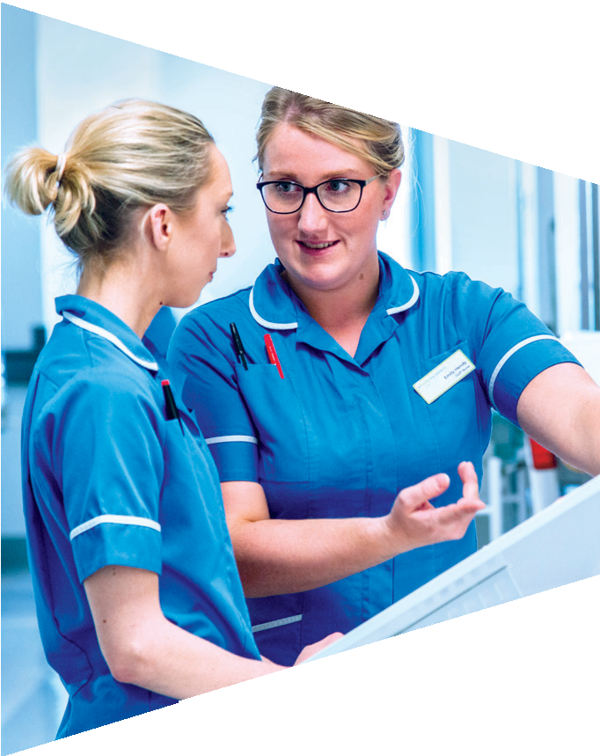
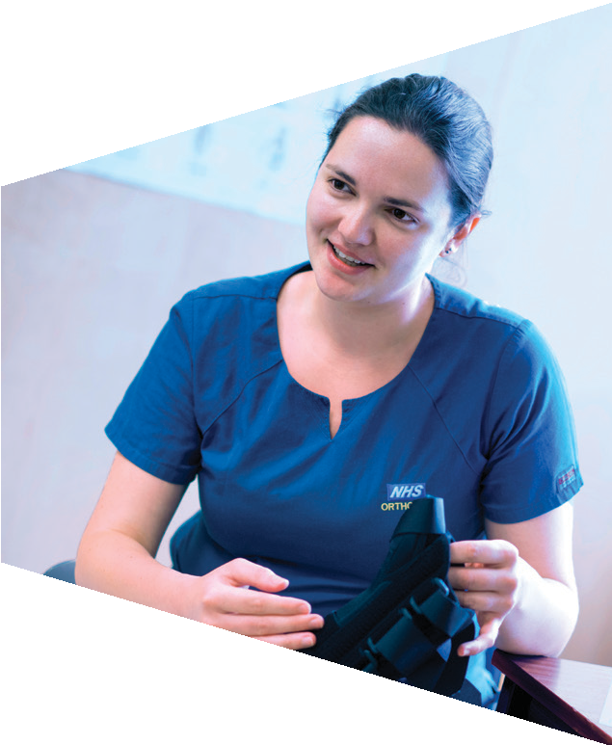
Activity 4: Verbal communication

Slide 35
Things to say
Take another look at the images.
In column C, write things that each person could say to reassure their patient.

