Slide 1

One lesson launch
1 hour
Notes:
This lesson plan covers all the learning needed for students to start their competition entries after one hour. Your students will need internet access during this lesson plan to research roles. They’ll also need copies of the job description activity sheet and job description top tips (from step two on stepintothenhs.nhs.uk/secondary-schools)

Slide 2

What’s in this lesson?
Watch the video as an introduction to the competition task and then work through the three steps:
Step 1 (slide 4): the discovery phase. Use some online tools to discover the variety of roles within the NHS (25 minutes).
Step 2 (slide 10): understanding the job. Research your chosen role and fully understand the responsibilities (25 minutes).
Step 3 (slide 14): the job advertisement. Begin thinking about creating your entry (10 minutes).

Slide 3
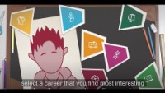
Introducing the competition
Watch the video to learn about the NHS and how to enter the competition.
Notes:
This video introduces the competition task and what students will need to do.

Slide 4
Step 1:
The discovery phase
Discover over 350 careers in the NHS
25 minutes
Notes:
During this step, students discover the breadth of careers in the NHS and select one to research in-depth. They will need access to the internet for this step.

Slide 5
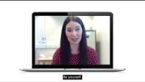
There are over 350 different careers available in the NHS!
Here are just some of the NHS team to tell you about their jobs.
Meet some of the NHS team
Notes:
Play the video and encourage students to make note of all of the jobs they like the sound of.

Slide 6

Discover over 350 NHS careers
Discover a wide variety of roles in the NHS using the following:
The Career mapper quiz
The Careers A-Z
We’ll show you how to use them on the next two slides.
At the end of this activity, you’ll need to decide which NHS career you’d like to advertise in your competition entry.
Notes:
Tell students they should use these tools to decide what career they’d like to advertise.

Slide 7
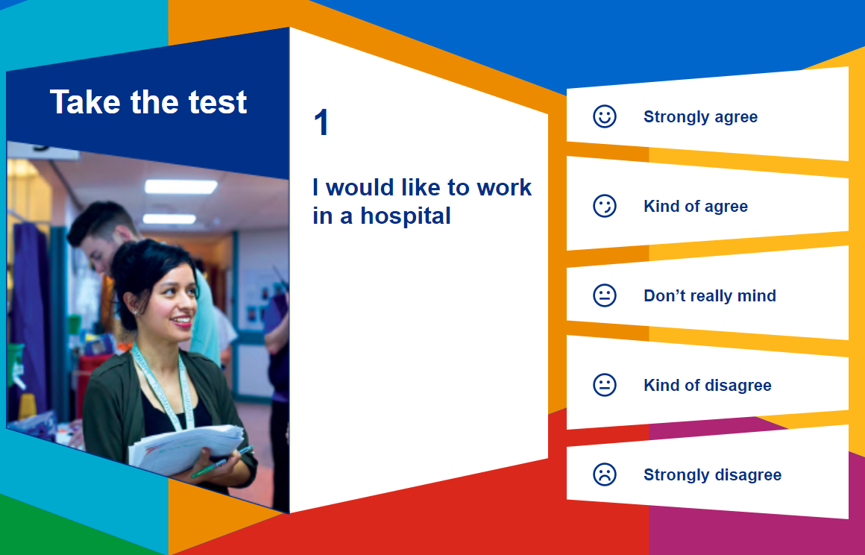
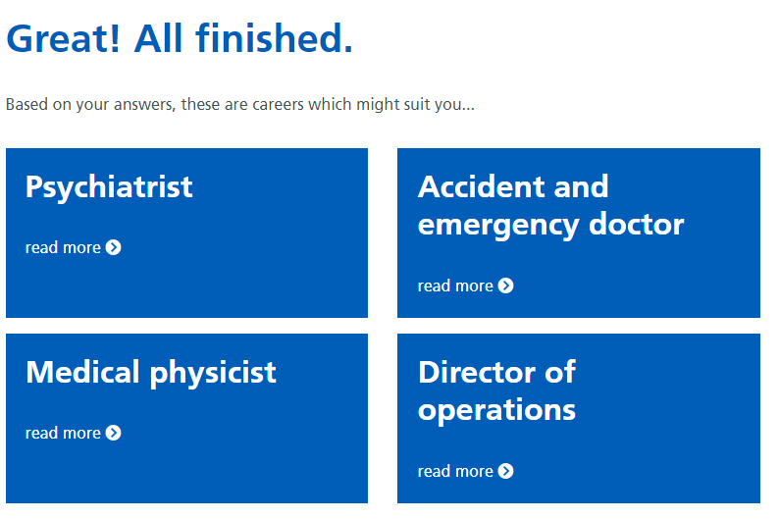
Take the test to see which careers best suit you, then select the results to learn more about each one.
Career mapper
quiz
Notes:
Example of tool 1 to talk through to students

Slide 8


Use the A-Z to discover a day in the life of some of the NHS team.
Careers
A-Z
Notes:
Example of tool 2 to talk through to students

Slide 9

Choose a career to advertise
Did any of the careers you learnt about sound like you?
Did you discover a role you didn’t think existed in the NHS?
Which career did you pick for the competition?
Notes:
After their research, discuss what careers they discovered and which one they decided to choose.

Slide 10
Step 2:
Understanding the job
Now it’s time to research your chosen career
25 minutes
Notes:
During this step, students research their chosen career in terms of qualifications, skills and experience. You’ll need the job description activity sheet and job description top tips sheet to hand out to students. (from step two on stepintothenhs.nhs.uk/secondary-schools)

Slide 11

Research your chosen career
Now, you’ll need to look at any qualifications, experience and skills required to do your chosen career.
This information is usually included in something called a job description.
Use the job description activity sheet to help you gather the information you need for your entry.
Notes:
You’ll need to explain to students that a job description helps you understand a specific role by spelling out its responsibilities. It also details any qualifications, experience and skills required to do the job properly. Explain that they need to find out all of these details for their chosen role. To help with this research, they can either complete the job description activity sheet or create their own job description. NOTE: The job description is no longer a required part of the final entry and does not need to be submitted.

Slide 12
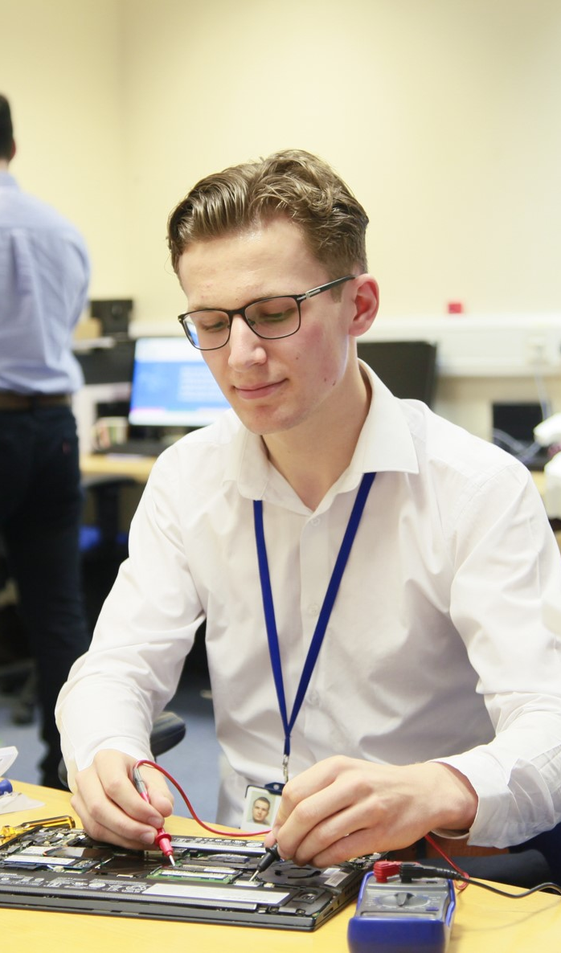
Research your chosen career
Use the job description top tips sheet to help you with your job description.
Notes:
The top tips sheet offers further hints they may wish to consider.

Slide 13


Research your chosen career
You can:
Use the career mapper quiz and the A-Z
Do some research online (make sure all information comes from websites in England!)
Notes:
This further research can be set as a homework activity.

Slide 14
Step 3:
The job advertisement
Get started on creating an exciting entry
10 minutes
Notes:
During this step, students create a fun, creative and unique advertisement to tell other young people about the role. It should show the research students have completed and explain any skills, experience or qualifications the role requires.

Slide 15


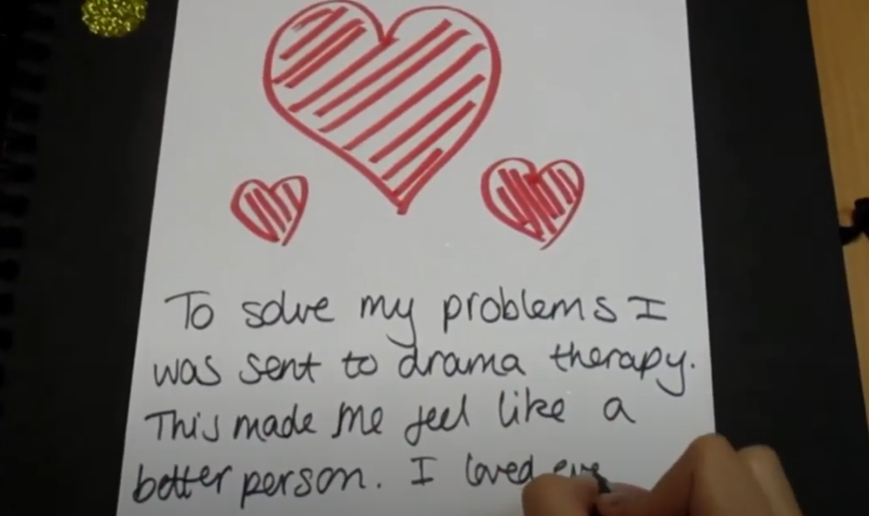
Examples of previous entries
  Previous winners have produced posters and leaflets, videos, websites and even video games!
Notes:
Inspire your students by showing them examples of previous winners’ entries.

Slide 16
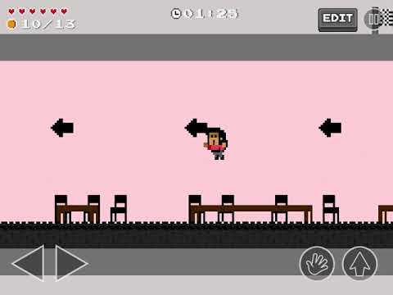
Career chosen: Psychiatrist
Entry type
Video game to explain ​
the day in the life of a psychiatrist, explaining what the role involves and its responsibilities.

Slide 17
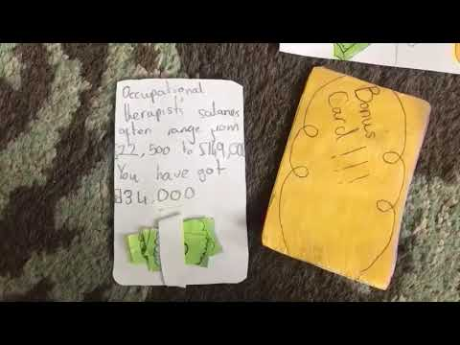
Career chosen: Occupational therapist
Entry type
Video to explain
the role and responsibilities
of an occupational therapist.

Slide 18

Career chosen: Paediatric nurse
Entry type
Video to explain
the role and responsibilities
of a paediatric nurse.

Slide 19
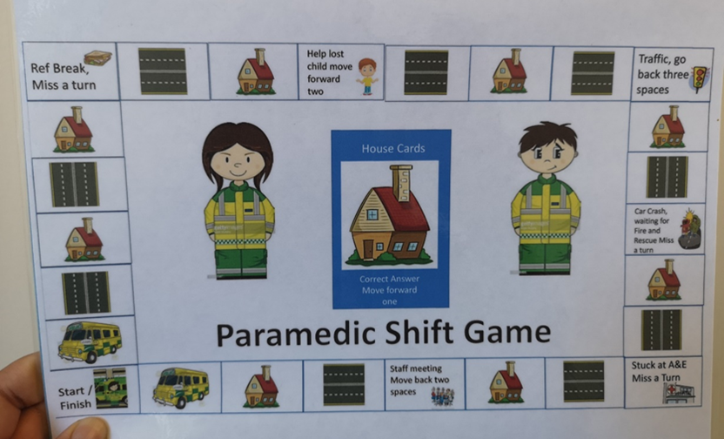
Career chosen: Paramedic
Entry type
Board game to understand the role and responsibilities of a paramedic.

Slide 20
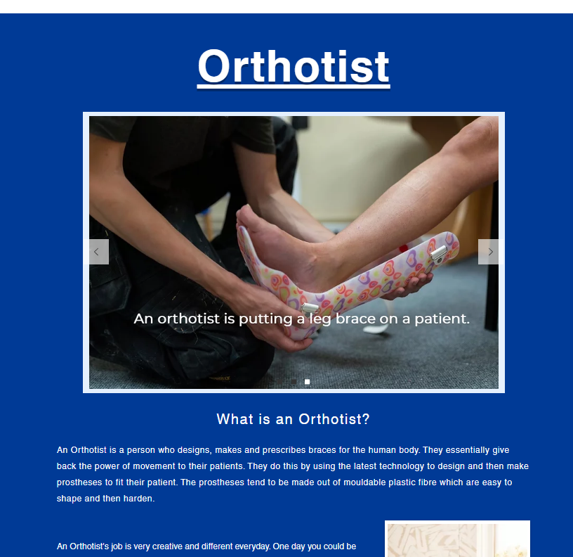
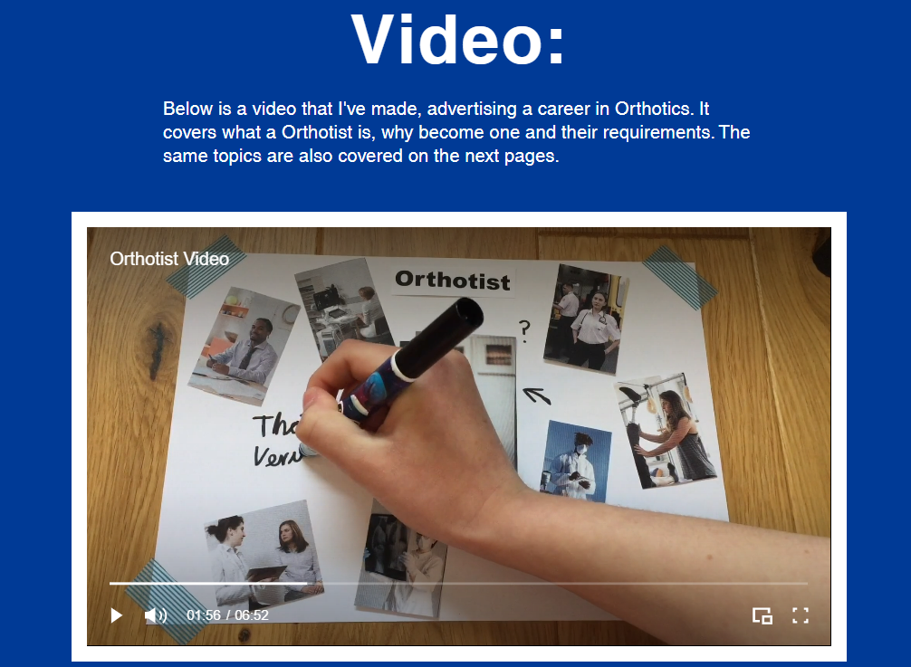
Career chosen: Orthotist
Entry type
Website to explain the role of an orthotist including a stop motion video, some key information about the role, and a gallery of orthotist images.
Visit:
Click to view

Slide 21

Career chosen: Psychotherapist
Entry type
Plastic puzzle,
with each piece highlighting a
fact about psychotherapy,
and a website.
Visit:
Click here for link

Slide 22
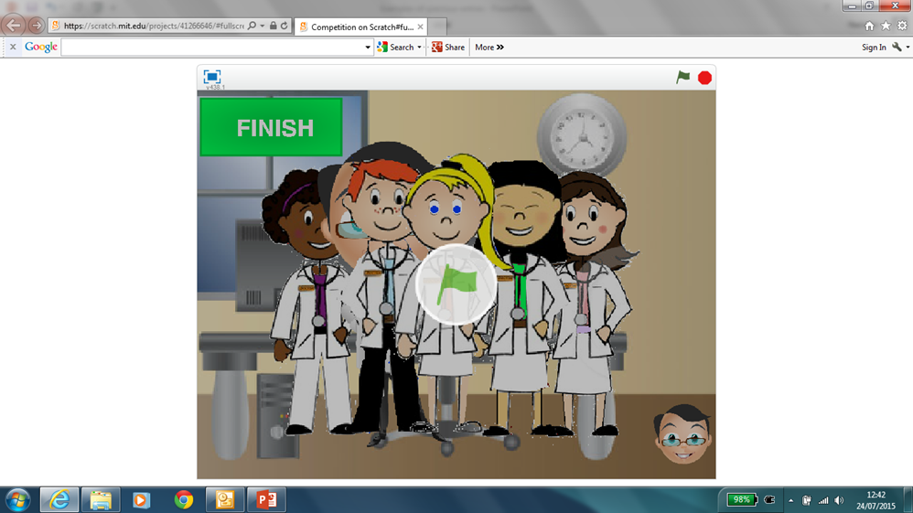
Career chosen: Neuroradiologist
Entry type
Computer game to explain the role of a neuroradiologist
Visit:
Click here for link

Slide 23

A reminder of the prizes
Overall national winner
artwork displayed in public as a real-life job advert
Amazon voucher worth £50, plus an NHS goody bag
a prize for your school!
a framed certificate
Regional winners
Amazon voucher worth £20, plus an NHS goody bag and certificate
If you’re highly commended…
a highly commended certificate with judges’ comments
Whether you enter individually or as a group, each of you will receive a prize if your entry is chosen. Winning and highly commended entries will be showcased on our website!
Notes:
Students can enter individually or in groups of up to 4.

Slide 24

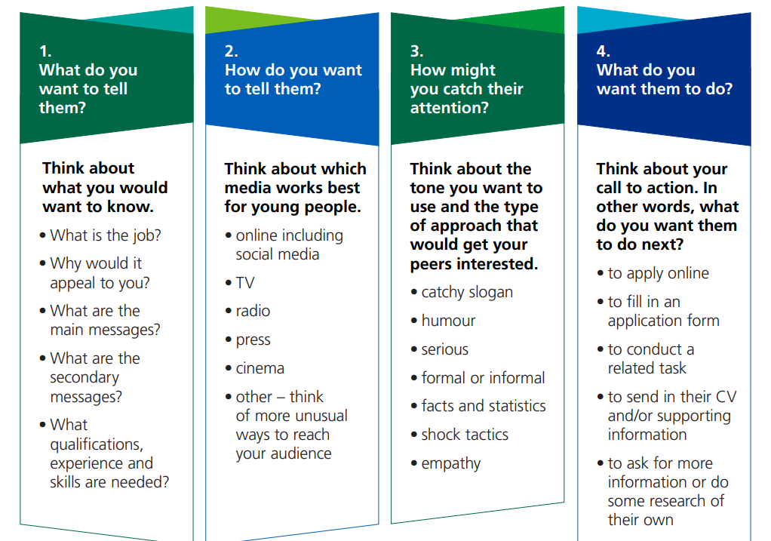
Time to get started
Now you understand your chosen career, create a fun and lively job advertisement.
It should show the research you have completed and explain any experience or qualifications the role requires.
Our guidance sheet can help you with your planning.
Notes:
You can download the job advertisement guidance sheet (from step three on stepintothenhs.nhs.uk/secondary-schools)

Slide 25
Best of luck!
Together we can make a difference!

