Slide 1

One lesson launch
1 hour
Notes:
This lesson plan covers all the learning needed for pupils to start their competition entries after one hour. Before the lesson you will need to have downloaded the Who am I? and Danny’s story cards worksheets for your pupils from the Step into the NHS website.

Slide 2
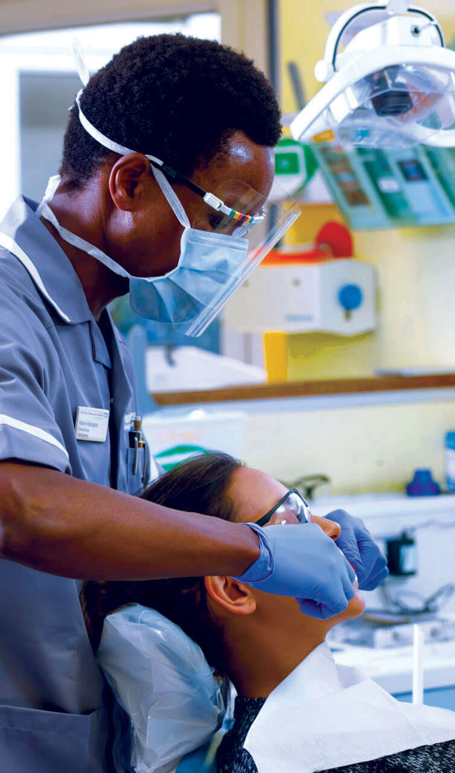
What’s in this lesson?
Part 1 (slide 3): pupils complete a worksheet activity to learn what they are good and some facts about the NHS that might surprise them (15 minutes).
Part 2 (slide 8): pupils undertake two interactive activities to explore a wide range of jobs in the NHS (25 minutes).
Part 3 (slide 16): pupils take a quick class quiz about the NHS to dispel misconceptions and stereotypes (10 minutes).
Part 4 (slide 18): pupils watch the video and learn how to create their competition entries (10 minutes).

Slide 3
Part 1:Who am I?
  ‘Like me’ or ‘Not like me’
15 minutes

Slide 4
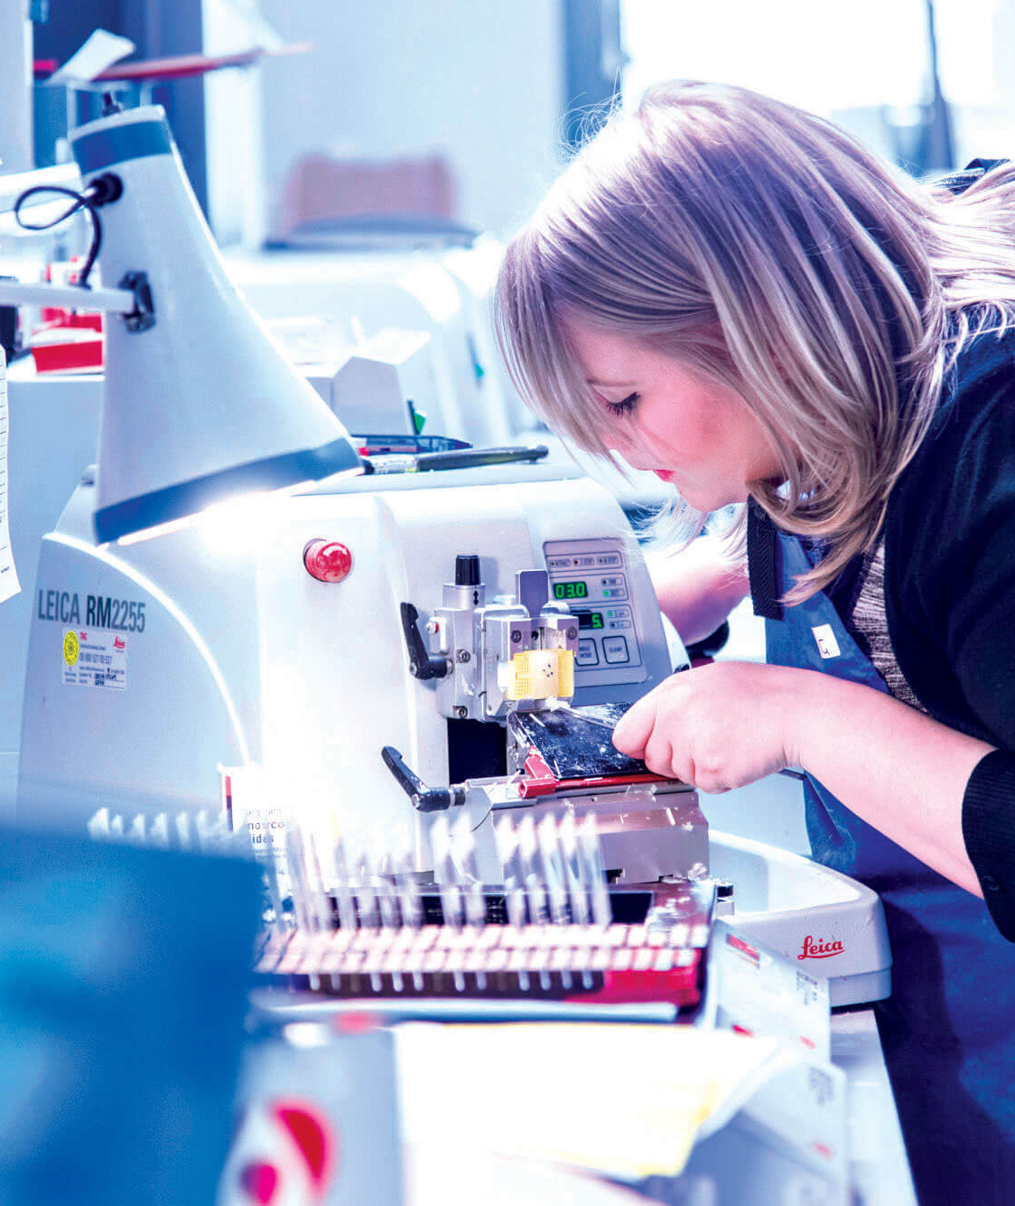
Who am I?
What do you think you might want to
do when you grow up and why?
How do you think you can get there?
Notes:
Make sure you have downloaded the Who am I? worksheet (from part one on stepintothenhs.nhs.uk/primary-schools) and provided this to your pupils. For this slide, you can create a class list of their preferred jobs then discuss how they can achieve them. For example, what do they need to be good at? Do they need to go to college and/or university?

Slide 5
Who am I?
Different jobs require different skills and knowledge.
Tick the things that are most like you.
Put a cross against the things that are least like you.
Notes:
Explain that different jobs require different skills and knowledge. For example, someone who takes x-rays in hospital needs to be interested in technology. Someone who helps wash and dress patients needs to be cheerful and friendly. Someone who tests blood needs to be good at concentrating on detailed tasks.

Slide 6
Who am I?
Describe yourself to the person next to you. Use the things you have ticked on the sheet to help you. Think about why you made those choices.
Did you learn something new about your partner?
Notes:
Pupils complete the worksheet. They describe themselves to the person next to them, giving reasons to explain why they made those choices.

Slide 7
Who am I?
Show of hands
Did you put a tick against this point?
I think I can do any job I want in the future if I work for it
Is there anything you think you can’t do?
If so, why?
Notes:
Through a show of hands, find out how pupils marked the point, ‘Think I can do any job I want to in the future if I work for it.’ Discuss this point in more detail. Challenge assumptions that suggest certain characteristics are exclusively male or female. For example, are there any characteristics the girls have unanimously rejected? Were any non-traditional choices made?

Slide 8
Part 2: Discover NHS job roles
  How many NHS job roles do you know?
25 minutes

Slide 9
Talk to your partner about what jobs there might be in this community
Notes:
Show the community scene. How many different jobs can they think of?

Slide 10
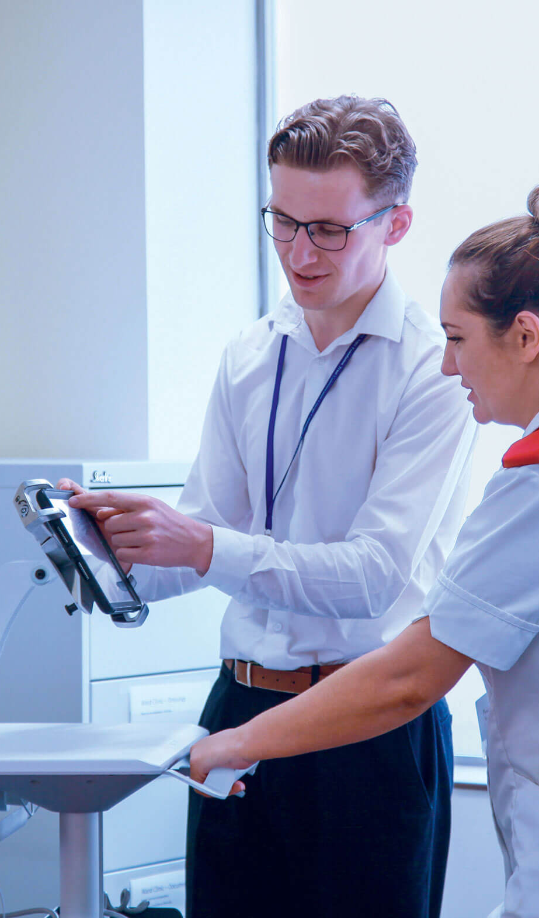
Community job search
Which jobs did you think of with your partner?
Let’s have a look at the jobs available in this community.

Slide 11
Gym
Physiotherapist: helps with bending and moving after injury
Dentist
Dentist, dental nurse, dental technician: check and look after your teeth
Bank
Finance manager: deals with money matters
Care home for
the elderly
Healthcare assistant: helps the elderly with their needs (washing, dressing, hygiene)
Optician
Optometrist: looks after your eyes
Supermarket
Lots of jobs, including managers, human resources (train and find new people to work), baker and cook, pharmacist, security staff
Local chemist
Pharmacist: prepares medicine
Launderette
Laundry assistant: sorts and cleans washing
GP
Doctor, practice nurse, receptionist: usually the first people you go to when you feel unwell
Restaurant
Chef: cooks tasty food
Ambulance
Paramedic: transports people to hospital
Offices
IT staff: sets up computer equipment
Personal assistant: helps the managers organise their day
Facilities manager: helps look after the building, including heating and lighting
Accountant: looks after the company’s money
School
Teacher: teaches you;
School nurse: looks after your wellbeing;
Caretaker: looks after the school building;
Catering staff: prepares and serves meals.
Green spaces
Gardener: makes sure green spaces are neat and tidy
Notes:
Please use Slide Show mode and click to reveal each job.

Slide 12

Community job search
Which of these jobs do you think
you can do for the NHS?
Where do you think you would work if you
have a job working for the NHS?
Notes:
Ask which of these jobs can they do for the NHS and where would they work?

Slide 13
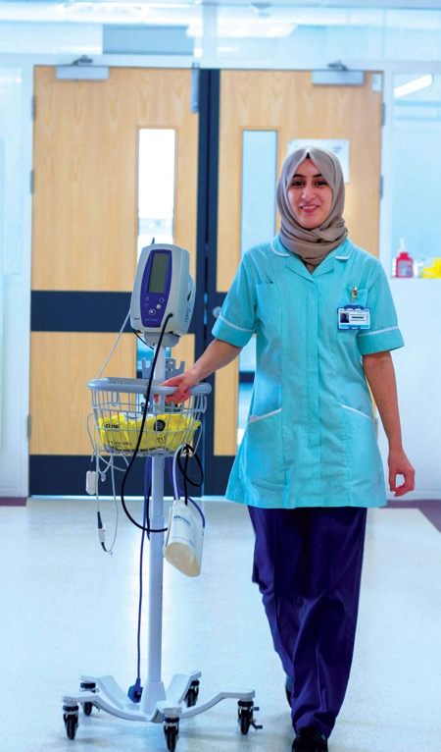
You can do all of these jobs for the NHS!
If you work for the NHS, you can work in:
  a hospital
  in a surgery or clinic
  in the community
  in an ambulance
  in an office
  in a laboratory
  in a patient’s own home
There are more than 350 jobs in the NHS!
Notes:
Explain that they can do ALL of the jobs for the NHS in a variety of places – it’s not just doctors and nurses working in a hospital!

Slide 14
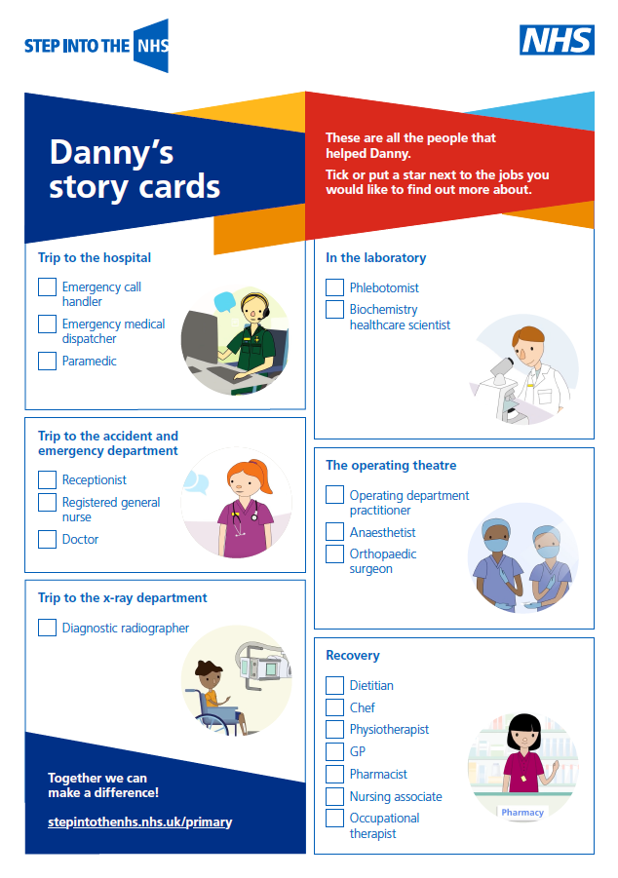
Danny’s story
How many different people working in the NHS help Danny?
As you hear Danny’s story,
are there any jobs that sound interesting to you?
Notes:
Before playing the video, hand out Danny’s story card sheet (from the extra resources section on stepintothenhs.nhs.uk/primary-schools), which you will need to download prior to the lesson. As pupils listen to the story, they mark the jobs they want to find out more about.

Slide 15
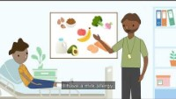
Danny’s story
  Who does Danny meet from the NHS and how do they help him?
Notes:
Once you have played the video discuss the jobs they chose.

Slide 16
Part 3: Did you really know?
  Quiz time
10 minutes
Notes:
Explore our new online quiz to surprise and dispel misconceptions (stereotypes and limited types of jobs) and to test what your pupils already think about the NHS.

Slide 17
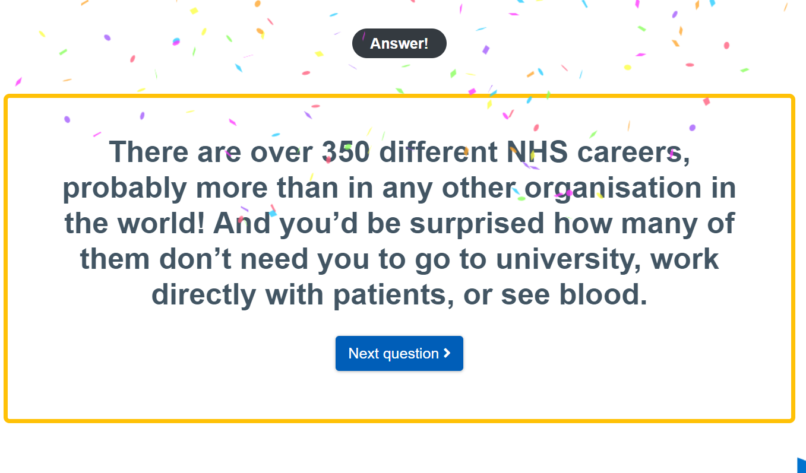
Did you really know?
How much do you
know about the NHS?
Take the quiz online!
Notes:
Explore our new online quiz to surprise and dispel misconceptions (stereotypes and limited types of jobs) and to test what your pupils already think about the NHS.

Slide 18
Part 4: The competition task
Get started on creating an exciting entry
10 minutes

Slide 19

Watch this video about the NHS
and our exciting competition.
Notes:
This video tells pupils a bit about the NHS and what they need to do to enter the competition.

Slide 20
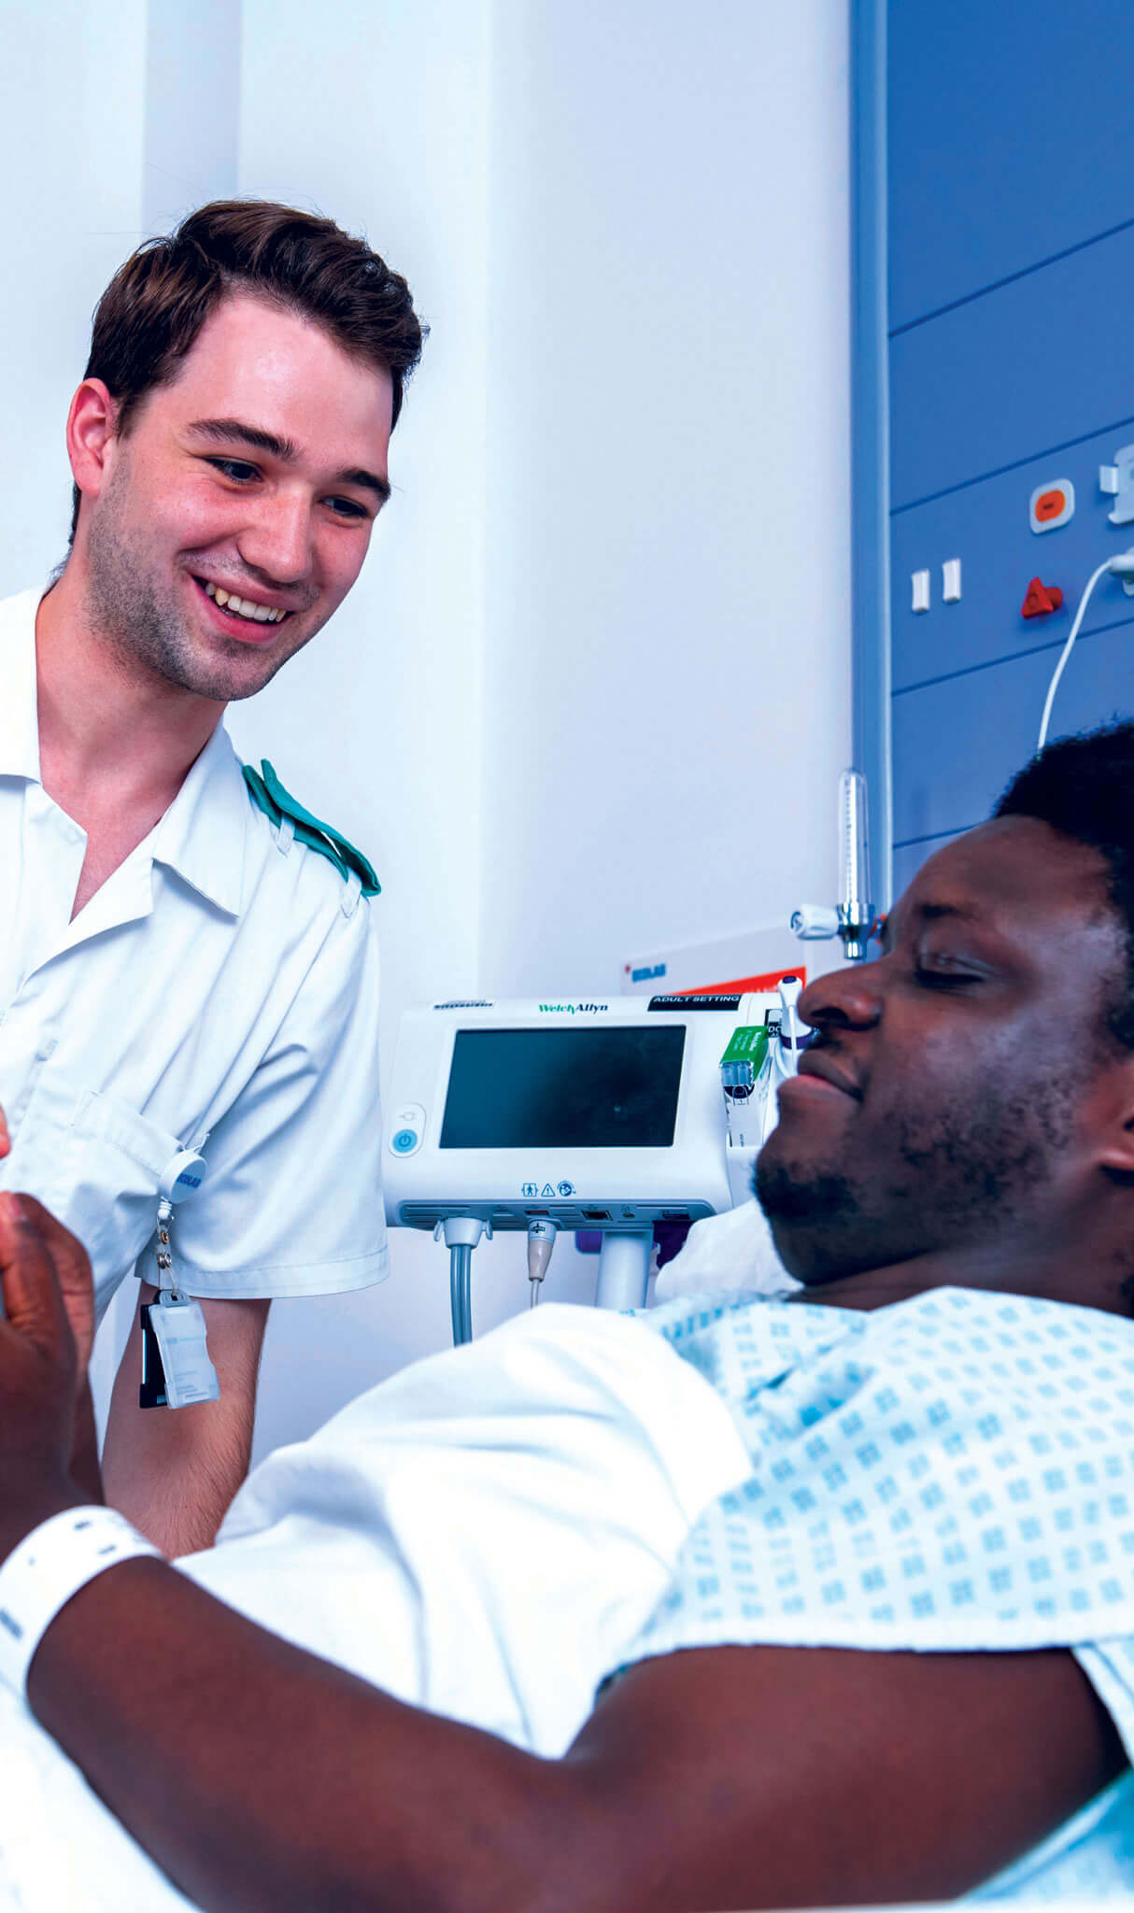
How will you showcase the variety of jobs in the NHS?
Get creative...
Produce a piece of artwork ̶ a painting, drawing, video or collage, for example.
or
Write something about it ̶ a poem, story or song.
Remember, we want to see lots of different jobs within the NHS!
Notes:
Pupils can work individually or in pairs.

Slide 21
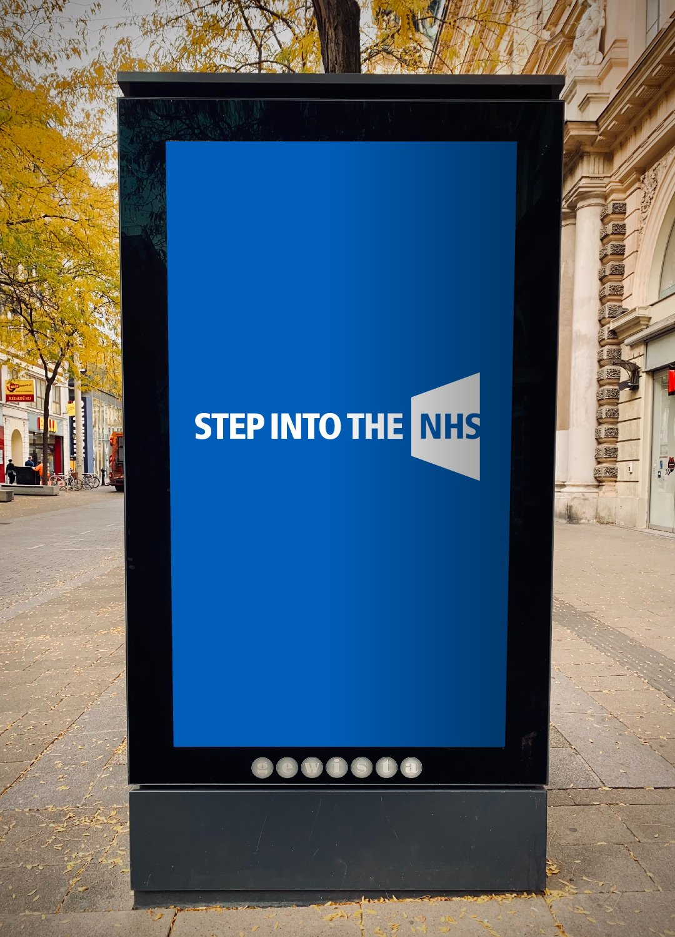
The prizes
Overall winner
artwork displayed in public
£50 Amazon voucher, plus an NHS goody bag
a prize for your school!
a framed certificate
Regional winners
£25 Amazon voucher, plus an NHS goody bag and certificate
If you’re highly commended…
a highly commended certificate with judges’ comments
Whether you enter individually or as a pair, each of you will receive a prize if your entry is chosen. Winning and highly commended entries will be showcased on our website!

Slide 22
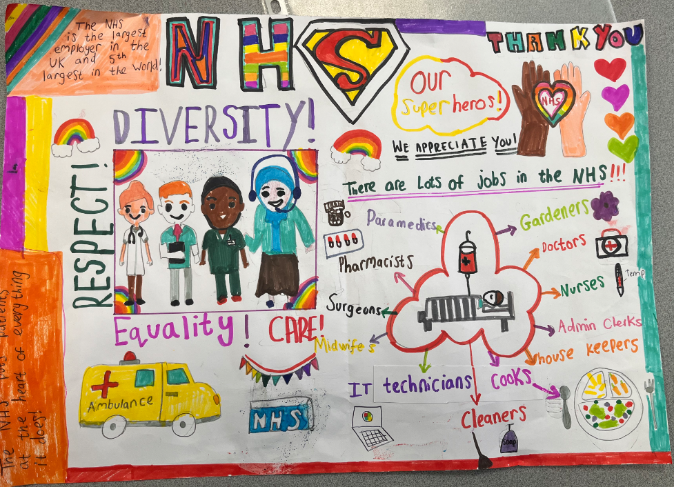
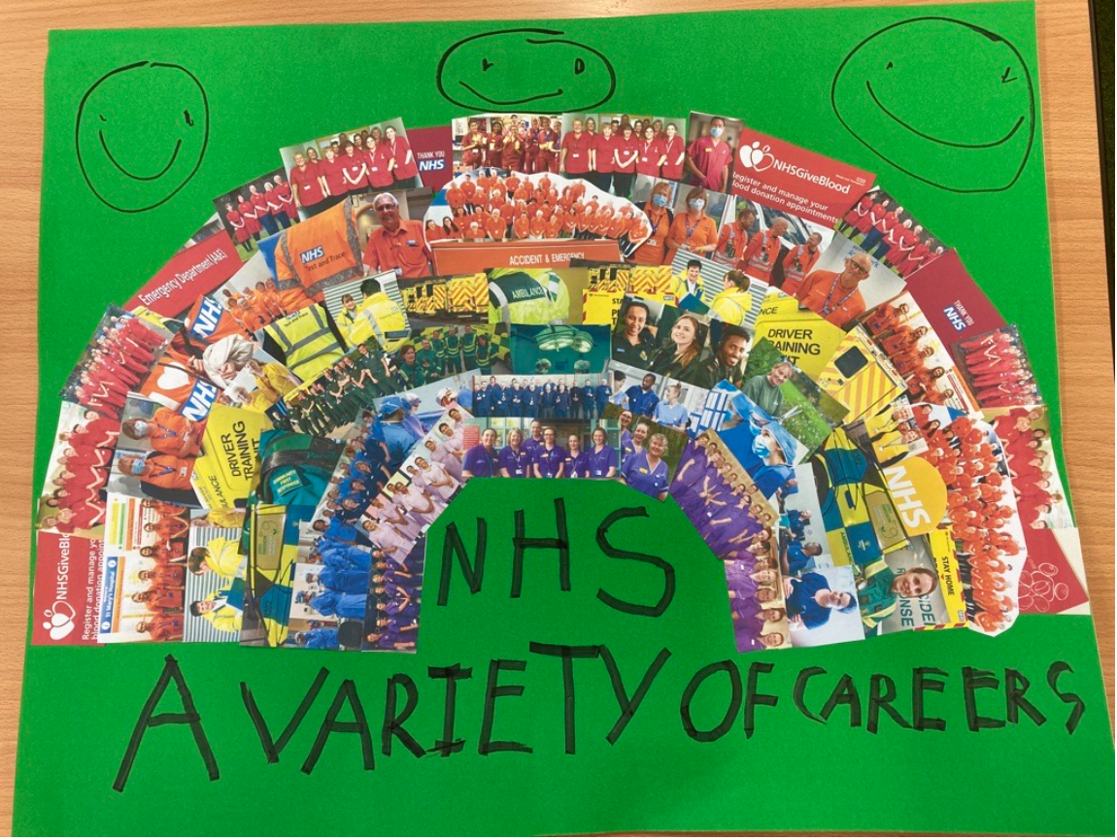
See some previous entries!
See our online gallery for more inspiration!

Slide 23
Some simple rules
You can work on
your own or in pairs
Submit online.
If that’s not possible, send by post. Entries must be on paper or card, no bigger than A3 in size
The closing date
for entries is 30
April 2024

Slide 24
Together we can make a difference!

