Slide 1

Step into the NHS ambassador guide
Competition deadline – 30 April 2025
stepintothenhs.nhs.uk

Slide 2

Contents
What is Step into the NHS? (slides 3-4)
Who this guide is for? (slide 5)
How do I tell schools about the competitions? (slides 6-11)
What you can do each month (slides 12-13)
Templates and resources to help you (slides 14-25)
Arranging a school visit (slide 15)
Social media guidance and template posts (slides 16-23)
Emailing schools about the competition (slide 24)
Newsletter submission (slide 25)
About the competitions (slides 26-33)

Slide 3
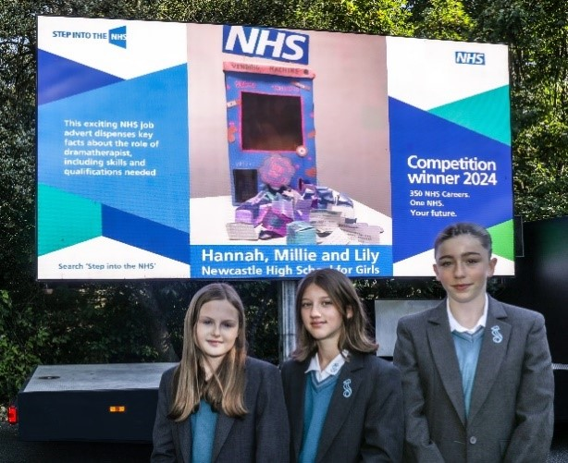
What is Step into the NHS?
Step into the NHS helps young people discover the wide range of career opportunities in the NHS.
There are competitions for primary and secondary schools that raise young people’s careers aspirations and awareness of the more than 350 NHS careers.
You can make a real impact by showing schools what it’s really like to work in the NHS and bringing careers learning to life!
The closing date is 30 April 2025.

Slide 4
About the competitions
Primary school competition
The primary school competition asks pupils in Key Stage 2 (aged 7-11) to choose up to three different job roles in the NHS that stand out. They can use their creativity to tell us what they’ve learnt about them.
Secondary school competition
The secondary school competition asks Key Stage 3 students (aged 11 – 14) to create a job advertisement showcasing one NHS role of their choice.
All the details are on the Step into the NHS website.
You can find out more about the competitions on slides 26-33.

Slide 5

Who is this guide for?
It is for anyone with a passion for inspiring young people to consider a career in the NHS:
For example:
You may already work in the NHS, be a student or on an NHS apprenticeship and looking to encourage young people to consider a career in your profession.
You may work in careers promotion, widening participation or NHS education and development, and want to help young people understand the variety of career options in the NHS.
To thank you for your work, we can send you a certificate of participation. Just fill out this form once the competition has ended.
Do you know of anyone else interested in becoming a Step into the NHS ambassador? Ask them to sign up.

Slide 6

How do I tell schools about the competitions?
There are lots of ways you can help us tell teachers and careers advisers about the competitions:
School visits
Social media
Email
Word-of-mouth
Volunteer work
The following slides will cover these in more detail. We also have templates to help you with all these on slides 14-25.
It may also be worth reaching out to your widening participation or communications team who may be able to support you further with these activities, especially if you work in a larger NHS organisation.

Slide 7
How do I tell schools about the competitions?
Activity | What you can do | How we can help
School visits | Contact your local school and offer to kick-off the competition for students with a Q&A about your career. Think about your career journey and what qualities and skills you need in your job. What myths about your profession can you dispel? Don’t forget to mention the rest of the NHS team you work with! Ask the teacher to take a photo of you presenting and share this on social media, or ask your NHS organisation’s communications team to share it on their channels! | Use our slide pack on the Step into the NHS website. Also see the ‘key messages’ section on slides 10-11.
Social media | Post on your social media channel(s). We find that X and LinkedIn are particularly popular with teachers. You can also follow NHS Health Careers (@HealthCareersUK and @Health-careersuk) and share our competition posts. | Use our pre-made templates on slides 19-23. Images can be downloaded from the Step into the NHS website. Don’t forget to use the #StepIntoTheNHS hashtag!

Slide 8
Top tips for promoting the competitions
Activity | What you can do | How we can help
Social media - videos | Videos are very popular, so why not record a short clip explaining what you do and mention the competition? Here’s some inspiration from one of our judges. You can even post a photo or video that illustrates your working ‘day in the life’ – remember to get your manager’s permission for this. Tell your colleagues and communications team so they can share it more widely.
Email | Do you have any school or teacher contacts you could email? Do you distribute any newsletters that could mention the competition? Could you contact your NHS organisation’s communications team to ask them to include it? | Use or send our pre-made email template later in this document.
Word-of-mouth | Do you have colleagues or friends who have children in primary or secondary education? Tell them about the competition or send them this guide. Does your NHS organisation have a careers, outreach or widening participation team? Maybe they work with careers hubs or academies? Let them know. | Our separate guides for families (one for each competition) are available from the ‘supporting resources’ section of each competition page on the Step into the NHS website detail how parents/carers can support their child’s entry.

Slide 9
Top tips for promoting the competitions
Activity | What you can do | How we can help
Volunteer work | Are you or your NHS organisation involved in any youth organisations or education initiatives? Are there any universities or educational providers you work with that have schools outreach teams? Let them know about the competition. Are you a school governor or do you volunteer at after-school clubs? This is a great way to raise awareness of the competition. | Use or send our pre-made email template later in this document.
If you have any questions or need any guidance, please email us on england.healthcareers@nhs.net

Slide 10
What do I say to primary schools?
Key messages for primary schools
The following key messages are important information that we’d like teachers to know. They are slightly different for each competition. Feel free to copy and paste these into your emails and social media posts!
Introduce your pupils to over 350 NHS careers and help your class learn there’s an NHS job for everyone, no matter their background.
You can deliver the competition in one hour with the ‘one lesson launch’ resource.
Winners will have the chance of seeing their entries displayed in public for their local community to see. There are also Amazon vouchers, exciting goody bags and certificates to win.
The competition has free, engaging teacher resources that align with the DfE careers strategy and KS2 curriculum.
The NHS will be beamed LIVE into schools in March 2025. Pupils will have the unique opportunity to ask NHS staff their burning questions.

Slide 11
What do I say to secondary schools?
Key messages for secondary schools
Introduce your students to over 350 NHS careers and raise their careers aspirations.
You can deliver the competition in one hour with the ‘one lesson launch’ resource.
There is the chance for winning students to have their entries displayed in public for everyone in their community to see. There are also Amazon vouchers, exciting goody bags and certificates to win.
The competition has free, engaging teacher resources that align with the Gatsby Benchmarks, DfE careers strategy and KS3 curriculum.
The NHS will be beamed LIVE into schools in March 2025. Pupils will have the unique opportunity to ask NHS staff their burning questions.

Slide 12
What you can do each month Here’s some suggestions of what we’d love you to do each month. However, you’re welcome to do any of these activities up until the deadline!
 | What you can do | Other ideas
December/January | Visit your local school to kick off the competition with a Q&A about your career. | Record a video / post on social media talking about your involvement in the competition and sharing how schools can get involved. Contact your NHS organisation’s communications team to have the competition mentioned in your internal staff newsletter.
February | Create a social media post (using the templates) about the Step into the NHS Day and how schools can get involved. | Create a social media post informing parents how they can get their children involved in the competition over half-term.
March | Record a short video or take a photo showcasing your working ‘day in the life’ for National Careers Week (3-8 March) or British Science Week (7-16 March) Mention the competition and students can find out more about this career and others. | Create a social media post informing parents how they can get their children involved in the competition over the Easter holidays.

Slide 13
Key dates for your calendar slide 2
 | What you can do | Other ideas
April | Create a social media post (using the templates) encouraging schools to enter before the deadline. | Create a social media post showcasing the entries we have already received (we will provide photos).
May | Create a social media post (using the templates) congratulating the winners of the competition and thanking everyone who participated. | Contact your NHS organisation’s communications team to have the competition mentioned in your internal staff newsletter.

Slide 14

Templates and resources to help you
Arrange a school visit with our email template and use our slide packs from the Step into the NHS website to introduce the competitions
Social media guidance and templates (slide 16-23)
Email schools about the competition (slide 24)
Newsletter submission (slide 25)
Images for you to use from the Step into the NHS website
Please note that the primary and secondary competitions are different in terms of the entry task (see slide 4) and key messages (see slides 10 and 11). They also have different webpages on the Step into the NHS website.
Please be mindful of this if you are promoting both competitions at the same time (i.e. share both webpages rather than just one).

Slide 15
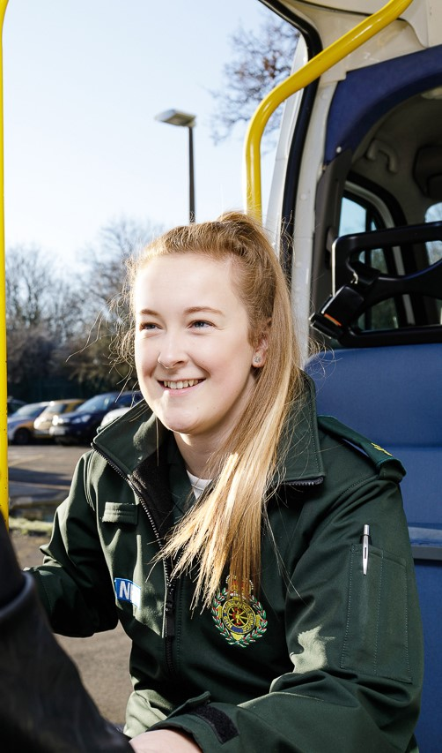
Email template to arrange a school visit
Dear [teacher name],
I’m an NHS ambassador and would love to come into your school to tell your pupils about my role as a [job role].
I can also tell your pupils about the fantastic Step into the NHS (https://www.stepintothenhs.nhs.uk/schools) careers competition which is open for entries.
They’ll learn about over 350 NHS careers and learn there’s a job for everyone, no matter their background.
If you are interested, please let me know what dates and times are suitable for your school.
Thank you,
[Your name]
Step into the NHS ambassador
Email template

Slide 16
Social media guidance
Social media can be effective in reaching schools, young people and parents/carers.
General guidance
X and LinkedIn are particularly popular with teachers and careers advisers, while TikTok, Snapchat and Instagram are more effective for young people.
Facebook and Instagram might be more suited to parents and carers.
Please include the following in ALL posts:
#StepIntoTheNHS
https://www.stepintothenhs.nhs.uk/schools
mention any organisations (using ‘@’) you work with that may be able to repost or pass the message onto schools.
Images and video content can also help with getting more engagement. We have some images available on the Step into the NHS website for you to use.

Slide 17

Other ideas for social media engagement
Post a video
Say you’re an ambassador for the Step into the NHS schools’ competition and that schools can enter by searching ‘Step into the NHS.’
Why not include some of the key messages on slides 10 and 11? Post a photo or video that illustrates your working ‘day in the life’. Mention that you’re an ambassador for the Step into the NHS schools’ competition and that you hope this inspires pupils and helps them with their entries.
Remember to get your manager’s permission.

Slide 18

Other ideas for social media engagement
Engaging with NHS staff online
You may want to inspire some discussion with your audience about career aspirations.
Did you want to work in the NHS when you were a primary school pupil?
How did you learn about careers when you were at school?
Do you think there are more NHS careers today than when you were a pupil at school?
If you work in the NHS or know someone who does, you could share what your/their role is. Especially if the role is not as well-known or challenges stereotyping. Don’t forget to tag with #StepIntoTheNHS.

Slide 19
Template social media posts
Audience: careers advisers / school outreach
Tell the teachers you know about the fantastic #StepIntoTheNHS competitions! Young people explore over 350 NHS careers and learn there’s an NHS job for everyone in a one-hour lesson. Visit https://www.stepintothenhs.nhs.uk/schools to find out about the competitions for primary and secondary education.
#StepIntoTheNHS is a fantastic free resource for careers learning in schools. Young people in primary and secondary schools can learn about more than 350 different NHS careers and enter an exciting competition! Download the one lesson launch for primary and secondary education at https://www.stepintothenhs.nhs.uk/schools
The free #StepIntoTheNHS ‘one lesson launch’ can raise young people’s careers aspirations in an hour. Competition winners in KS2 and KS3 will have the chance to see their entries displayed in public! Visit https://www.stepintothenhs.nhs.uk/schools

Slide 20
Social media posts for teachers slide 2
Audience: teachers
Did you know there are over 350 roles in the NHS? The #StepIntoTheNHS careers competition helps raise your students’ career aspirations. They’ll also have the exciting chance to see their winning entry displayed in public! https://www.stepintothenhs.nhs.uk/schools
Looking to inspire young people in your school? Explore over 350 NHS careers available with the free, curriculum-linked ‘one lesson launch’ for KS2 and KS3. Visit https://www.stepintothenhs.nhs.uk/schools #StepIntoTheNHS
Explore free careers resources for your KS2 and KS3 students! With #StepIntoTheNHS, you can introduce your pupils to the breadth of over 350 roles available in the NHS. https://www.stepintothenhs.nhs.uk/schools

Slide 21
Social media posts for parents
Audience: parents
If you have children in years 3-6 or 7-9, let their school know that they can explore over 350 careers and enter an exciting competition. Winners have the chance to see their entry displayed in public! https://www.stepintothenhs.nhs.uk/schools
For early-mid February If you have school-age children, they can #StepIntoTheNHS this half-term and learn about the world of NHS careers. There’s also a fantastic competition for KS2 and KS3 – let their teacher know! Get started by taking our fun quiz: https://www.stepintothenhs.nhs.uk/careers/take-the-test
For late March/early April If you have school-age children, they can #StepIntoTheNHS this Easter holidays and learn about the world of NHS careers. There’s also a fantastic competition for KS2 and KS3 – let their teacher know! Get started by taking our fun quiz: https://www.stepintothenhs.nhs.uk/careers/take-the-test

Slide 22
Social media posts for Step into the NHS day
Post about the Step into the NHS Day in March
KS2 The NHS will be beamed LIVE into primary schools on Thursday 13 March. Pupils will have the unique opportunity to ask NHS staff their burning questions. Find out how to register on the #StepIntoTheNHS website! https://www.stepintothenhs.nhs.uk/primary-schools
KS3 The NHS will be beamed LIVE into secondary schools on Wednesday 5 March. Pupils will have the unique opportunity to ask NHS staff their burning questions. Find out how to register on the #StepIntoTheNHS website! https://www.stepintothenhs.nhs.uk/secondary-schools

Slide 23
Social media posts for entry deadline
There’s still time to enter the #StepIntoTheNHS careers competition! Teachers can submit their students’ creations before 30 April for the chance to see their winning entry displayed in public! Enter now: https://www.stepintothenhs.nhs.uk/schools
Post after the 30 April 2025 deadline Thank you to all schools for entering the #StepIntoTheNHS competition! We can’t wait to judge your fantastic entries. Good luck! See the winners here soon: https://www.stepintothenhs.nhs.uk/schools
Post before the 30 April 2025 deadline

Slide 24

Email template
Email to schools about the competition
Dear [teacher name/school],
I’m an NHS ambassador and want to tell you about the fantastic Step into the NHS careers competition, which is open for entries!
The NHS is offering you fantastic free resources to help you inspire your pupils about NHS careers. Step into the NHS can help them explore over 350 roles in the NHS. They’ll learn there’s an NHS job for everyone, no matter their background.
What do my pupils need to do? (Delete as appropriate)
(KS2) - Pupils choose up to three different NHS jobs from the more than 350 available. We then want them to work alone or in pairs to creatively tell us what they have learnt about them.
(KS3) – Students create a job advertisement showcasing one NHS role of their choice.
The national winning entry will be displayed in public for all to see! There are also Amazon vouchers, goody bags and certificates available.
How can I get started?
Download the ’one lesson launch’ (https://www.stepintothenhs.nhs.uk/schools ) classroom slide pack to kick-start your pupils’ entries in just one hour.
This curriculum-linked resource contains videos, worksheets and activities that will help pupils reflect on any perceived barriers to careers and consider lots of different jobs.
Hear from NHS staff
If you want to really bring careers to life, join our Step into the NHS Day on (delete as appropriate)
(KS2) - Thursday 13 March
(KS3) - Wednesday 5 March
The NHS will be beamed LIVE into your school, allowing your pupils to hear from NHS staff, ask any burning questions.
Find out how to sign up on the Step into the NHS (https://www.stepintothenhs.nhs.uk/schools) website.
The deadline for the entries is 30 April 2025.
Good luck!
[Your name]
Step into the NHS ambassador

Slide 25
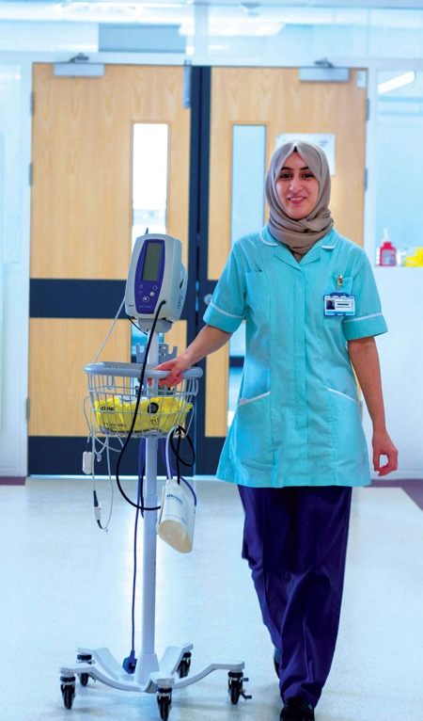
Newsletter submission
Schools can enter an exciting NHS careers competition to explore the more than 350 NHS roles.
Step into the NHS is asking students in KS2 and KS3 to get creative, highlighting the amazing careers in the NHS.
The national winners will see their entry displayed in public for their local community to see!
Teachers can get started by downloading the KS2 and KS3 ‘one lesson launch’ resources. These curriculum-linked classroom pack contains videos, worksheets and activities that inspires pupils to learn that there’s an NHS job for everyone, no matter their background.
Find out more on the Step into the NHS (https://www.stepintothenhs.nhs.uk/schools) website. The deadline for competition entries is 30 April 2025!

Slide 26
About the competitions
The Step into the NHS primary and secondary schools’ competitions are managed by NHS Health Careers (part of NHS England).
They aim to open students’ eyes to over 350 careers in the NHS and raise their careers aspirations.
Why are we running these competitions?
The NHS is the UK’s biggest employer with 1.5 million staff employed in England in more than 350 different roles.
With so many careers and job roles available within the NHS, from dentists to plumbers and from midwifes to pharmacists, the resources and competition are vital in opening young people’s eyes to a future career in healthcare.
Whereas the primary schools’ competition encourages pupils to challenge gender stereotyping in NHS roles, the secondary schools competition focuses more on raising young people’s career aspirations and improving their job-seeking skills.
How do schools take part?
Teachers can get started by downloading the one lesson launch from the Step into the NHS website. There is one for primary schools and one for secondary schools. The ‘one lesson launches’ can be delivered directly to students to help them prepare their competition entries.
There is also supporting guidance and optional extension activities that explore the vast number of careers available in the NHS. The resources can be tailored to students’ ages and abilities, and they are flexible enough to be adapted for different lessons.

Slide 27
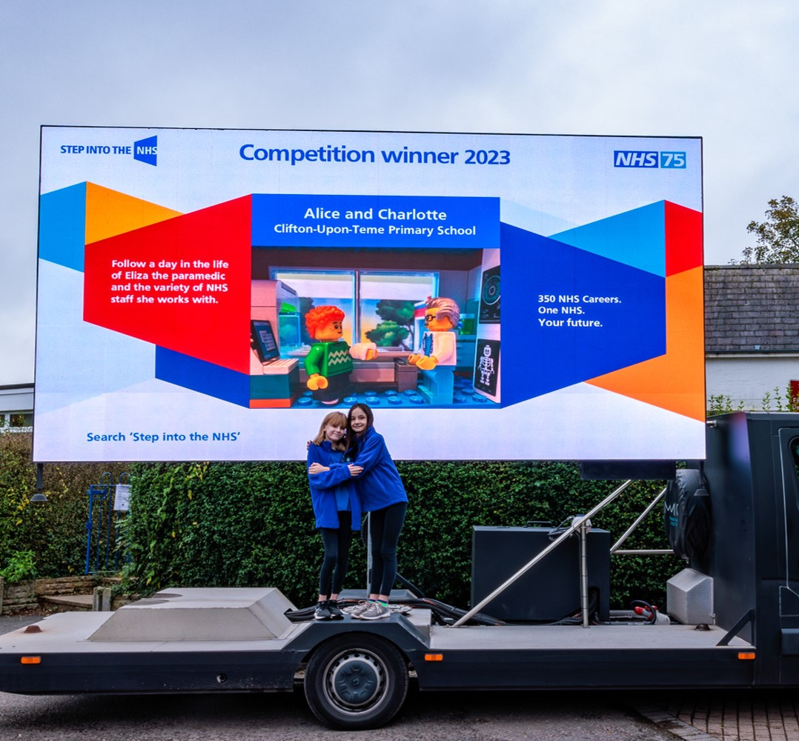
The prizes
Overall winner
entry displayed in public!
£50 Amazon voucher each,
plus an NHS goody bag
a framed certificate each
a prize for their school
What if I don’t win?
Top entries get a ‘highly
commended' certificate
A digital
‘well done’ certificate
Regional winners
£25 Amazon voucher each,
plus an NHS goody bag and
certificate

Slide 28
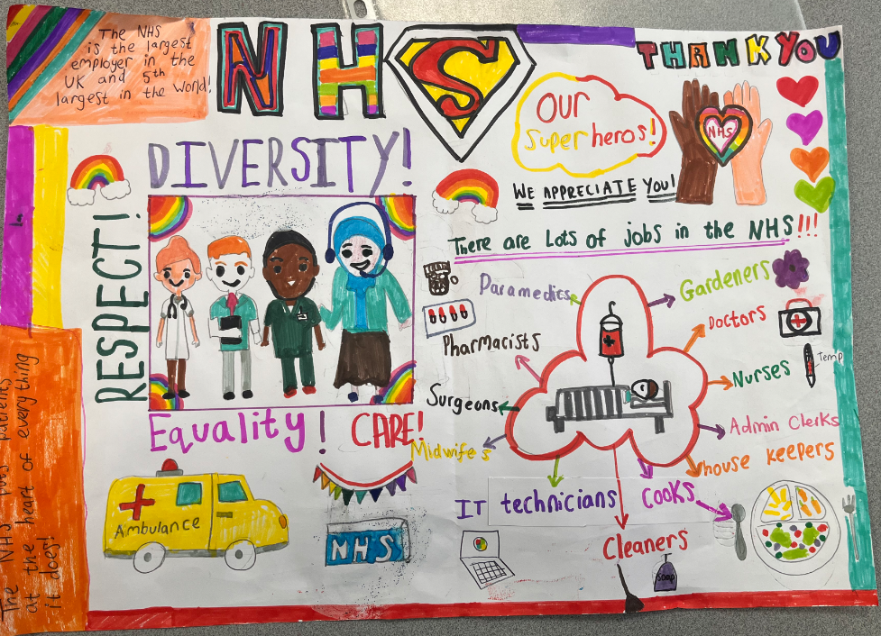
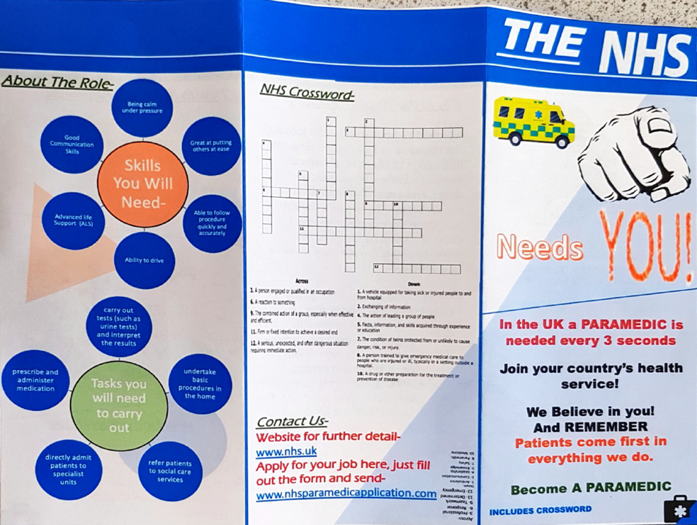
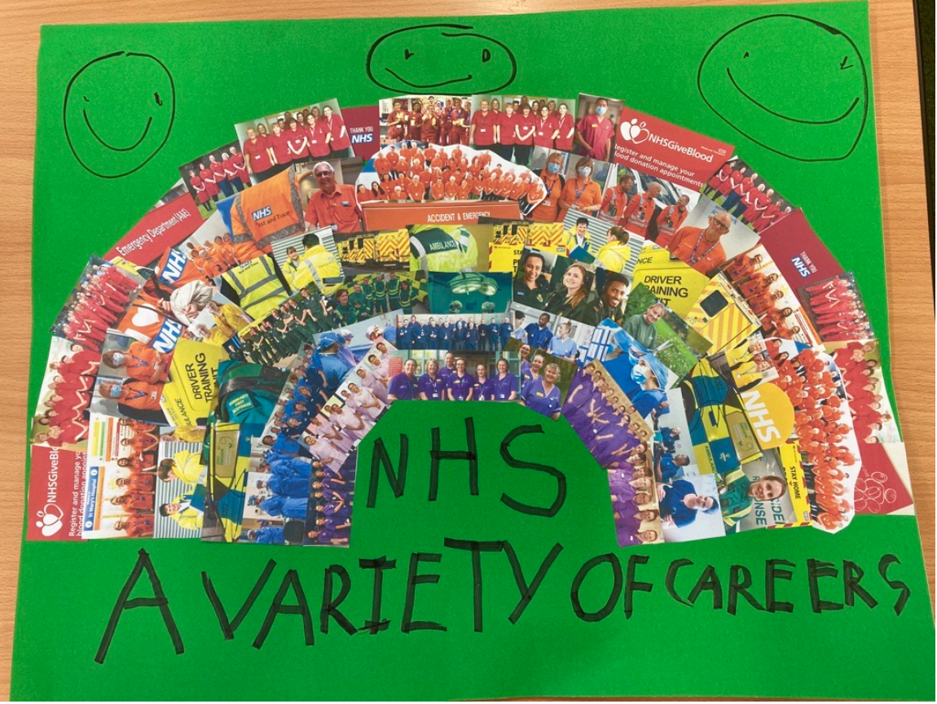

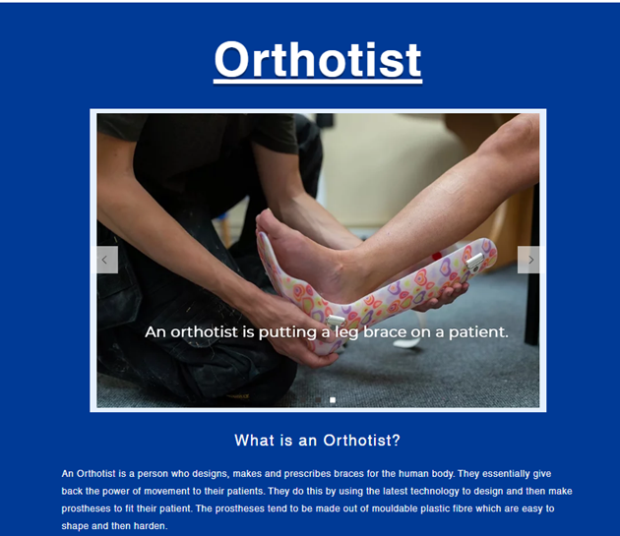
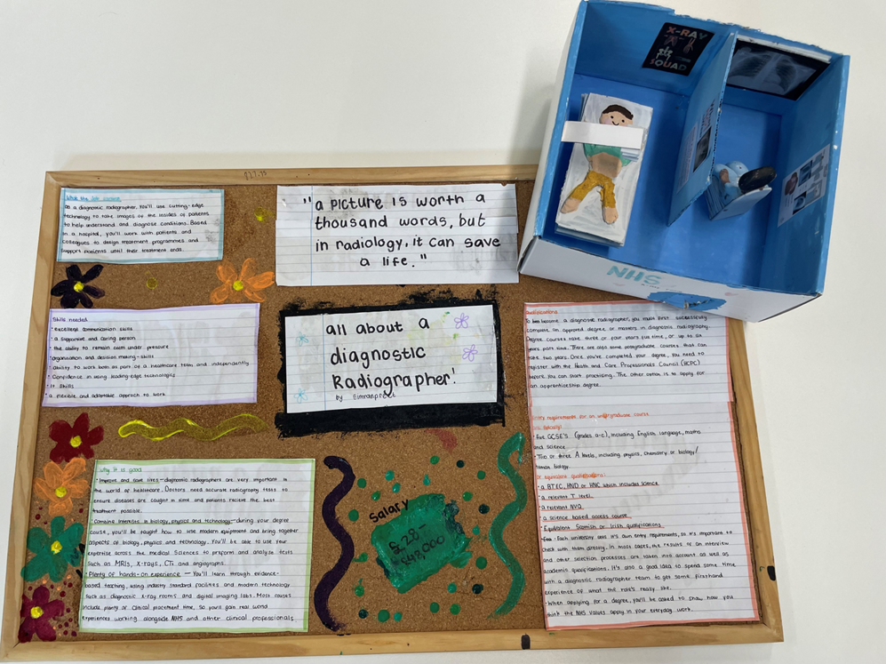
Previous entry examples

Slide 29

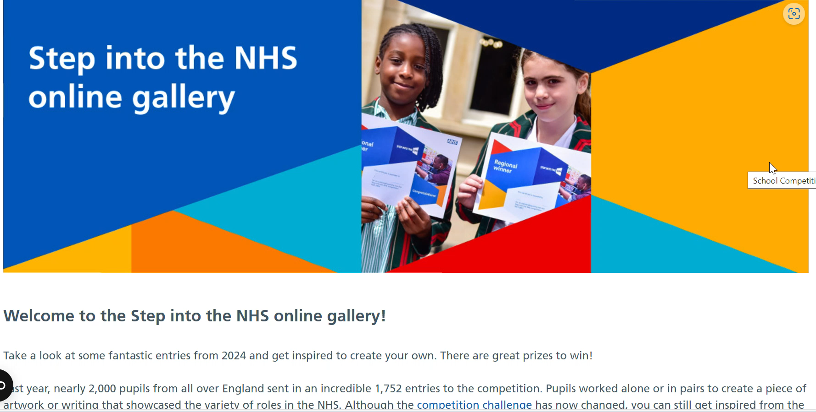
Online galleries
The online gallery for each competition is a fantastic way of acknowledging schools’ hard work!
KS2 – stepintothenhs.nhs.uk/primary-schools/online-gallery
KS3 – stepintothenhs.nhs.uk/secondary-schools/online-gallery

Slide 30
Competition timeline
Here are some activities and key events for you to be aware of:
 | Key event | Further information
January | Email to teachers | A Step into the NHS email will be sent to teachers to encourage them to submit entries and sign up for our ‘Step into the NHS Day’ livestream.
February | Email to teachers Half-term | Our next Step into the NHS email to teachers will be sent before half-term. This will encourage them to sign up to the livestream. 17-21 February (for most schools). Early February is a great time to encourage teachers to set the competition as a homework activity or encourage parents to use the resources with their children over the break.

Slide 31
Competition timeline
 | Key event | Further information
March | National Careers Week (3-8 March) Step into the NHS Days (5 and 13 March) | A celebration of careers guidance and resources, primarily aimed at young people. Many schools will be focused on careers during this week. Our Step into the NHS livestreams will allow students to hear from NHS staff and ask them their burning questions. Secondary schools: 5 March Primary schools: 13 March
April | Final email to teachers Easter holidays Closing date | The Step into the NHS team will be sending a final email to encourage entries. Between 7-20 April for most schools. Late March/early April is a great time to encourage teachers to set the competition as a homework activity or encourage parents to use the resources with their children over the break. The competition closes on 30 April 2025

Slide 32
Competition timeline
 | Key event | Further information
May | Regional winners chosen | Winners will be listed in our website’s online gallery (one for primary and one for secondary)
June | Overall national winner chosen | Regional winners will be invited to showcase their entries to a panel of NHS judges over video call. The judges will then decide the overall national winner.
July | Winners announced publicly | Check the winners on the Step into the NHS website, NHS Health Careers website and our X account.

Slide 33
Thank you and good luck spreading the word!

