Slide 1


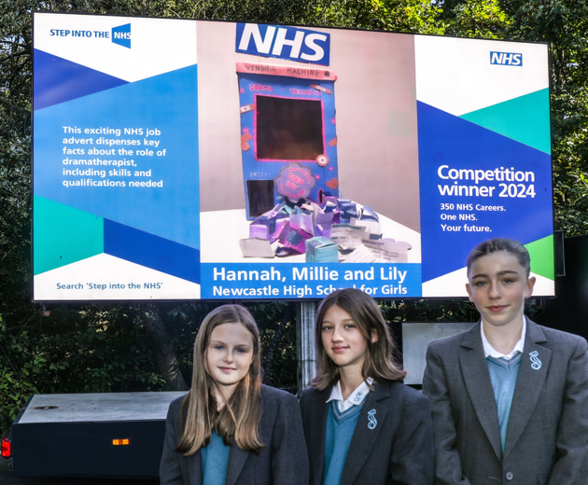
Step into the NHS competition
2024-25
Notes:
Ambassadors: please add to these slides with your own career journey or information about the NHS

Slide 2
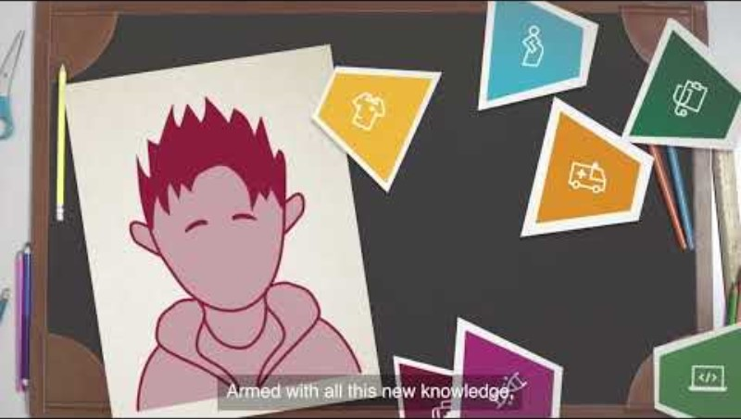
What is Step into the NHS?
Exciting careers competition for ages 11-14
Learn about over 350 NHS roles
Design a creative job advert for one NHS role
Amazon vouchers, goody bags and certificates to win!
Watch the video to find out more >>>

Slide 3
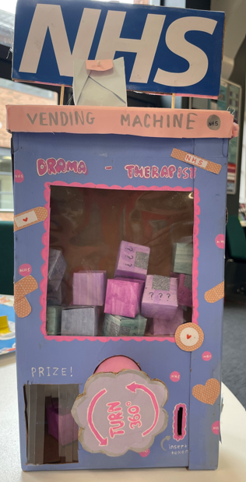
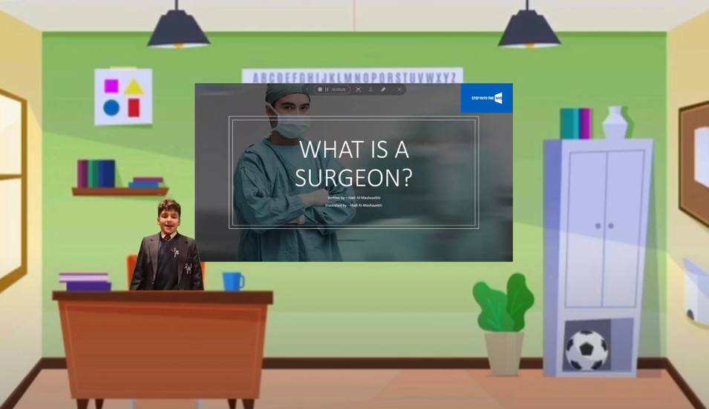
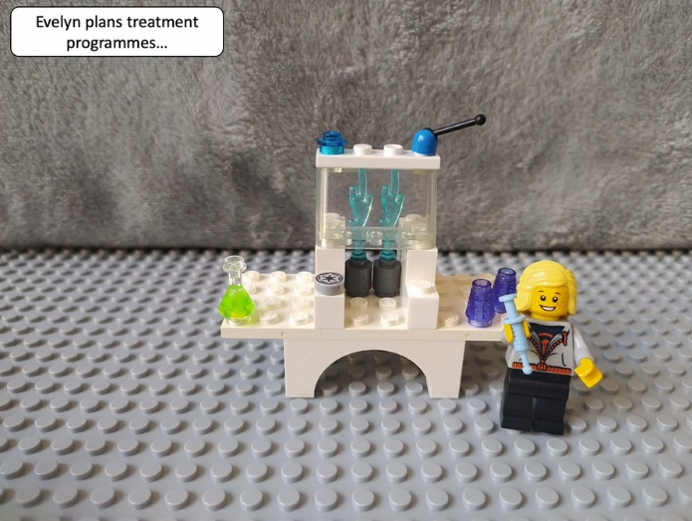
Some examples of previous winning entries…
Virtual presentation to advertise the role of surgeon
Lego-animated video to advertise the role of medical physicist
Vending machine to advertise the role of dramatherapist

Slide 4

Why enter?
Learn about the breadth of NHS roles. It’s not just doctors or nurses!
The chance to have your entry displayed in public and win other prizes!
Learn vital job-seeking skills for the future
Learn about careers you never thought existed in the NHS – dramatherapist, gardener, physician associate

Slide 5

National winning entry displayed in public!
Notes:
The national winner will have their entry displayed in their local community. This is a photo of the digivan display in public for the KS2 competition last year, as an example of how it will look.

Slide 6

How to get started
Teachers!
Visit stepintothenhs.nhs.uk to download the one lesson launch to kick-start entries in one hour
Submit entries online or by post by 30 April 2025
Students!
Visit stepintothenhs.nhs.uk to learn about the 350+ roles
Research your chosen NHS role and create your adverts
Notes:
Our main message is that it only takes one hour to deliver all the learning to students.

Slide 7

Step into the NHS Day
Hear LIVE from NHS staff!​
Hear from lots of different NHS staff members, complete fun activities and ask any burning questions you might have
How will the day help me?​
You’ll learn about different roles within the NHS​
You’ll be able to use this learning to then create a fantastic entry (if you haven’t already started!)
Teachers – visit the Step into the NHS primary school pages to sign up!
Join us on Wednesday 5 March!
Notes:
Teachers can visit https://www.stepintothenhs.nhs.uk/secondary-schools to sign up

Slide 8
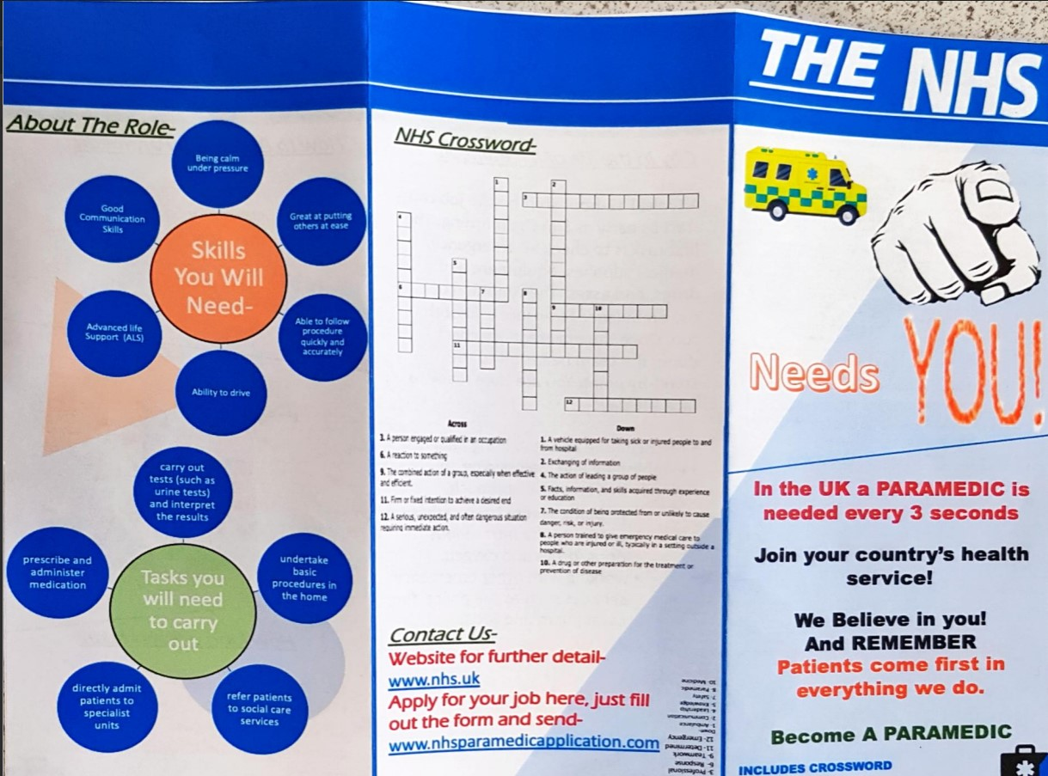
Good luck!

