Slide 1

Step into the NHS ambassador guide
Competition deadline – 30 April 2026
stepintothenhs.nhs.uk

Slide 2

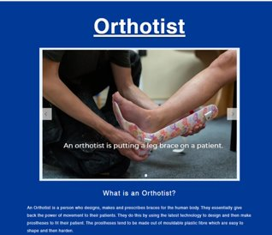
Contents
Competition details (slide 3)
How do I tell schools about the competition (slides 4-8)
Template resources (9-13)
  Social media guidance (slide 10-11)
  Emailing schools (slides 12-13)
  Newsletter/bulletin example (slide 14)
Online galleries (slide 15)
Notes:
To be amended:
What is Step into the NHS? (slides 3-4)
Who this guide is for? (slide 5)
How do I tell schools about the competitions? (slides 6-11)
What you can do each month (slides 12-13)
Templates and resources to help you (slides 14-25)
Arranging a school visit (slide 15)
Social media guidance and template posts (slides 16-23)
Emailing schools about the competition (slide 24)
Newsletter submission (slide 25)
About the competitions (slides 26-33)

Slide 3
About the competitions
The Step into the NHS primary and secondary schools’ competitions are managed by NHS Health Careers (part of NHS England).
They aim to open students’ eyes to over 350 careers in the NHS and raise their careers aspirations.
Why are we running these competitions?
The NHS is the UK’s biggest employer with 1.5 million staff employed in England in more than 350 different roles.
With so many careers and job roles available within the NHS, from dentists to plumbers and from midwives to pharmacists, the resources and competition are vital in opening young people’s eyes to a future career in healthcare.
Whereas the primary schools’ competition also encourages pupils to challenge gender stereotyping in NHS roles, the secondary schools' competition focuses more on raising young people’s career aspirations and improving their job-seeking skills.
How do schools take part?
Primary school competition
The primary school competition asks pupils in Key Stage 2 (aged 7-11) to choose up to three different job roles in the NHS that stand out. They can use their creativity to tell us what they’ve learnt about them.
Secondary school competition
The secondary school competition asks Key Stage 3 students (aged 11 – 14) to create a job advertisement showcasing one NHS role of their choice.
All the details are on the Step into the NHS website. The closing date is 30 April 2026.
Notes:
The prizes
National winner
entry displayed in public!
£50 Amazon voucher each, plus an NHS goody bag
a framed certificate each
a prize for their school
Regional winners
£25 Amazon voucher each, plus an NHS goody bag and certificate
Top entries also get a ‘highly commended’ certificate and there is also a downloadable ‘well done’ certificate for schools to use.

Slide 4
How do I tell schools about the competitions?
Activity | What you can do | How we can help
School visits | Contact schools to offer a career Q&A session to launch the competition. Share your career journey, highlight key skills needed, bust common myths about your profession, and showcase your NHS team. Don't forget to capture the moment – ask teachers to photograph your visit and share on social media, or get your communications team to promote it through official channels! (Ensure you have the permission for photographs) | Use our slide pack on the Step into the NHS website. Also see the ‘key messages’ section on slides 10-11.
Social media | Post on your social media channel(s). We find that X and LinkedIn are particularly popular with teachers. You can also follow NHS Health Careers (@HealthCareersUK and @Health-careersuk) and share our competition posts. | Use our pre-made templates on slides 19-23. Images can be downloaded from the Step into the NHS website. Don’t forget to use the #StepIntoTheNHS hashtag!

Slide 5
Activity | What you can do | How we can help
Social media - videos | Record a short video explaining your role and promoting the competition – videos are highly engaging and shareable. Consider posting 'day in the life' photos or videos to showcase your work (with manager approval). Share with colleagues and your communications team for wider distribution across channels.
Email | Do you have any school or teacher contacts you could email? Do you distribute any newsletters that could mention the competition? | Use or send our pre-made email template later in this document.
Word-of-mouth | Do you have colleagues or friends who have children in primary or secondary education? Tell them about the competition or send them this guide. | Our separate guides for families (one for each competition) are available from the ‘supporting resources’ section of each competition page on the Step into the NHS website detail how parents/carers can support their child’s entry.

Slide 6
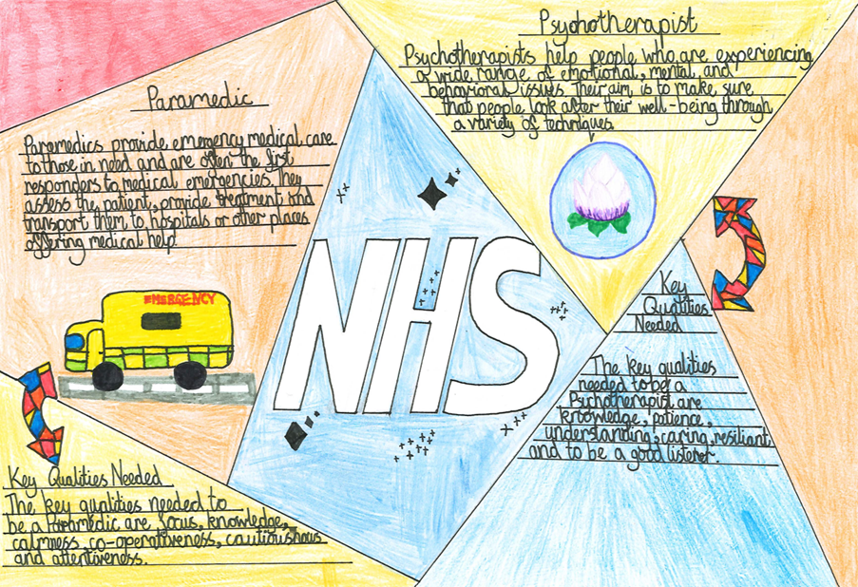
Top tips for promoting the competitions
Activity | What you can do | How we can help
Volunteer work | Are you or your NHS organisation involved in any youth organisations or education initiatives? Are there any universities or educational providers you work with that have schools outreach teams? Let them know about the competition. Are you a school governor or do you volunteer at after-school clubs? This is a great way to raise awareness of the competition. | Use or send our pre-made email template later in this document.
If you have any questions or need any guidance, please email us on england.healthcareers@nhs.net

Slide 7
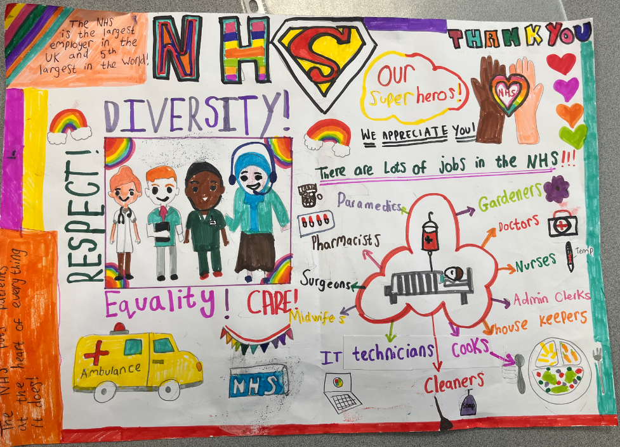
What do I say to primary schools?
Key messages for primary schools
The following key messages are important information that we’d like teachers to know. They are slightly different for each competition. Feel free to copy and paste these into your emails and social media posts!
Introduce your pupils to over 350 NHS careers and help your class learn there’s an NHS job for everyone, no matter their background.
You can deliver the competition in one hour with the ‘one lesson launch’ resource.
Winners will have the chance of seeing their entries displayed in public for their local community to see. There are also Amazon vouchers, exciting goody bags and certificates to win.
The competition has free, engaging teacher resources that align with the DfE careers strategy and KS2 curriculum.
The NHS will be beamed LIVE into schools in March 2025. Pupils will have the unique opportunity to ask NHS staff their burning questions.

Slide 8
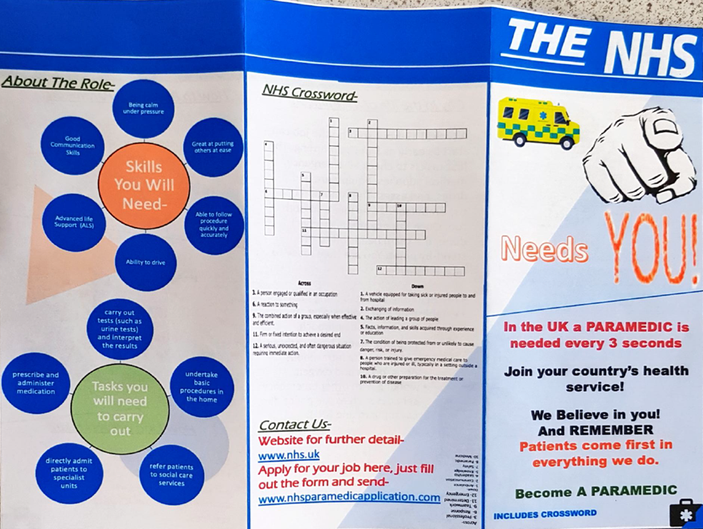
What do I say to secondary schools?
Key messages for secondary schools
Introduce your students to over 350 NHS careers and raise their careers aspirations.
You can deliver the competition in one hour with the ‘one lesson launch’ resource.
There is the chance for winning students to have their entries displayed in public for everyone in their community to see. There are also Amazon vouchers, exciting goody bags and certificates to win.
The competition has free, engaging teacher resources that align with the Gatsby Benchmarks, DfE careers strategy and KS3 curriculum.
The NHS will be beamed LIVE into schools in March 2025. Pupils will have the unique opportunity to ask NHS staff their burning questions.

Slide 9

Templates and resources to help you
Arrange a school visit with our email template and use our slide packs from the Step into the NHS website to introduce the competitions
Social media guidance and templates (slide 10 & 11)
Email schools about the competition (slide 12 & 13)
Newsletter submission (slide 14)
Images for you to use from the Step into the NHS website
Please note that the primary and secondary competitions are different in terms of the entry task (see slide 3 ) and key messages (see slides 7 and 8). They also have different webpages on the Step into the NHS website.
Please be mindful of this if you are promoting both competitions at the same time (i.e. share both webpages rather than just one).

Slide 10
Social media guidance
Social media can be effective in reaching schools, young people and parents/carers.
General guidance
X and LinkedIn are particularly popular with teachers and careers advisers, while TikTok, Snapchat and Instagram are more effective for young people.
Facebook and Instagram might be more suited to parents and carers.
Please include the following in ALL posts:
  #StepIntoTheNHS
  https://www.stepintothenhs.nhs.uk/schools
  Tag health careers (Instagram - @healthcareers, LinkedIn & Facebook – NHS Health Careers, X- @HealthCareersUK)
  mention any organisations (using ‘@’) you work with that may be able to repost or pass the message onto schools.
Images and video content can also help with getting more engagement. We have some images available on the Step into the NHS website for you to use.
Notes:
Other ideas for social media engagement
Post a video or photo
• Share your 'day in the life' content
• Mention you're a Step into the NHS ambassador
• Tell schools to search 'Step into the NHS' to enter
• Include key messages from slides 10-11
• Get manager's permission first
Ask your audience
• Did you want to work in the NHS as a primary school pupil?
• How did you learn about careers at school?
• Are there more NHS careers now than when you were at school?
Share career stories
• Highlight your role or someone you know in the NHS
• Focus on lesser-known roles that challenge stereotypes
• Always tag #StepIntoTheNHS

Slide 11
Template social media posts
Audience: careers advisers/school outreach #StepIntoTheNHS is a fantastic free resource for careers learning in schools. Young people in primary and secondary schools can learn about more than 350 different NHS careers and enter an exciting competition! Download the one lesson launch for primary and secondary education at https://www.stepintothenhs.nhs.uk/schools
Audience: Teachers Looking to inspire young people in your school? Explore over 350 NHS careers available with the free, curriculum-linked ‘one lesson launch’ for KS2 and KS3. Visit https://www.stepintothenhs.nhs.uk/schools #StepIntoTheNHS
Audience: Parents If you have school-age children, they can #StepIntoTheNHS this half-term and learn about the world of NHS careers. There’s also a fantastic competition for KS2 and KS3 – let their teacher know! Get started by taking our fun quiz: https://www.stepintothenhs.nhs.uk/careers/take-the-test

Slide 12
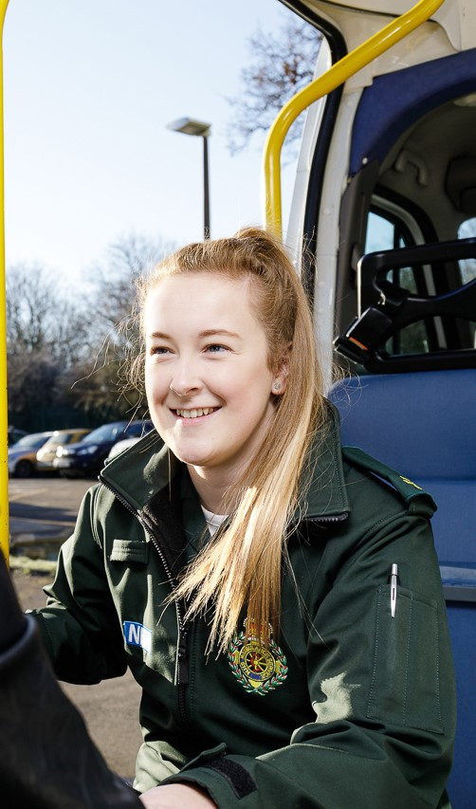
Email template to arrange a school visit
Dear [teacher name],
I’m an NHS ambassador and would love to come into your school to tell your pupils about my role as a [job role].
I can also tell your pupils about the fantastic Step into the NHS (https://www.stepintothenhs.nhs.uk/schools) careers competition which is open for entries.
They’ll learn about over 350 NHS careers and learn there’s a job for everyone, no matter their background.
If you are interested, please let me know what dates and times are suitable for your school.
Thank you,
[Your name]
Step into the NHS ambassador
Email template

Slide 13

Email template
Email to schools about the competition
Dear [teacher name/school],
I hope you're well! As an NHS ambassador, I'm excited to tell you about the Step into the NHS careers competition – a fantastic opportunity for your pupils to discover NHS careers they never knew existed.
This free competition helps young people explore over 350 NHS roles and discover that there's a place for everyone in healthcare, whatever their background.
What do pupils need to do?
KS2: Choose up to three NHS jobs and creatively share what they've learnt about them (working alone or in pairs).
KS3: Design a job advert for one NHS role of their choice.
Great prizes await! Winning entries will be displayed publicly, plus there are Amazon vouchers, goody bags and certificates to be won.
Getting started is simple, download the 'one lesson launch' pack – everything you need to get pupils started in just one hour, including videos, worksheets and engaging activities.
The NHS are also offering a special opportunity to join the Step into the NHS Day, in March 2026 for a live broadcast to schools where pupils can hear directly from NHS staff, ask questions and explore inspiring career pathways. Sign-up details for KS2 and KS3 can be found here.
This competition is a wonderful way to inspire your pupils about healthcare careers whilst linking to your curriculum.
Best of luck!
[Your name]
Step into the NHS Ambassador

Slide 14
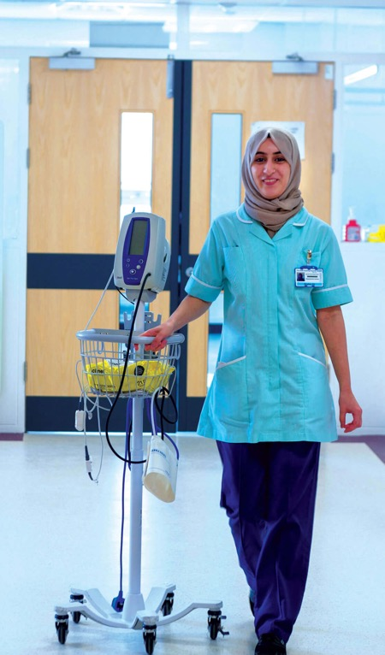
Newsletter submission
Schools can enter an exciting NHS careers competition to explore the more than 350 NHS roles.
Step into the NHS is asking students in KS2 and KS3 to get creative, highlighting the amazing careers in the NHS.
The national winners will see their entry displayed in public for their local community to see!
Teachers can get started by downloading the KS2 and KS3 ‘one lesson launch’ resources. These curriculum-linked classroom pack contains videos, worksheets and activities that inspires pupils to learn that there’s an NHS job for everyone, no matter their background.
Find out more on the Step into the NHS (https://www.stepintothenhs.nhs.uk/schools) website. The deadline for competition entries is 30 April 2026!

Slide 15
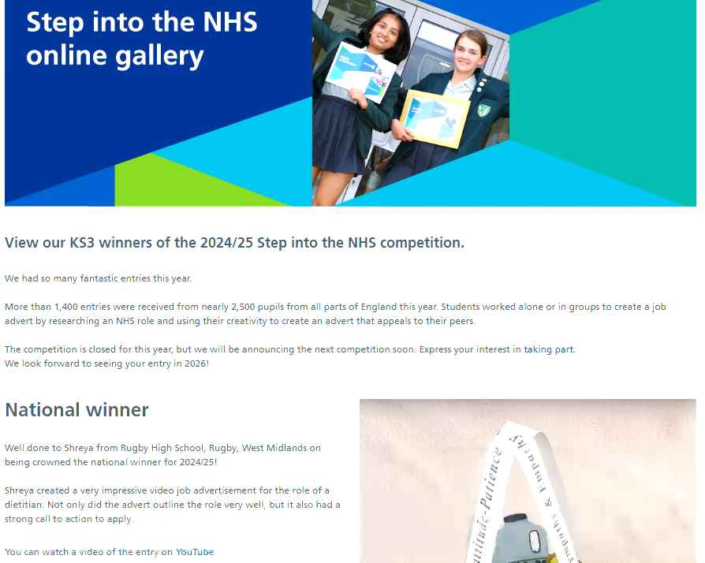
Online galleries
The online gallery for each competition is a fantastic way of acknowledging schools’ hard work!
KS2 – stepintothenhs.nhs.uk/primary-schools/online-gallery
KS3 – stepintothenhs.nhs.uk/secondary-schools/online-gallery

Slide 16
Thank you and good luck spreading the word!

