Slide 1



Step into the NHS
competition
2025-26
Notes:
Ambassadors: please add to these slides with your own career journey or information about the NHS

Slide 2

What is Step into the NHS?
  Exciting careers competition for ages 7-11
  How can you showcase up to three NHS careers in a creative way?
  Watch the video to find out more >>>

Slide 3
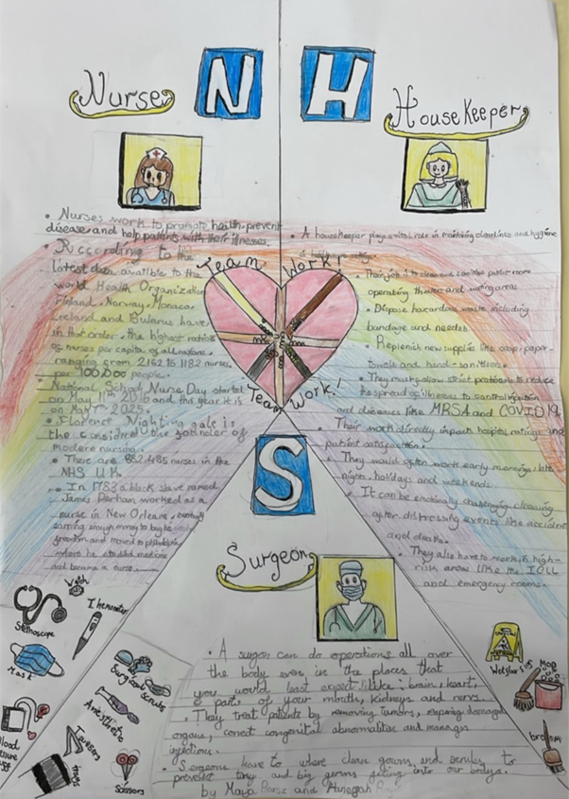
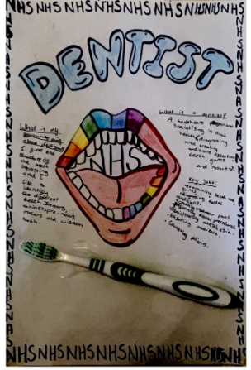
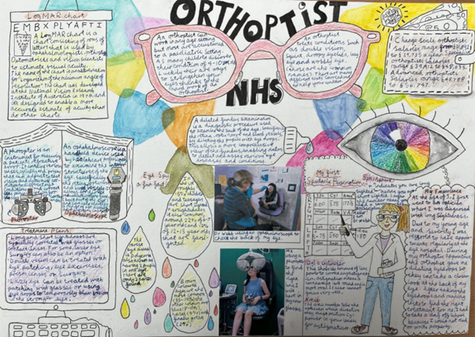
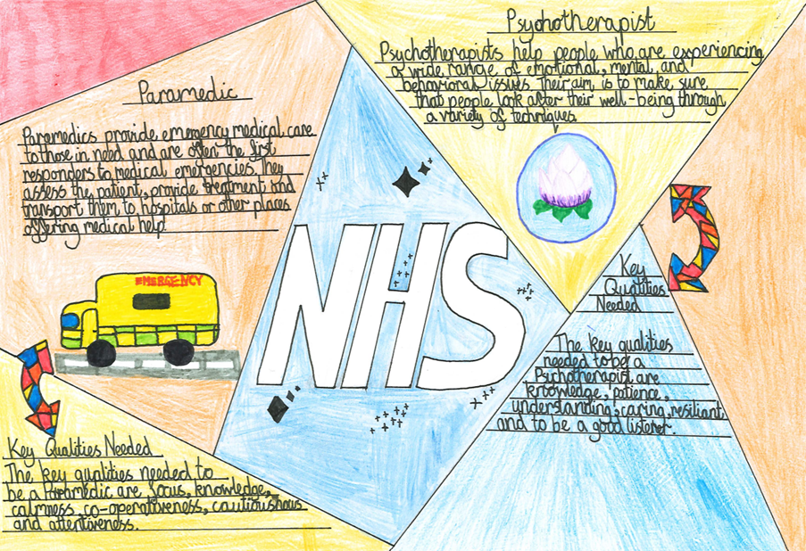
Some examples of previous winning entries…
You could create a poster, a drawing or a poem for example!

Slide 4

Why enter?
You’ll learn about all the different jobs in the NHS!
You’ll learn that anyone can do any job in the NHS, regardless of their gender or background. Anyone can be a surgeon, just like anyone can be a midwife!
The chance to have your entry displayed in public and win other prizes!

Slide 5

National winning entry displayed in public!
Notes:
The national winner will have their entry displayed in their local community. This is a photo of Aarna in year 5, the national winner for 2024-25

Slide 6
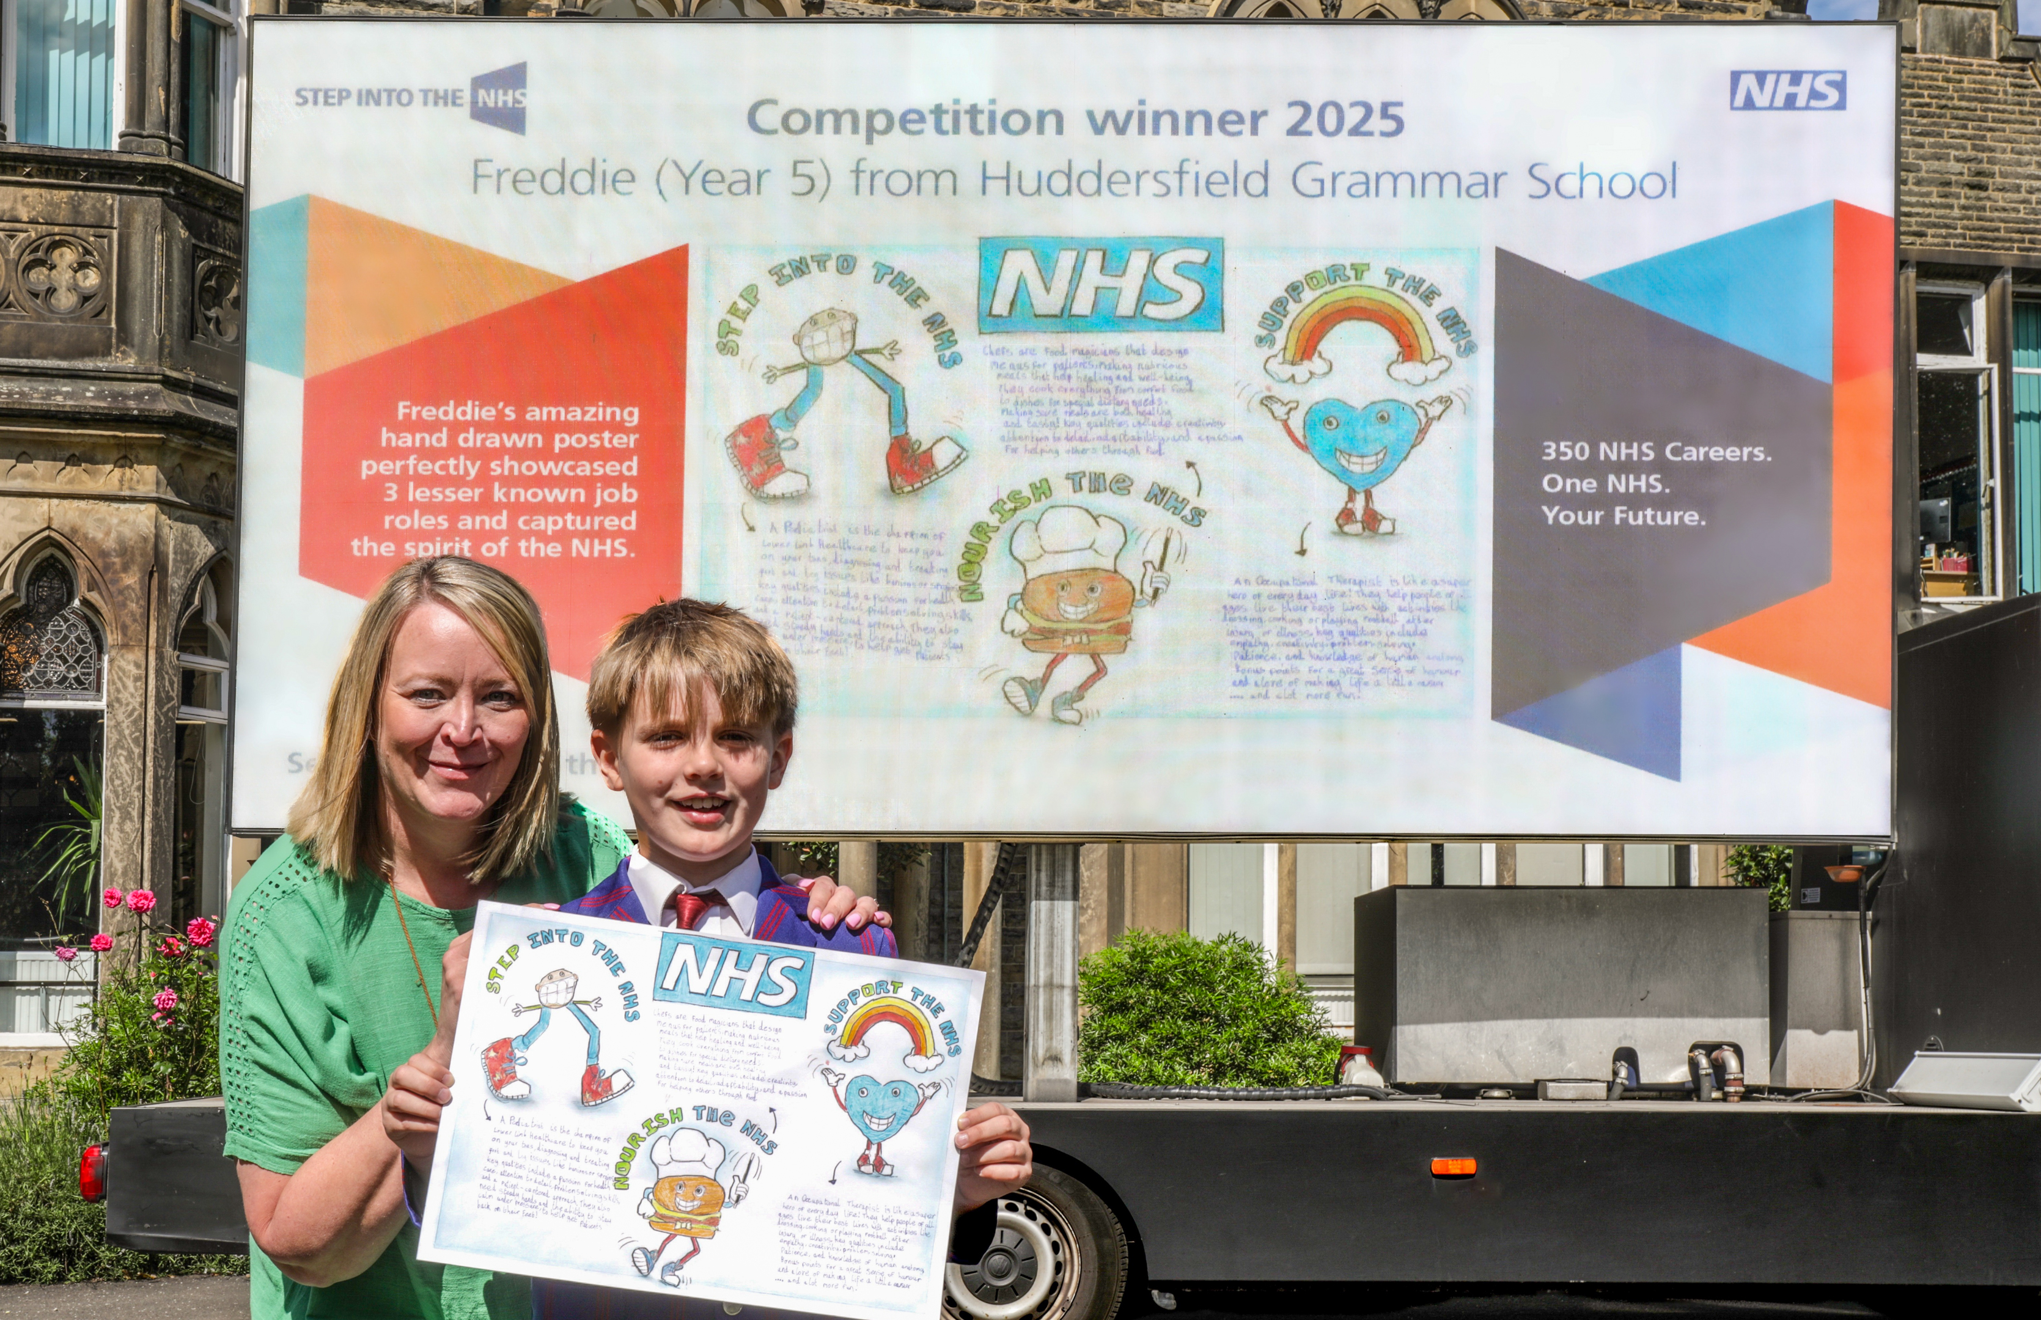
How to get started
Teachers!
Visit stepintothenhsˌnhsˌuk to download the one lesson launch to kick-start entries in one hour
Submit entries online or by post by 30 April 2025
Pupils!
Teachers will introduce you to the NHS and all of its careers
Get creative with your entries!
Notes:
Our main message is that it only takes one hour to deliver all the learning to pupils.

Slide 7

Step into the NHS Day
Hear LIVE from NHS staff!​
Hear from lots of different NHS staff members, complete fun activities and ask any burning questions you might have.
How will the day help me?​
You’ll learn about different roles within the NHS​
You’ll be able to use this learning to then create a fantastic entry (if you haven’t already started!)
Teachers – visit the Step into the NHS primary school pages to sign up!
Join us on Thursday 13 March!
Notes:
Teachers can visit https://www.stepintothenhs.nhs.uk/primary-schools to sign up

Slide 8

Good luck!

