Slide 1
Step forward into the NHS

Slide 2

What will you learn?
What could the future look like?
What could your future look like?

Slide 3
The T Factor
Technology changes how we do things. How does it play a part in your and your family’s life?

Slide 4
The T Factor
How we communicate
Mobile phones, smart devices, emails, laptops, social networking
How we entertain ourselves
LCD TV, smart TVs, Xbox, 3D cinema
How we live
The majority of items in our homes today are automated and we can even shop without leaving the house!

Slide 5
The T Factor
How we learn
We have modern technology in our classrooms in order to learn better. For example, whiteboards and iPads
How we get around
Transport is an important part of our lives. Technology has worked on making it more efficient and quicker
How we are treated by the NHS
Technology is the driving force behind the huge improvements in NHS healthcare

Slide 6






Examples of how the NHS has used new technology
Technology to perform transplants | CT scans to see inside the body | A website to provide health advice | Robotic arm for heart operations

Slide 7
Look into the future
What technology will the NHS adopt next to improve the work that it does?
What does the future look like?
Here are five new technologies. How would you use them if you worked for the NHS?

Slide 8
Robotics
What if robots could learn, adapt and take decisions?
They could work for you, beside you, assist you and interact with you.
How would you use them in the NHS?

Slide 9
Virtual reality
Virtual reality creates a world that feels real.
You can interact with, and explore it ̶ all you need is some electronic equipment such as a helmet with a screen inside. You might have seen it used in gaming!
How would you use it in the NHS?

Slide 10
Self-driving vehicles
Have you ever heard of vehicles driving themselves? Driverless buses have already been tried out in a town in Japan!
How could the NHS use vehicles which drive by themselves? How would they help or improve the important work that it does?

Slide 11
Smartphones and tablets
Smartphones are the most popular way to get online and the iPad has been a runaway success since its launch in 2010. In fact more than half of UK homes own a tablet and many kids don’t even have to share one with their parents!*
How would you use them in the NHS?
* Source: Ofcom (2015)

Slide 12
Artificial intelligence
The new Amazon Echo technology is an example of an intelligent machine.
It’s a speaker. You speak your wishes and it makes them happen ̶ at least simple ones like making a shopping list or playing your music. You can command it to do other things too.
How could the NHS use it to help patients?

Slide 13
Some predictions
Robotics: Help healthcare staff perform their jobs
Virtual reality: Used to train doctors and nurses
Self-driving vehicles: Ambulances drive without a driver, freeing up more time for the paramedics
Smartphones and tablets: Video call a doctor or nurse
Artificial intelligence: The Amazon Echo could, for example, help older people with things like remembering to take their medication so that they are able to live safely in their own homes for longer

Slide 14


Some predictions
Technology has created lots of jobs already.
With all this new technology, could there be NHS jobs in the future that don’t exist as yet?
What could they be?

Slide 15
When I look into my future…
What do I see?

Slide 16
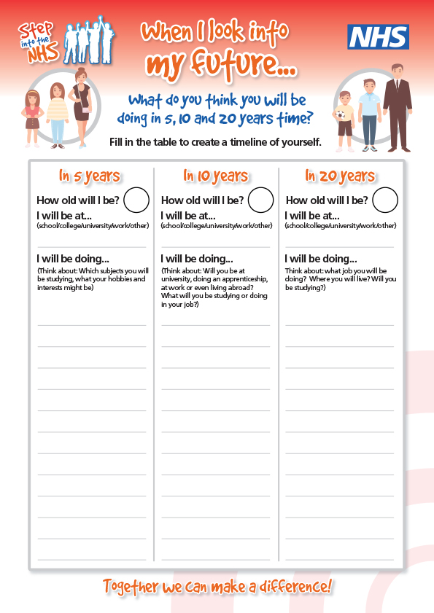
What do I see?
What do I see in:
5 years?
10 years?
20 years?
I will be:
At school?
At college?
At university?
At work? Which job?

Slide 17
In 5 years? | In 10 years? | In 20 years?
How old will I be? | How old will I be? | How old will I be?
I will be at... (school/ university/work etc.) | I will be at... (school/ university/work etc.) | I will be at... (school/ university/work etc.)
I will be doing... | I will be doing... | I will be doing...

Slide 18
Things to think about to help you
Which NHS job do you think you might like to do?
What do you need to learn?
Do you need to train for it?
Which subjects do you need to study etc.
How long will you need to study or train for it?

Slide 19
When I look into my future…
Create a short presentation about: “When I look into my future...”
Use pictures and words
Include slides on:
This is me
This is what I could be in the NHS

Slide 20
This is me
Me and my family
My interests and favourite things
Three words that describe me
1.
2.
3.
I am good at...

Slide 21
This is what I could be in the
About the job
Why I would be good at this job
How I can get there
Best part of this job is...

Slide 22
What did you learn?
Learning outcomes

Slide 23
Learning outcomes
You understand that developments in technology impact how we work and what we can achieve.
You understand the important role technology has played in the NHS and what this could mean for future jobs.
You can represent yourself in pictures and words.
You can talk positively about what you might like to do.

