Slide 1





Topic 4:
Working to help young people deal with their problems

Slide 2

Part 1: Mental health

Slide 3

Describe the feeling
Winning Love Island
Notes:
Wikimedia commons: http://commons.wikimedia.org/wiki/File:X-factor-thumb.jpg

Slide 4

Describe the feeling
Losing your favourite pet
Notes:
http://www.sxc.hu/photo/1309327

Slide 5
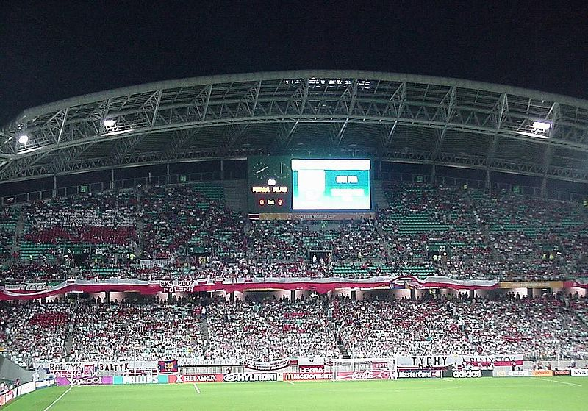
Describe the feeling
Scoring the winning goal in the World Cup final
Notes:
Wikimedia commons: http://commons.wikimedia.org/wiki/File:Polish_football_fans_-_Korea_2002_FIFA_World_Cup.jpg?uselang=en-gb

Slide 6

Describe the feeling
Arguing with a friend or partner
Notes:
Wikimedia commons: http://commons.wikimedia.org/wiki/File:Factor_x_chile.jpg

Slide 7

Describe the feeling
Sitting an exam

Slide 8
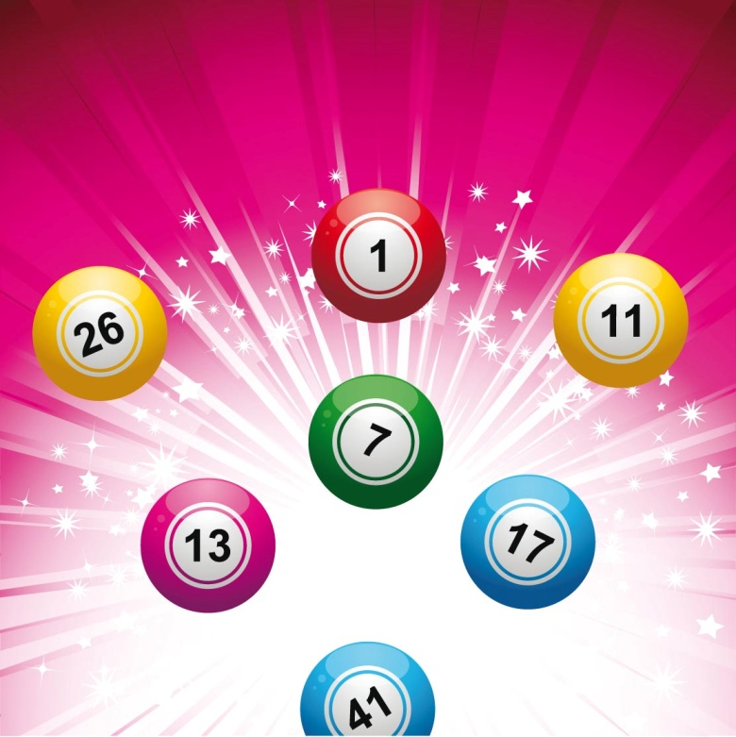
Describe the feeling
Winning the lottery
Notes:
Wikimedia commons: http://commons.wikimedia.org/wiki/File:Kupony_Lotto.jpg

Slide 9
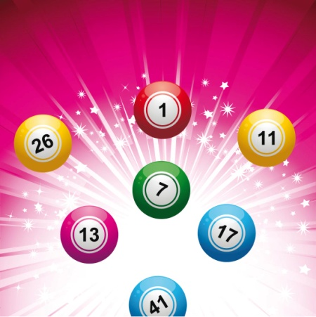
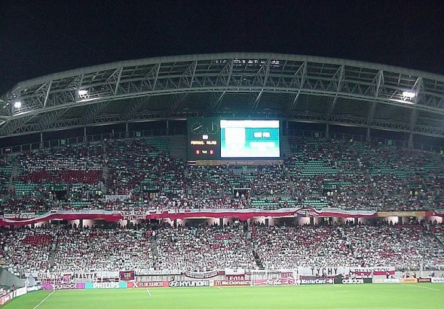
‘Stressful’ or ‘happy’?

Slide 10
Feelings
We all deal with different feelings and emotions every day.
Sometimes these can be positive and easy to cope with, but other times they can be stressful and much harder to manage.
The things that cause you worry or stress are often shared by many other young people and by talking to someone it can help to ease the problem.

Slide 11
It stresses me out when…..

Slide 12
Examples of stress
Exams
Arguments
Making and keeping friends
Bullying
Body image
Changing body
Knowing what I want to do in the future
Stress

Slide 13
Maintaining mental health
Here are five things that can help to maintain good mental health:
  Feeling safe and looked after
  Being able to give your opinions and have people listen to you
  Giving positive attention to others (it could be a person or a pet)
  Getting respect for stuff you are good at
  Having help with money and finances
Organise these five factors into order of importance.

Slide 14
Part 2: Drugs

Slide 15
What leads young people to take drugs?

Slide 16
Some reasons for taking drugs
Peer pressure
Curiosity
Boredom
Fun
Relaxation
Escapism
Experiment

Slide 17
Scenario 1: Josh’s party
Nancy is 16 and her new boyfriend Josh has invited her to a party. Josh is one of the fittest boys in school, and two years above Nancy. All of Josh’s friends will be there – they’re all pretty cool.
At the party Nancy has a couple of drinks and starts talking to Josh’s mates. They’re all planning to do such amazing things with their lives – travelling, going to Uni, and a couple of them are in a band.
As they are talking, one friend starts to hand out some small tabs to Josh and the others. He offers one to Nancy and she watches as the others take theirs with an excited grin.
Nancy doesn’t really know what the tabs are and starts to say 'no', but the others all tell her what a good time she’ll have if she takes it. She looks at Josh - she wants to show him how grown up and exciting she is, and desperately wants to fit in with his friends. If everyone else was doing it she wanted to do it too. She took the tab and placed it in her mouth as she had seen the others do….

Slide 18
Scenario 2: Justin’s trap
Justin started smoking weed around six months ago. His mum recently married his step dad and now his four step-brothers and sisters have come to stay too. The house is really crowded and Justin needs to escape sometimes to meet his mates.
About a month ago, Justin’s friend Tom introduced him to Warren. Warren always had the best weed. Justin was now smoking so much, sometimes bunking off school and smoking all day, that he couldn’t always afford the really good stuff.
Warren offered Justin the chance to earn some cash by running a small errand, taking a bag of drugs to a friend and bringing back cash in return. The job was easy enough, but then Warren started asking Justin to do more and more of them.
Justin felt excited at first but the jobs were getting bigger and harder now and were taking him to some pretty scary places. If he ever suggested that he couldn’t help, Warren would turn nasty and threaten to beat him up. Justin felt trapped but instead of getting help he would light up to escape. He hadn’t thought of the consequences of getting caught up in this world he did not understand….

Slide 19
Part 3: Body image

Slide 20
What is body image?
Body image refers to a person’s perception of their body.
It’s how a person feels about their body and how they think they look.
A person might have a positive or negative perception of their body image.

Slide 21
Your task
You have two copies of a worksheet.
On one worksheet, annotate the images with positive words that young people might use to describe their body.
On the other worksheet, annotate the images with negative words that young people might use to describe their body.

Slide 22
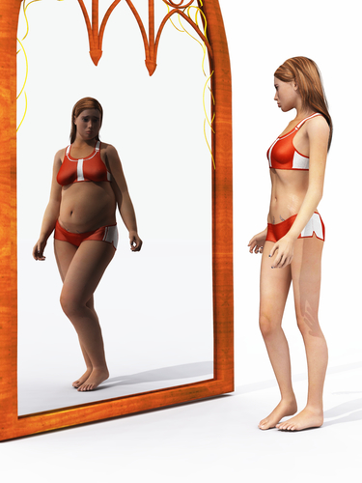
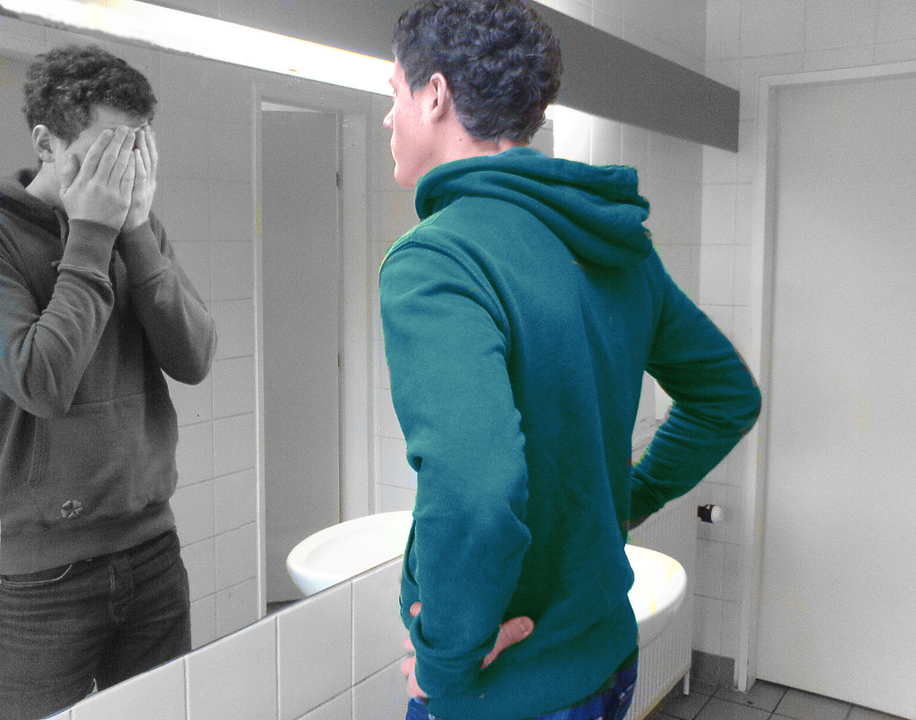
Young people’s perception of body image
Young people’s perception of body image can also be very different to what other people see.

Slide 23
What influences young people’s perceptions of body image?
Models
Magazines
Social media
Celebrities
Movie stars
Bloggers
Music videos

Slide 24
What influences young people’s perceptions of body image?
All the images of celebrities and models that we see in the media can negatively influence young people’s attitudes towards their own body image.
However, many images that you see in magazines, on TV and via social media are not realistic as they have been changed to make people look flaw free!
These false images can often make people feel bad about their own body image.
It is important to remember that in reality, people come in ALL shapes and sizes!

Slide 25
Part 4: Helping young people

Slide 26
Getting help
Many young people can experience problems.
Sometimes you might think you are the only person dealing with your problem, but it’s not true.
It’s good to talk things through with someone you can trust – a friend, teacher, parent or carer.
But, there are also lots of helplines and organisations that can give you advice and support.

Slide 27

Helping young people
Your challenge is to create a campaign that can help young people to deal with mental health, drugs or body image problems.
Whilst exploring these issues further, you will also discover careers in the NHS that you could work in to help people deal with these kinds of problems.

Slide 28

Helping young people
You need to create a campaign that:
  Provides tips and advice to help young people deal with issues around mental health, drugs or body image.
  Raises awareness of the places they can go for advice
  Identifies the people who can help them.

Slide 29
Your challenge
You should be creative when thinking about your campaign:
  How can you catch the attention of young people?
  What channel should you use to reach young people?
It may be a radio show, website, leaflet, poster, social media campaign, TV show or advert etc.
The factsheets are your starting point for research, but you can also explore the useful websites highlighted in the documents.

Slide 30
Careers
Did you discover any new careers that sounded interesting?
What do you think it would be like working with people experiencing these issues?
What would be the good and challenging parts of these jobs?
For further information about careers in the NHS visit: www.stepintothenhs.nhs.uk
For further information about the NHS visit: www.nhs.uk

