Slide 1
History of the NHS

Slide 2
What will you learn?
The NHS was born in July 1948. It has changed and achieved a vast amount since that time.
In what ways has it changed and what are people’s experiences of it?

Slide 3
Look back at the past
Use the timeline to find the following information...

Slide 4
The history of the NHS
When and why was the NHS set up?
How has the NHS changed in size?
How many patients does the NHS see?
Have men and women always had the same rights to opportunities? If not, how has that changed over time?
Can you find at least two examples of how science and technology have helped to improve health and save lives?
Do you think the jobs in the NHS today are the same as they were in 1948?

Slide 5
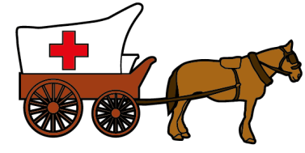
1. When and why was the NHS set up?
1948 | Before 1948
To provide free healthcare to everyone | People generally had to pay for their healthcare

Slide 6
2. How has the NHS changed
in size?
THEN | NOW
144,000 people worked there when it launched in 1948 | 1.7 million people work there now. That’s over 11 times more

Slide 7
3. How many patients does the
NHS see?
The NHS now sees and treats more patients than ever before.
One million patients every 24 hours!

Slide 8
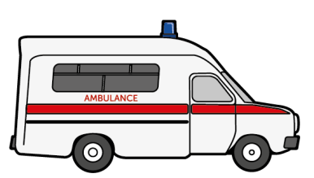
4. Have men and women always had the same rights to opportunities?
NO. But a new law was passed in 1975 which said women need to be treated equally and given the same opportunities as men in the workplace.
The law protects men too. For example, in 1983 men for the first time, were allowed to work as midwives in the NHS. Up until then, only women had worked as midwives.

Slide 9
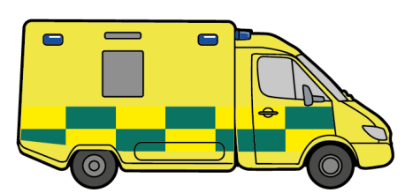
5. Examples of how the NHS has used science and technology
Technology to perform transplants | CT scans to see inside the body | A website to provide health advice | Robotic arm for heart operations | Vaccinations to prevent diseases
Improvements in scientific discovery and advances in technology are helping people to live longer and healthier lives

Slide 10
6. Are jobs in the NHS the same today
as they were in 1948?
There are over 350 different roles in the NHS today. Technology has created new jobs and changed the way some jobs are done, e.g.
Using new technology, such as: how to carry out CT scans, record patient information electronically, and use special equipment for operations
Sharing information using email, social media and websites. The NHS is now one of the the largest e-health services in the world and offers health advice to the public by telephone or through a website (111 and NHS Choices)

Slide 11
What’s their story?
Let’s capture some stories about the NHS. Speak to your family about their experiences. Or, do you know anyone who works/has worked for the NHS?

Slide 12
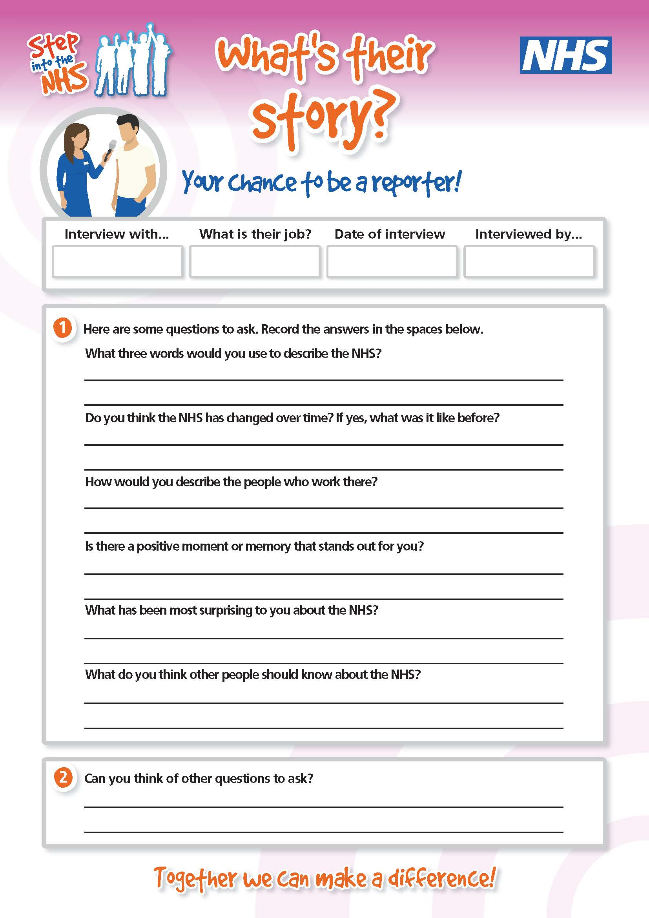
Example questions to ask
What three words would you use to describe the NHS?
Do you think the NHS has changed over time? If yes, what was it like before?
How would you describe the people who work there?
Is there a positive moment or memory that stands out for you?
What has been most surprising to you about the NHS?
What do you think other people should know about the NHS?

Slide 13
What’s their story?
Write up their story to capture their experience, whether they work/ worked for the NHS or the NHS has helped them.

Slide 14
What did you learn?
Learning outcomes

Slide 15
Learning outcomes
You know about the NHS and understand that jobs, and how you do them, can change over time. Developments in science and technology impact how we work and what we can achieve.
You can speak to, and listen to others to capture stories and share them.
You know that laws have been specially introduced to say that men and women have the same rights to opportunities as each other. There is no such thing as a man’s or woman’s job any more.

