Slide 1
There are over 350 different careers available in the NHS!
Here are just some of the NHS team to tell you about their jobs.

Slide 2
The apprentice
Name: Pascal Wellington
Role: Business administrative apprentice
Responsibilities: Assist the director’s PA with
managing emails, diary and
telephone systems. Process invoices
and keep staff record database up to
date.
Personality: Organised, responsible and reliable, with excellent communication skills.
Advice: An apprenticeship is a great way of
getting some extra qualifications
while working.
Entry requirements: There are no set entry qualifications,
but employers will want to make
sure that you can cope with the
work involved. Requirements depend
on the employer and the type and
level of apprenticeship.

Slide 3
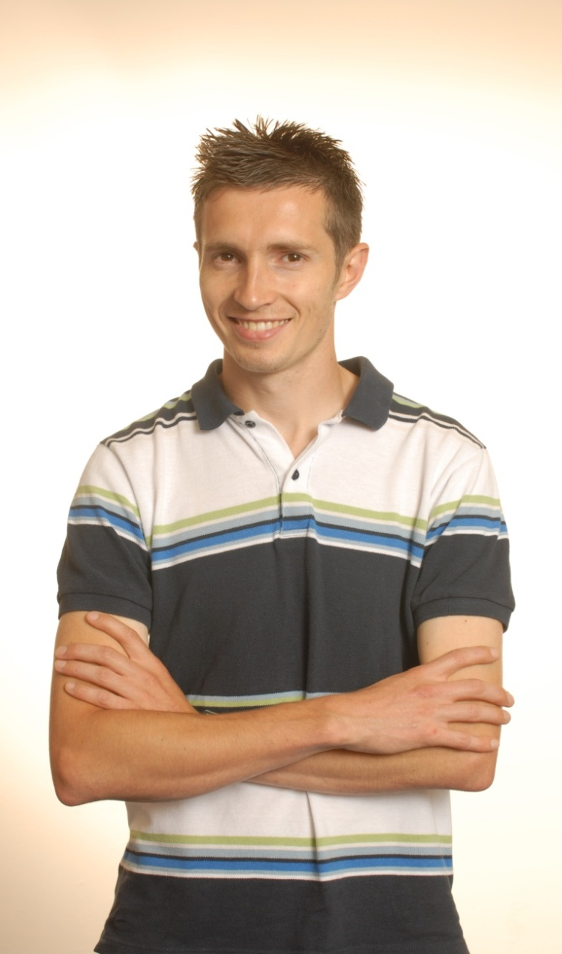
The exercise physiologist
Name: Scott Elliott
Role: Exercise physiologist and smoking
cessation officer
Responsibilities: A vital part of a life-saving healthcare team, working with patients with heart problems, carrying out diagnostic investigations and offering expert advice to doctors.
Personality: Calm, understanding and confident enough to put people at ease.
Advice: If you’re interested in sport and fitness, this is the perfect job. You get to use some sophisticated medical equipment too.
Entry requirements: Five GCSEs at grade 9-4 (A*-C) or
equivalent.
At least two A levels (including a science subject) or equivalent.
Degree in physiological science.

Slide 4
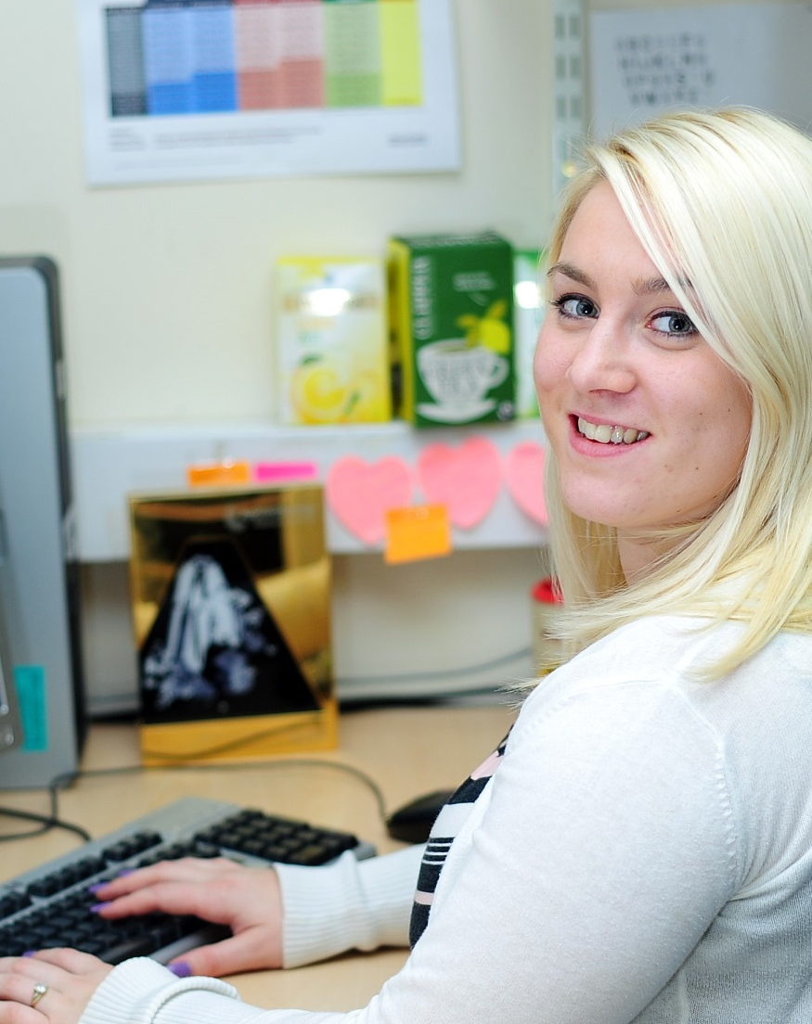
The finance assistant
Name: Lydia Wager
Role: Income and costing accountancy
assistant
Responsibilities: Finance reporting, including compiling spreadsheets, graphs and written data.
Prepare invoice data for care provided to
patients.
Personality: Strong analytical skills and be able to
work in a team but also work
independently on your own tasks.
Advice: If you have a logical mind and like analysing facts and figures then this is a great job for you.
Entry requirements: Five GCSEs at grade 9-4 (A*-C) or equivalent.
At least two A levels or equivalent.
Degree in accountancy or relevant subject. You can then apply for an NHS training position.

Slide 5
The clinical psychologist
Name: Anna Disney
Role: Assistant clinical psychologist
Responsibilities: Assessing patients and offering counselling, therapy and advice to a wide-range of people with mental health problems.
Personality: Interested in the feelings of others and fascinated by human behaviour. Empathise with people and understand their feelings.
Advice: I love working so closely with people and the challenge of such a steep learning curve, at the same time as feeling fully supported by my brilliant team.
Entry requirements: Five GCSEs.
Three A level subjects or equivalent.
Approved degree in psychology and postgraduate qualification in clinical psychology.

Slide 6
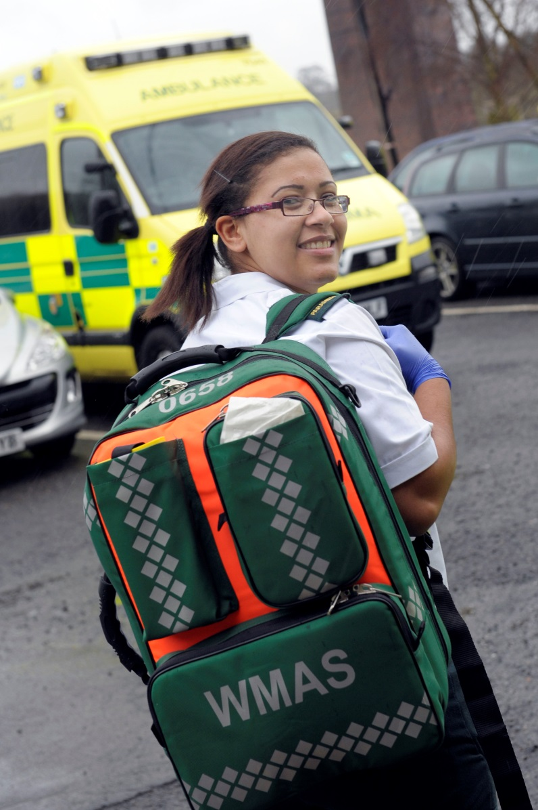
The paramedic
Name: Elisha Miller
Role: Paramedic
Responsibilities: Respond to emergency calls and provide all
aspects of urgent and emergency care,
ranging from problems such as cardiac
arrest, heart attacks, strokes, spinal injuries
and major trauma, to minor illnesses and
injuries.
Personality: Calm under pressure and able to work
quickly and carefully.
Advice: You have to be really on the ball and be able
to understand a situation quickly. Even when
the adrenalin’s pumping you have to stay
calm and reassure the patient.
Entry requirements: To practise as a paramedic, you first need to
successfully complete an approved
qualification in paramedic science which
could be a diploma, a foundation degree or
degree.

Slide 7
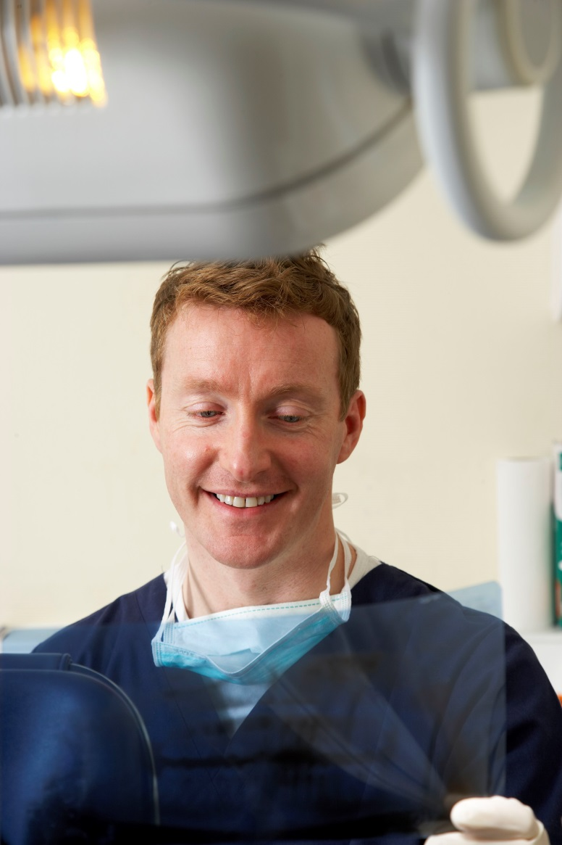
The dental therapist
Name: Dave Martin
Role: Dental therapist
Responsibilities: Provide treatment in a range of places in the
community, such as schools and care
homes. Carry out a range of routine dental
work including oral assessments, and taking
dental radiographs.
Personality: A good and patient communicator with
proficient, highly technical clinical skills.
Advice: To work in this role, will need to encourage
anxious patients to accept dental treatment.
You will need to be confident to work on
your own and be able to put even the
youngest of patients at ease.
Entry requirements: You’ll need to obtain a diploma or degree in
dental therapy and be registered on the
General Dental Council’s roll of dental
therapists. To get on the course, you will
need five GCSE subjects at grade 9-4 (A* to C) or equivalent, plus two A-levels or a recognised qualification in dental nursing.

Slide 8
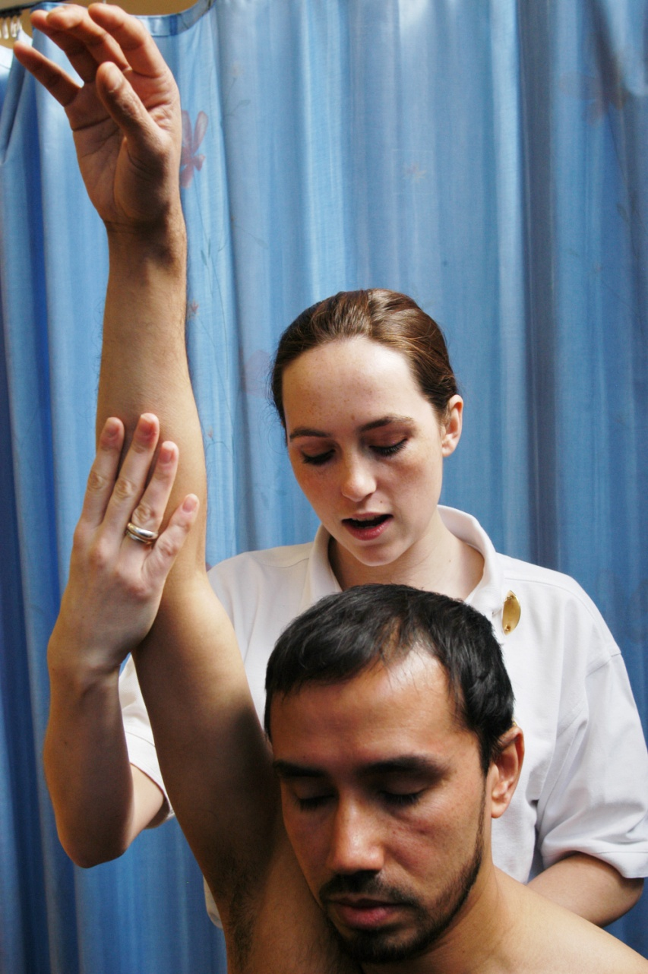
The physiotherapist
Name: Celia Cohen
Role: Senior physiotherapist
Responsibilities: Treating people with physical problems caused by illness, accident or ageing. Identifying the problems and helping to maximise patient mobility using manual therapy and therapeutic exercises.
Personality: Tolerant, patient, compassionate towards others, very level headed and practical.
Advice: It can be stressful dealing with a constant stream of patients but that’s also what makes the work really rewarding.
Entry requirements: Five GCSEs, including science.
Three A levels (including biology) or
equivalent.
Approved three or four year degree in
physiotherapy.

Slide 9
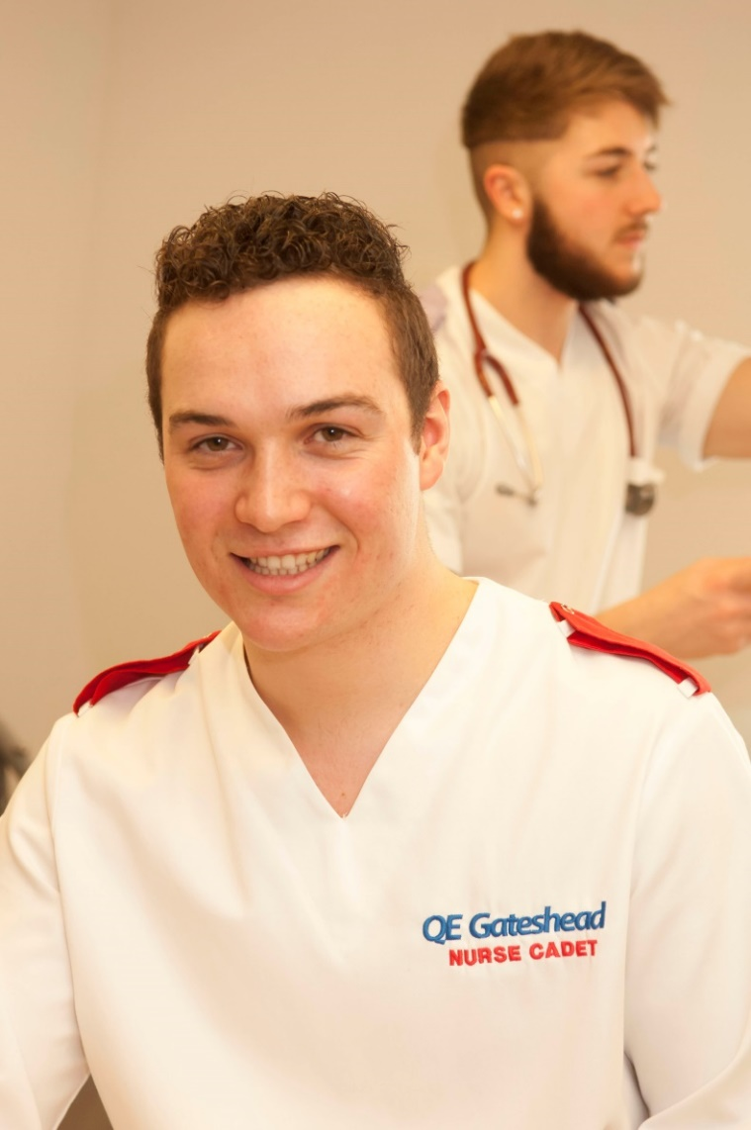
The healthcare assistant
Name: Luke Watson
Role: Nurse cadet
Responsibilities: Providing hands-on care to patients with all kinds of problems. I help lots of different
healthcare professionals with their daily tasks:
everyone from nurses, doctors and healthcare
assistants to porters, housekeepers,
physiotherapists and occupational therapists.
Personality: Work well under pressure and able to carry out
many tasks at once without getting stressed.
Advice: Working as an apprentice first gave me a real
feel for the health sector. I loved every minute!
Entry requirements: There are no set entry requirements to become a
healthcare assistant. Employers expect good
literacy and numeracy and may ask for GCSEs
(or equivalent) in English and maths. They may
ask for a healthcare qualification, such as BTEC
or NVQ.

Slide 10
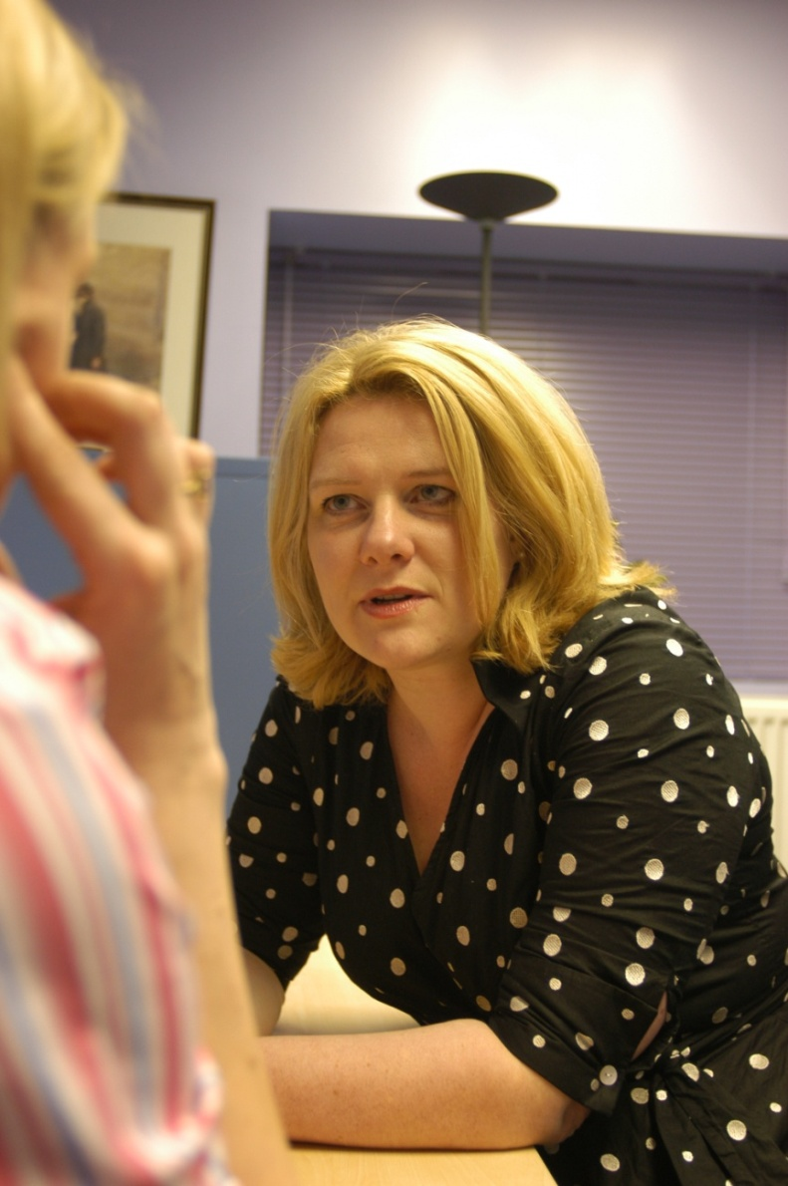
The human resources professional
Name: Louise Brandon
Role: Assistant personnel officer
Responsibilities: Staff management including recruitment and employee welfare; pay issues, training and development, health and safety, plus advising hospital managers.
Personality: Enjoy working with other people, organised and able to do many tasks at once, staying calm under pressure.
Advice: If you’re looking for a career with lots of opportunities to progress up the ladder, this job is excellent.
Entry requirements: There are no minimum entry requirements, but you'll need to demonstrate a good basic education.
You can either enter at an administrative level and work your way up or you can complete A levels (or equivalent) and then study for a degree - perhaps in human resource management.

Slide 11
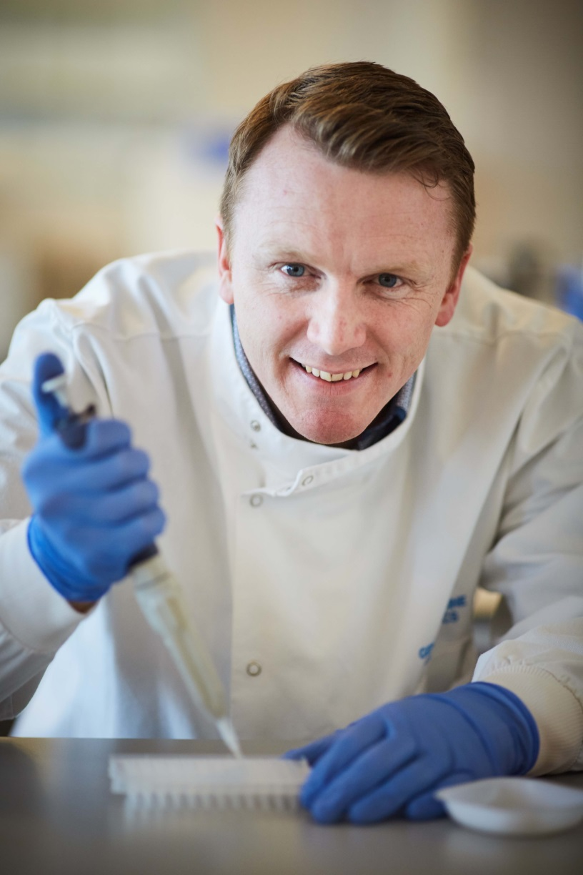
The clinical scientist
Name: Ronnie Wright
Role: Clinical scientist
Responsibilities: Taking samples of genetic materials and analysing it for diseases or abnormalities in the lab.
Personality: Able to concentrate for long periods of time, pay attention to detail and have good problem-solving skills.
Advice: If you’re interested in science, medicine and computing, and love using the latest technology, you couldn’t find a better job. Some of the mutations I find are quite unique - they have never been seen by anyone else in the world before.
Entry requirements: Five GCSEs at grade 9-4 (A*-C) or equivalent (including maths, English and two science subjects).
At least two A levels or equivalent. A biomedical science degree followed by the three year NHS Scientist Training Programme.

Slide 12
The intensive care nurse
Name: Anna Kerry
Role: Registered nurse in intensive care
Responsibilities: Providing one-to-one patient care for seriously ill people, monitoring and registering all the support equipment needed to keep patients alive.
Personality: Well balanced, mature and practical.
Able to work well under pressure.
Advice: It can be emotionally draining, you have to keep pretty balanced. The job can move from the sad times when everything you do is just not enough to help, to the fantastic sense of achievement of saying goodbye to a patient well on their way to recovery.
Entry requirements: Five GCSEs at grade 9-4 (A*-C) or equivalent (including English and a science subject), plus at least two A levels or equivalent. A degree in nursing.

Slide 13
The radiographer
Name: Ricardo Khine
Role: Lecturer/practitioner in therapeutic radiography
Responsibilities: Planning and accurate delivery of the correct radiotherapy according to patient needs. This involves scans and x-rays for diagnosis and planning and operating highly specialised machines to treat the problem.
Personality: Able to put people at ease and enjoy working in a team.
Advice: This job enables you to explore an interest in digital imaging and technology within a medical environment.
Entry requirements: Five GCSEs at grade 9-4 (A*-C) or equivalent (including a good grade in science).
At least two A levels (including a science subject).
Approved three-year degree in therapeutic
radiography at university.

Slide 14
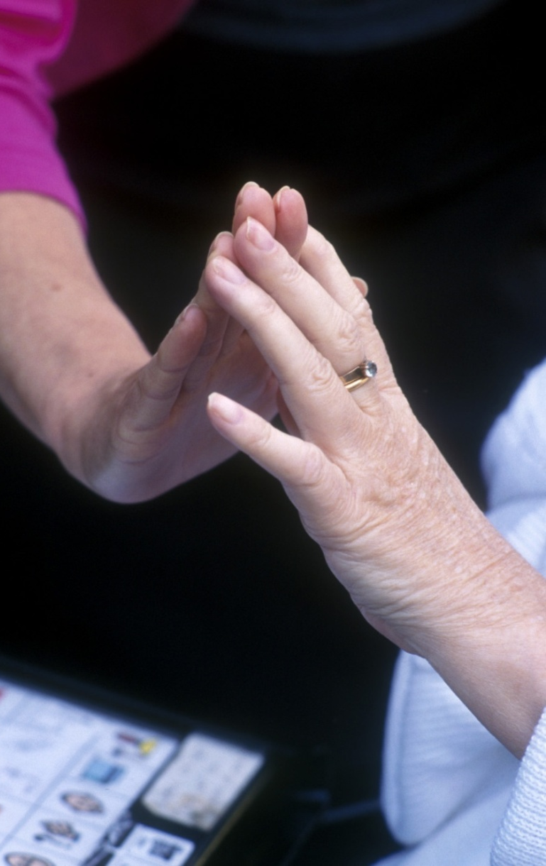
The occupational therapist
Name: Rachel Maton
Role: Occupational therapist in a children’s hospital
Responsibilities: Helping people who’ve been sick or injured to do everyday occupational activities. For children, this includes having a bath, eating breakfast, getting to school and playing.
Personality: Patient, determined with lots of common sense. Good at motivating others and like working closely with individuals.
Advice: Seventy per cent of my time is spent dealing with the effects of accidents, especially fractures to fingers and wrists. Trampolines and monkey bars have a lot to answer for!
Entry requirements: Five GCSEs at grade 9-4 (A*-C) or equivalent, (including a good grade in science).
At least two A levels (ideally including a science subject) or equivalent.
Approved three-year degree in occupational therapy at university.

Slide 15
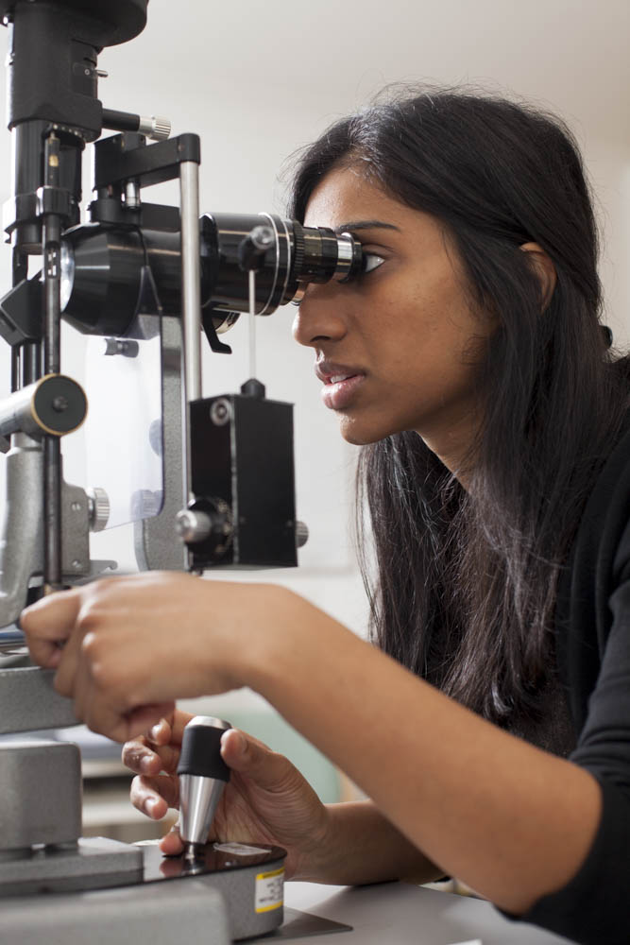
The GP
Name: Kavita Aggarwal
Role: Trainee ophthalmology doctor
Responsibilities: On a typical day, I assess patients who have
acute eye conditions, taking their history,
performing a clinical examination and treating
them appropriately. As a junior doctor, I also
attend weekly departmental teaching sessions.
Personality: Responsible, reliable with excellent communication skills. Make decisions quickly and like helping others.
Advice: Training to be a doctor usually takes five to
six years but the sense of job satisfaction is huge – you can really make a difference to
someone else’s life.
Entry requirements: Five GCSEs at grade 9-6 (A*-B) or equivalent.
Three good A level grades (including science) or equivalent.
Approved medical degree (usually five years) followed by foundation and further training.

Slide 16
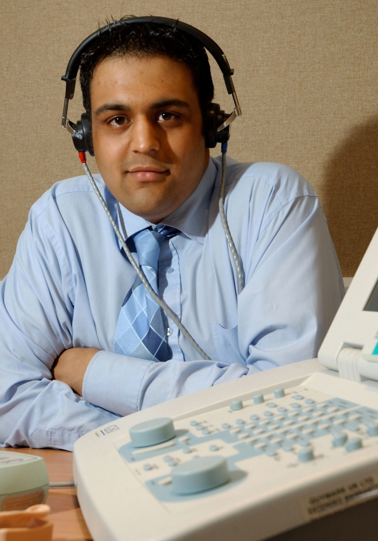
Healthcare scientist - audiology
Name: Devang Joshi
Role: Healthcare scientist specialising in audiology.
Responsibilities: Helping people with hearing and balancing disorders. Examining patients, assessing problems, prescribing the right kind of hearing aid or maybe arranging for further investigation.
Personality: Patient, understanding and enjoy helping others. Logical, with a passion for science.
Advice: It is challenging and always varied, with lots of opportunities to specialise; in babies, adults, special needs, or even research.
Entry requirements: Five GCSEs at grade 9-4 (A*-C) or equivalent (including a good grades in English, maths and science).
At least two A levels (including a science subject) or equivalent.
A relevant science degree followed by a three-year post under the NHS Scientist Training Programme.

Slide 17
Do any of them sound like you?
Visit https://www.stepintothenhs.nhs.uk to find out more about these careers.

