Slide 1
Create your Competition entry

Slide 2

What will you learn?
Recap learning objectives from Parts 1 and 2 and share what you have learnt with others entering the fun competition.

Slide 3






Watch the video about the NHS and our exciting competition @
www.stepintothenhs.nhs.uk/primary-schools

Slide 4
A recap of the key points…

Slide 5
Say thank you to the NHS by taking part in our competition
Get creative...
Produce a piece of artwork or performance art, for example: a painting, drawing, video, collage or temporary street art
OR a poem, story, song or dance

Slide 6
The prizes
There are some fantastic prizes available for winning students*:
Overall national winner(s) will receive Amazon vouchers worth £50
Ten regional winners will each receive an Amazon voucher worth £25
Highly commended certificates will also be awarded
April 2020 update: The specifics of the national winner’s prize beyond vouchers will be discussed with the winning school, to ensure something appropriate can be awarded should the previously listed class trip to a local science venue not be appropriate at this time.
*Whether you enter individually or as a pair, each of you will receive a prize if your entry is chosen.

Slide 7
How will you say thank you to the NHS?
Think about the wide range of jobs you have learnt about and how the NHS helps people. You can say thank you to people who do a particular job you have seen or say thank you to a whole team!
You have the chance to win fantastic prizes!

Slide 8

Some simple rules
You can work on your own or in pairs | Online entries accepted only (individual files should not exceed 50MB) | The closing date for entries is 19 June 2020
To submit entries visit:
stepintothenhs.nhs.uk/primary-schools/KS2-competition/send-us-your-entry

Slide 9
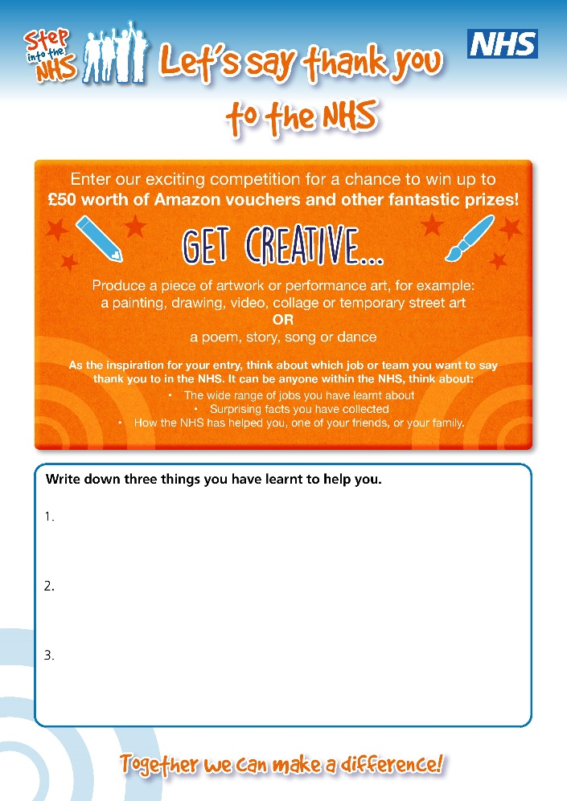
What have I learnt?
We have been doing a lot of work about jobs, especially in the NHS
Write down three things you have learnt to help inspire your competition entry

Slide 10
What did you learn?
Learning outcomes

Slide 11
Learning outcomes
You know about a wide range of jobs in the NHS and shared what you have learnt with others.
You know there’s no such thing as a man’s job or woman’s job; they have the same rights to opportunities as each other.
You feel proud of your achievements.

