Slide 1
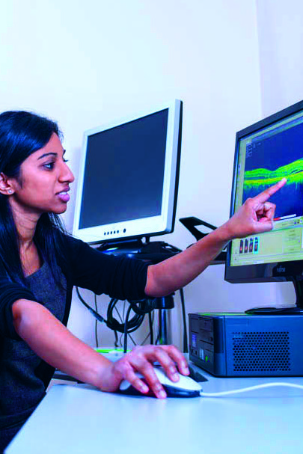
Technology and the NHS

Slide 2
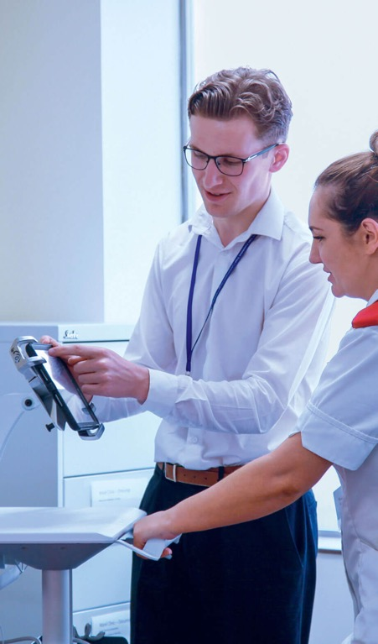
What will you learn?
What could the future look like?
What could your future look like?

Slide 3
The T Factor
  Technology changes how we do things. How does it play a part in your and your family’s life?

Slide 4
The T Factor
How we communicate
Smart phones, emails, laptops,
social media
How we entertain ourselves
Smart TVs, tablets, Xbox,
Alexa, VR (virtual reality) headsets
How we live
The majority of items in our homes today are automated
and we can even shop without leaving the house!

Slide 5
The T Factor
How we learn
We have modern technology in our classrooms in order to learn better. For example, whiteboards and iPads.
How we get around
Transport is an important part
of our lives. Technology has worked on making it more efficient and quicker.
How we are treated by the NHS
Technology is the driving force behind the huge improvements in NHS healthcare.

Slide 6
Examples of how the NHS has used new technology
Technology
to perform transplants
CT scans to
see inside
the body
A website
to provide health advice
Robotic arm
for heart operations

Slide 7
Look into the future
  What technology will the NHS adopt next to improve the work that it does?
  What does the future look like?
  Here are five new technologies.
  How would you use them if you worked for the NHS?

Slide 8
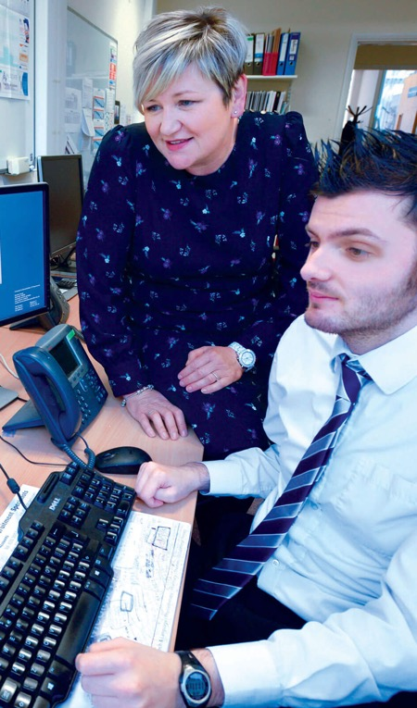
Robotics
What if robots could learn, adapt
and take decisions?
They could work for you, beside
you, assist you and interact with you.
How would you use them in the NHS?

Slide 9
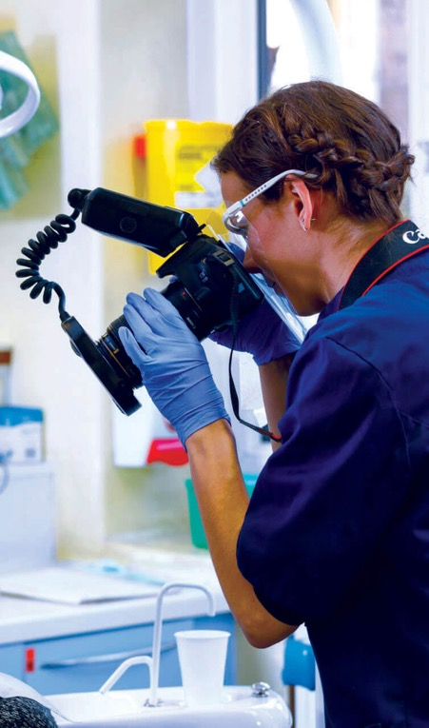
Virtual reality
Virtual reality creates a world that feels real.
You can interact with, and explore it ̶ all you need is some electronic equipment such as a helmet with a screen inside. You might have seen it used in gaming!
How would you use it in the NHS?

Slide 10

Self-driving vehicles
Have you ever heard of vehicles driving themselves? Driverless buses have already been tried out in a town in Japan!
How could the NHS use vehicles which drive by themselves? How would they help or improve the important work that it does?

Slide 11
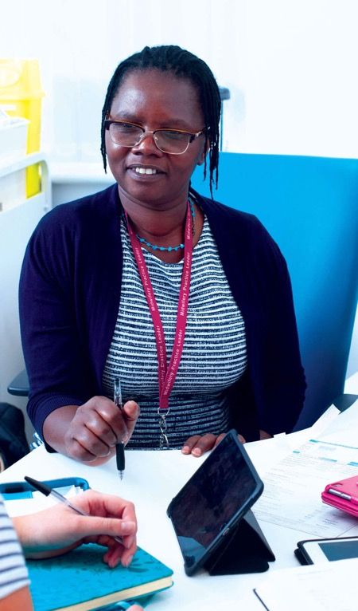
Smartphones and tablets
Smartphones are the most popular way
to get online and the iPad has been a runaway success since its launch in 2010.
In fact more than half of UK homes own
a tablet and many kids don’t even have
to share one with their parents!*
How would you use them in the NHS?
* Source: Ofcom (2015)

Slide 12
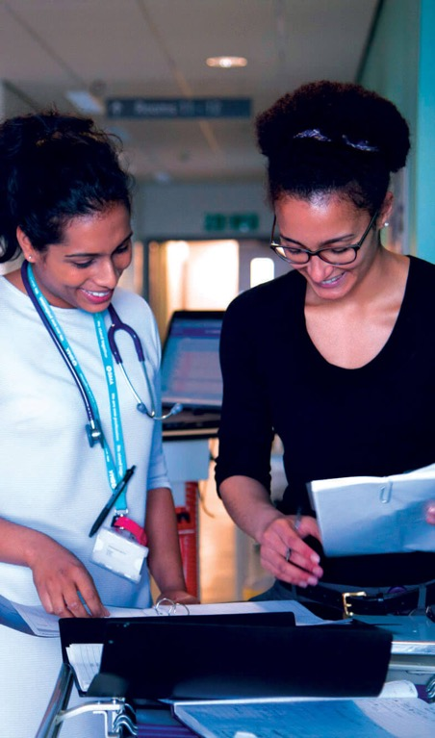
Artificial intelligence
The new Amazon Echo technology is an example of an intelligent machine.
It’s a speaker. You speak your wishes and it makes them happen ̶ at least simple ones like making a shopping list or playing your music. You can command it to do other things too.
How could the NHS use it to help patients?

Slide 13
Some predictions
Robotics: Help healthcare staff perform their jobs.
Virtual reality: Used to train doctors and nurses.
Self-driving vehicles: Ambulances drive without a driver, freeing up more time for the paramedics.
Smartphones and tablets:
Video call a doctor or nurse.
Artificial intelligence:
The Amazon Echo could, for example, help older people with things like remembering to take their medication so that they are able to live safely in their own homes for longer.

Slide 14
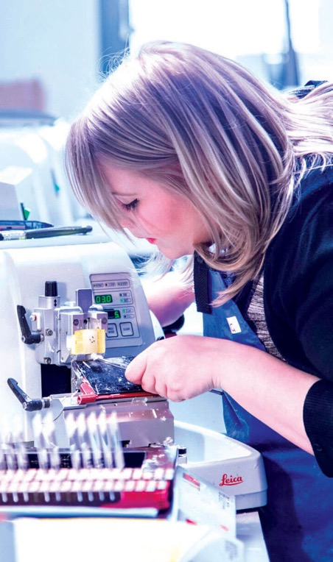
Some predictions
Technology has created lots of
jobs already.
With all this new technology, could there be NHS jobs in the future that don’t exist as yet?
What could they be?

Slide 15
When I look into
my future…
  What do I see?

Slide 16
What do I see?
What do I see in:
5 years?
10 years?
20 years?
I will be:
at school?
at college?
at university?
at work? Which job?

Slide 17
In 5 years? | In 10 years? | In 20 years?
How old will I be? | How old will I be? | How old will I be?
I will be at… (school/ university/work etc.) | I will be at… (school/ university/work etc.) | I will be at… (school/ university/work etc.)
I will be doing… | I will be doing… | I will be doing…

Slide 18
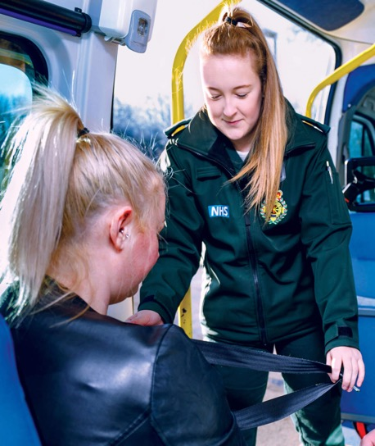
Things to think about to help you
Which NHS job do you think you might
like to do?
What do you need to learn?
Do you need to train for it?
Which subjects do you need to study, etc.?
How long will you need to study or train for it?

Slide 19
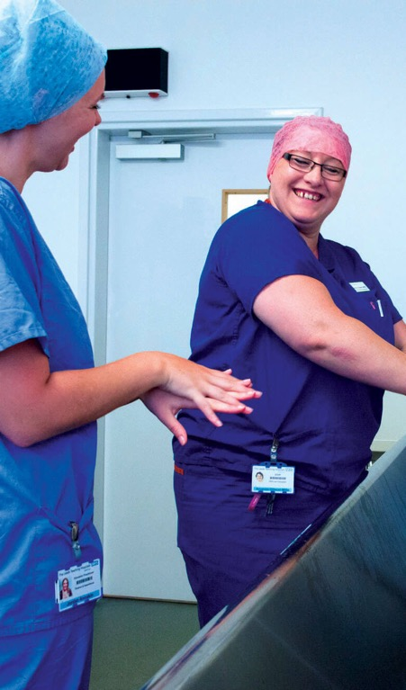
When I look into my future…
Create a short presentation about:
“When I look into my future...”
Use pictures and words
Include slides on:
This is me
This is what I could be in the NHS

Slide 20
This is me
Me and my family
My interests and favourite things
Three words that describe me
1.
2.
3.
I am good at...

Slide 21
This is what I could be in the NHS
About the job
Why I would be good at this job
How I can get there
The best part of my job…

Slide 22
What did you learn?
  Learning outcomes

Slide 23
Learning outcomes
You understand that developments in technology impact how we work and what
we can achieve.
You understand the important role technology has played in the NHS and what this could mean for future jobs.
You can represent yourself in pictures and words.
You can talk positively about what you might like to do.

Slide 24
Together we can make a difference!

