Slide 1
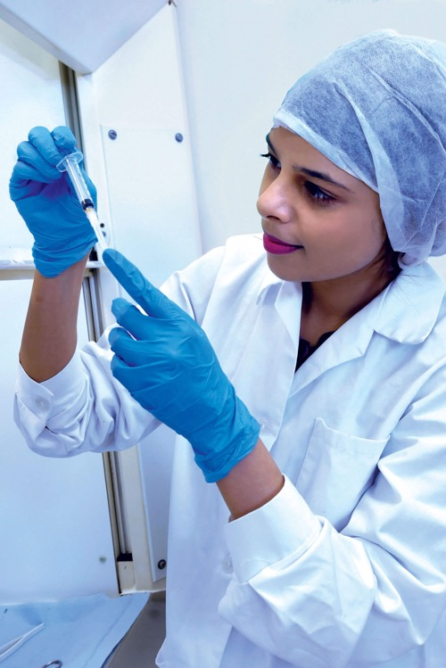
Working in the NHS

Slide 2
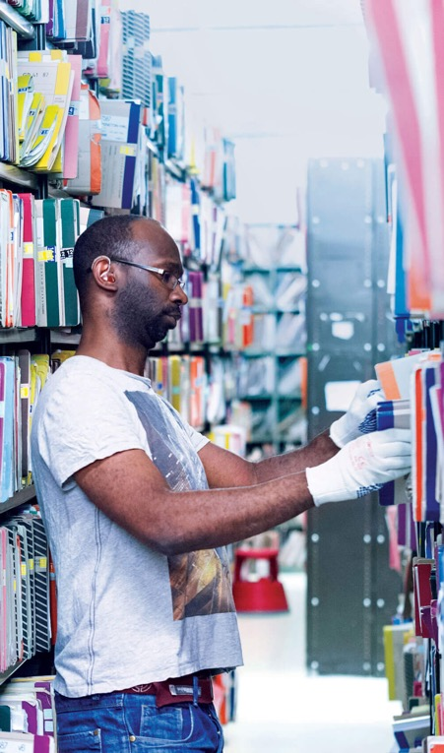
What will you learn?
You will be able to identify different
jobs in the community.
You will be able to describe a range of
jobs in the NHS.
You will be able to describe some of the
skills and qualities that different jobs need.

Slide 3
Community job search
  Investigate this community scene.
  How many different jobs can you
  think of?

Slide 5
Community job search
  Which jobs did you come up with?

Slide 6
Some jobs in the community
Workplace | Which jobs?
Bank | Finance manager: deals with money matters
Restaurant | Chef: cooks tasty food
Launderette | Laundry assistant: sorts and cleans washing
Dentist | Dentist, dental nurse, dental technician: check and look after your teeth
GP | Doctor, practice nurse, receptionist: usually the first people you go to when you feel unwell

Slide 7
Some jobs in the community
Workplace | Which jobs?
Local chemist | Pharmacist: prepares medicine
Optician | Optometrist: looks after your eyes
School | Teacher: teaches you School nurse: looks after your wellbeing Caretaker: looks after the school building Catering staff: prepares and serves school meals

Slide 8
Some jobs in the community
Workplace | Which jobs?
Ambulance | Paramedic: transports people to hospital
Gym | Physiotherapist: helps with bending and movement after injury
Green spaces | Gardener: makes sure green spaces are kept neat and tidy
Care home for elderly | Healthcare assistant: helps the elderly with their immediate needs such as washing, dressing and hygiene

Slide 9
Some jobs in the community
Workplace | Which jobs?
Supermarket | Managers: run areas of the store Human resources professional: trains staff and finds new people Baker and cook: prepare food in the store bakery and restaurant Pharmacist: runs the supermarket pharmacy Security staff: keeps a watchful eye over the store

Slide 10
Some jobs in the community
Workplace | Which jobs?
Offices of a large company | IT staff: sets up and looks after the office computer system Personal assistant: helps the managers organise their day Facilities manager: helps look after the building and ensures smooth running of things like the heating and lighting Accountant: looks after the company's money

Slide 11
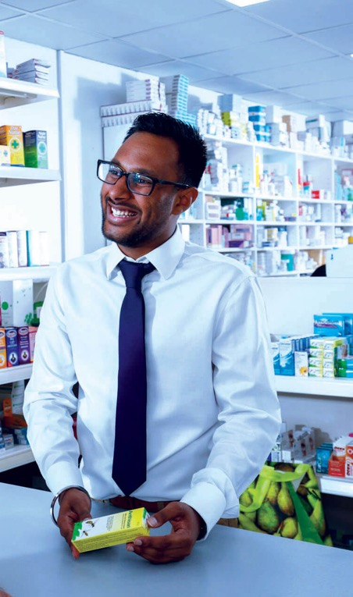
Community job search
Which of these jobs do you think
you can do for the NHS?
Where do you think you work if you
have a job working for the NHS?

Slide 12
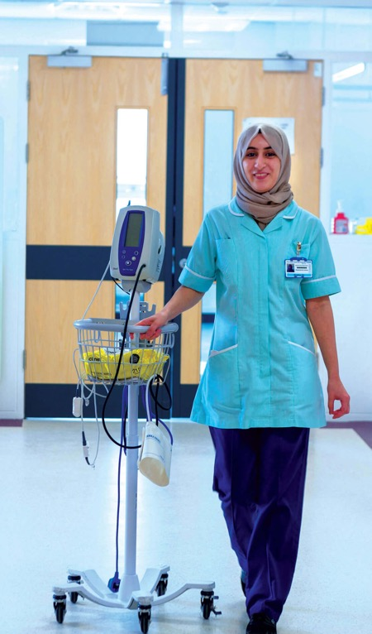
You can do all of these jobs for the NHS!
If you work for the NHS, you can work in:
  a hospital
  in a surgery or clinic
  in the community
  in an ambulance
  in an office
  in a laboratory
  in a patient’s own home
There are more than 350 jobs in the NHS!

Slide 13
Homework activity
What jobs do your family or friends do in the community?
  Complete a job card for someone you know
  Do they work for the NHS?
  If not, could they do their job
  for the NHS?

Slide 14
In the hot seat
  Let’s talk to some people from the community and the NHS.
  Interviews are a good way
  of finding out what a job is
  really like.

Slide 15
Example questions
What do you do?
Why did you choose this job?
What do you do in a
normal day?
What’s the best bit about
your job?
Is there anything that has surprised you?
What do you need to be good
at to do the job?
What did you need to learn?
Did you have to overcome any barriers? If so, how did you
do this?
What would you say to someone considering this job?

Slide 16
Sophie’s story
  Who does Sophie meet from the NHS and how do they help her?

Slide 17
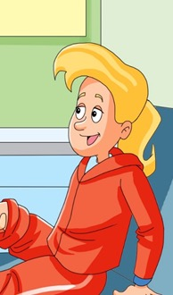
Sophie’s story
What’s the problem?
Sophie loves playing football. A bad tackle turns her leg into a balloon. It really hurts!
Her mum calls for an ambulance and the paramedic takes a look. She then takes Sophie to A&E.

Slide 18
Sophie’s story
How many different people working in the NHS help Sophie?
As you hear Sophie’s story,
are there any jobs that sound interesting to you?

Slide 19
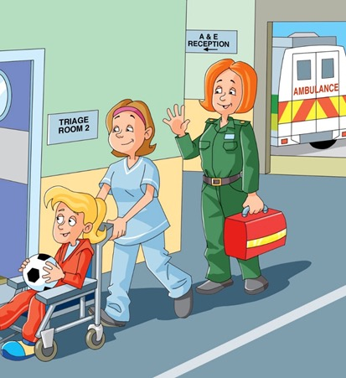
Accident and emergency
(A&E) department
Sophie arrives at A&E and a helpful porter brings her in from the ambulance.
The receptionist smiles and registers her. Then a triage nurse assesses her leg and asks how she's feeling – “A little dizzy to
be honest.”
Sophie sees an A&E doctor who thinks
it's broken. No wonder it's painful!

Slide 20
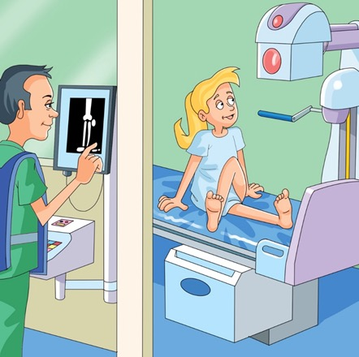
Trip to the x-ray department and back
She needs an x-ray. The porter wheels her
to the diagnostic radiographer.
It's confirmed – Sophie's leg is broken!
A children's nurse covers her wound with
a dressing. She needs to stay in hospital overnight. The porter is back and takes her
to the ward.

Slide 21
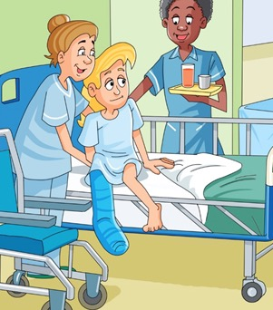
On the ward
The bed looks nothing like the messy one
she left in her bedroom this morning! The housekeeper has ensured it is perfectly
made using the clean sheets the laundry assistant dropped off earlier.
The healthcare assistant makes Sophie comfortable and the children's nurse gives
her some medicine for the pain.

Slide 22
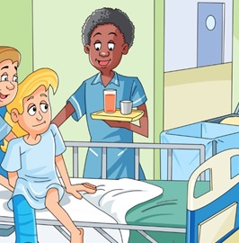
On the ward
The food arrives and "It's better than dad's cooking," thinks Sophie, and he's the best cook in their house! The chef must be good because she carries on eating even after hearing she needs an operation.

Slide 23
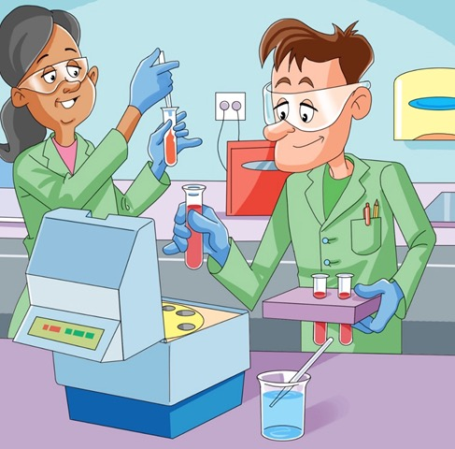
In the laboratory
A phlebotomist comes to take some blood. It's really not that bad!
The blood is then tested by a biomedical scientist to check she is okay to have
the operation.

Slide 24
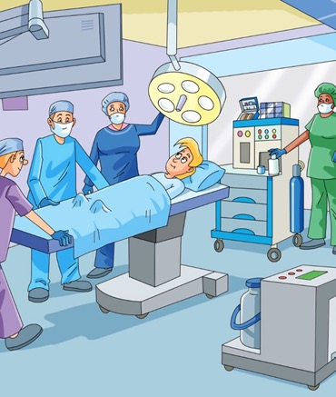
The operating theatre
A few hours later, a team of people greet her in the operating theatre. Sophie can’t believe they are all there for her! There's a surgeon, anaesthetist, theatre nurse and operating department practitioner. They all do different things.
After the operation, an orthopaedic practitioner puts a plaster cast on her leg. That will keep everything in place while it heals. Sophie can't wait for her friends to decorate it.

Slide 25
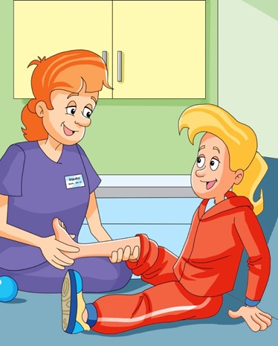
Recovery
When the surgeon is happy for Sophie to leave, the hospital pharmacist prepares her medicine. Then the patient transport services drive her home.
She has to go back two weeks later for a check-up. Then a few weeks after that a physiotherapist suggests some exercises
to make her leg strong again.

Slide 26
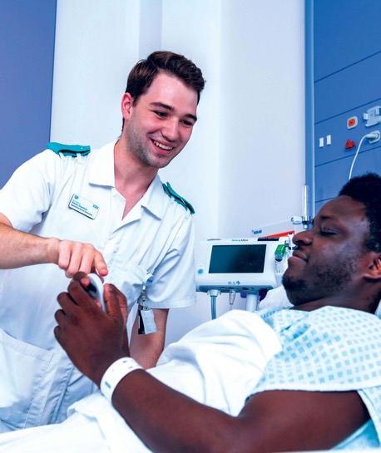
Result!
Sophie recovers well and gets picked
for the football team at school!
There are a lot of people she wants
to thank in the NHS!
Explore over 350 jobs in the NHS. What would you be?

Slide 27
Ajay’s story
  Who does Ajay meet from the NHS and how do they help him?

Slide 28
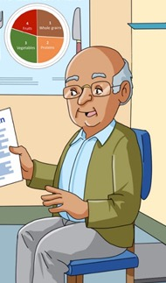
Ajay’s story
What’s the problem?
Ajay hates too much fussing. He just likes
to get on with things. His wife notices he’s
put on a bit of weight. Then he starts to get dizzy spells and some double vision. She decides to make an appointment with his
GP at their local surgery.

Slide 29
Ajay’s story
How many different people from the NHS, do you think, help Ajay?
As you listen to his story, mark the jobs that you want to find out more about or rank the cards.

Slide 30
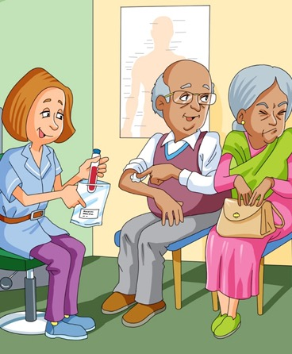
At the GP surgery
The practice nurse takes some blood. Ajay's wife is squeamish about needles and looks away!
The receptionist completes all the paperwork and Ajay's blood is sent off
to the laboratory.

Slide 31
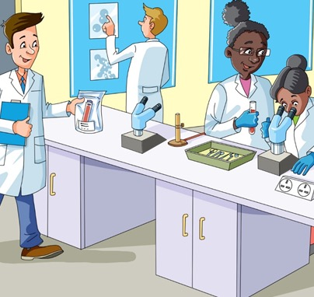
In the laboratory
A biomedical scientist receives Ajay's blood. High-tech medical equipment is used to test it.
What do the tests reveal?

Slide 32
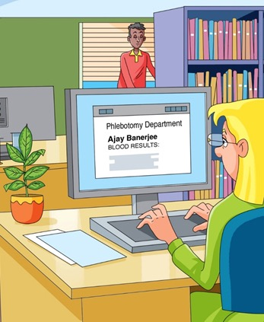
Health records department
The results come back from the laboratory and the health records
staff update Ajay's information.
He has Type 2 diabetes. They let
Ajay's GP know.

Slide 33
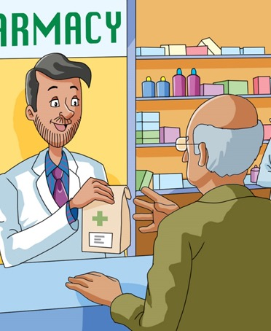
The community pharmacist
Ajay goes back to his GP again who
tells him that he has Type 2 diabetes.
He's given a prescription for new medication which he picks up from
the community pharmacist.

Slide 34
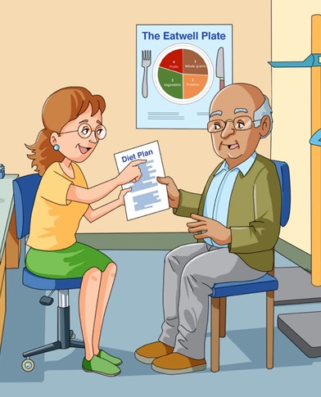
Dietitian
The GP also arranges for Ajay to see
a dietitian.
The dietitian devises an eating plan for Ajay. Sensible choices will help improve his wellbeing.

Slide 35
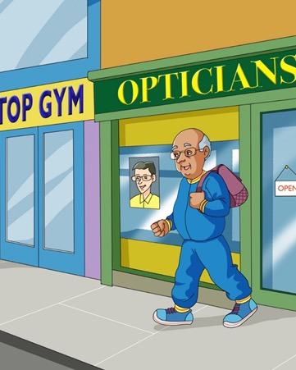
Other health professionals get involved
The GP continues to monitor Ajay’s
progress and develops a health plan to
control his diabetes.
An orthoptist treats his double vision.
A podiatrist checks his legs and feet.
A health trainer sets him goals for regular exercise and eating healthily.

Slide 36
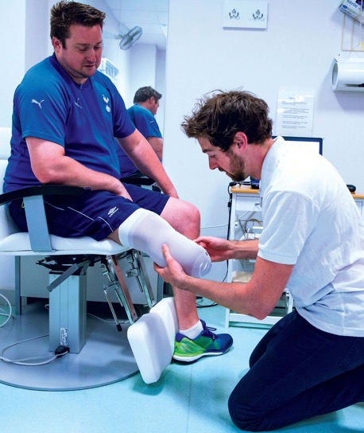
Result!
After all that fussing, Ajay feels better than he has
in a long time. His wife thinks he looks good too
– especially now that he's lost those extra pounds.
There are a lot of people he wants to thank
in the NHS!
Explore more than 350 jobs in the NHS.
What would you be?

Slide 37
Job cards
  Which jobs would you like
  to find out more about?

Slide 38
Job cards
Explore the job cards.
Choose which job or jobs you want to investigate further.
Fill in a blank job card with as much information as you can.

Slide 39
Hire me!
  The NHS needs you.
  Apply for a job of your choice.

Slide 40
Hire me!
Choose a job to apply for:
  Tell them about you:
  Your hobbies, interests and favourite things
  Why you want the job:
  Think about the things that interest you about it
  Why you would be good at the job:
  Highlight your talents or skills that would
  be helpful for the job

Slide 41
What did you learn?
  Learning outcomes

Slide 42
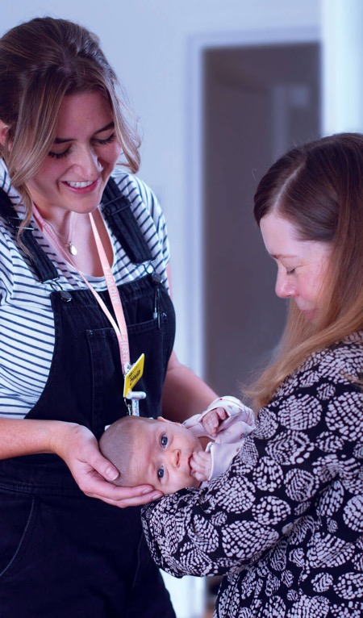
Learning outcomes
You can identify different jobs in
the community.
You can describe a range of jobs in the NHS.
You can describe some of the skills and qualities that different jobs need.

Slide 43
Together we can make a difference!

